Slide 1
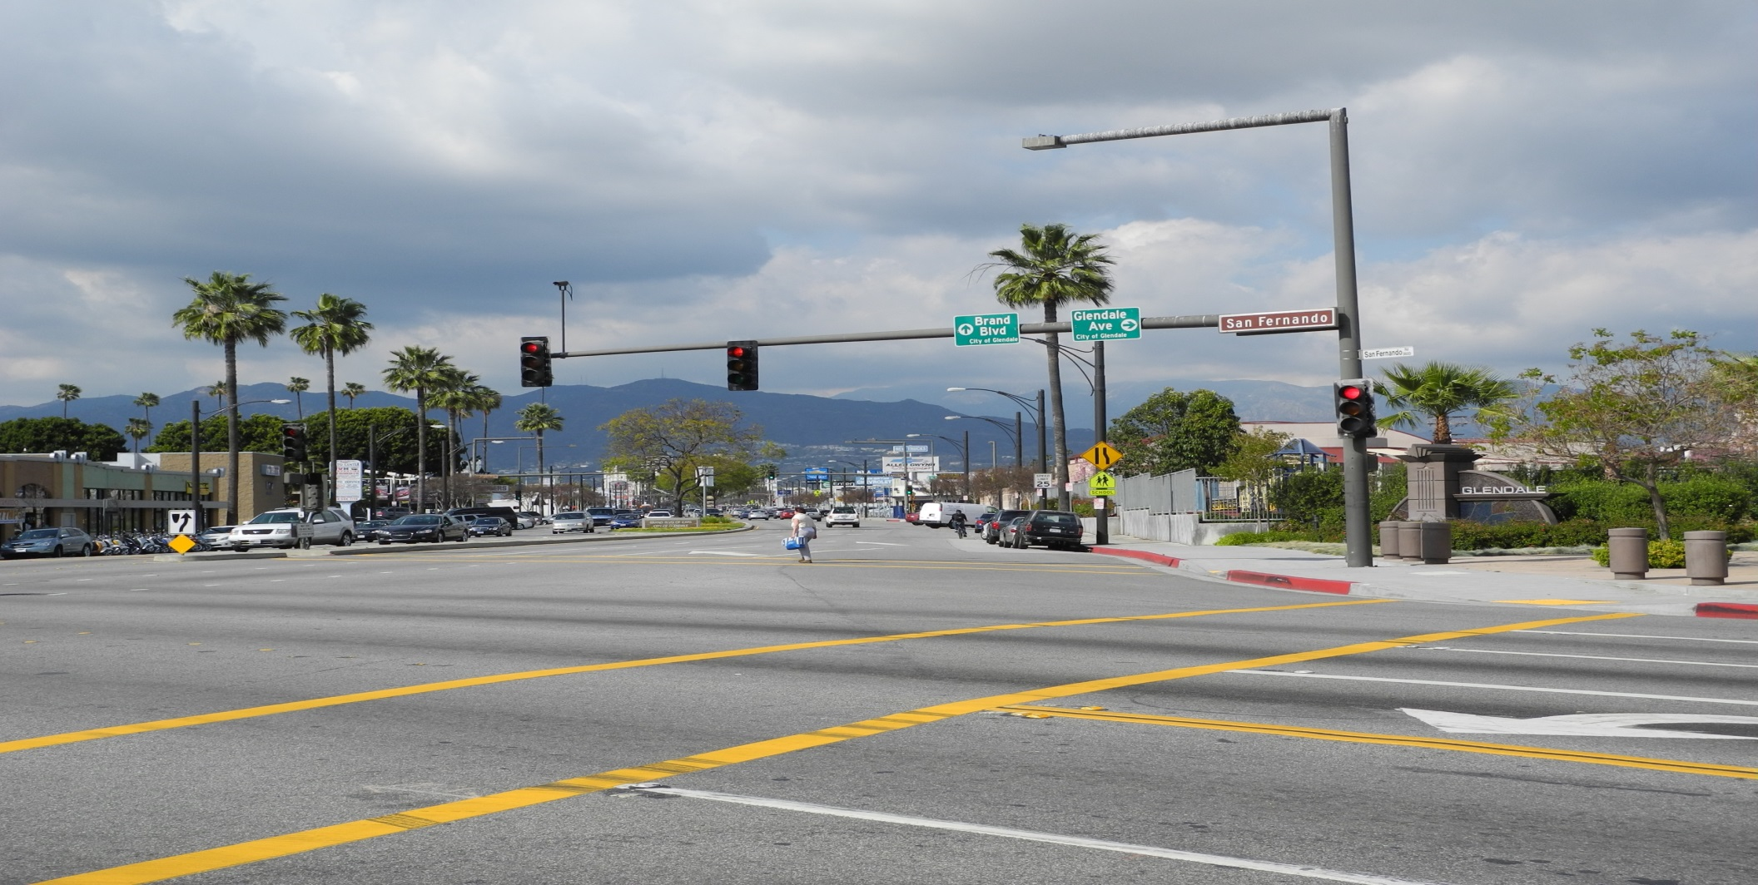
CITY OF GLENDALE, CA
APRIL 2, 2015
BRAND BLVD, GARDENA AVE & ADJACENT STREETS – SEWER AND STREET IMPROVEMENTS, AND TYBURN SEWER TRUNK LINE AT RAILROAD CROSSING IMPROVEMENT PROJECT

Slide 2
BRAND BLVD, GARDENA AVE & ADJACENT STREETS - SEWER AND STREET IMPROVEMENTS, AND TYBURN SEWER TRUNK LINE AT RAILROAD CROSSING IMPROVEMENT PROJECT
Concrete Improvements
Sewer Main Pipe Improvements
Street Pavement Rehabilitation
Traffic Signal Modifications
Signing and Striping
Construction Phasing/Scheduling
Public Notification Process

Slide 3
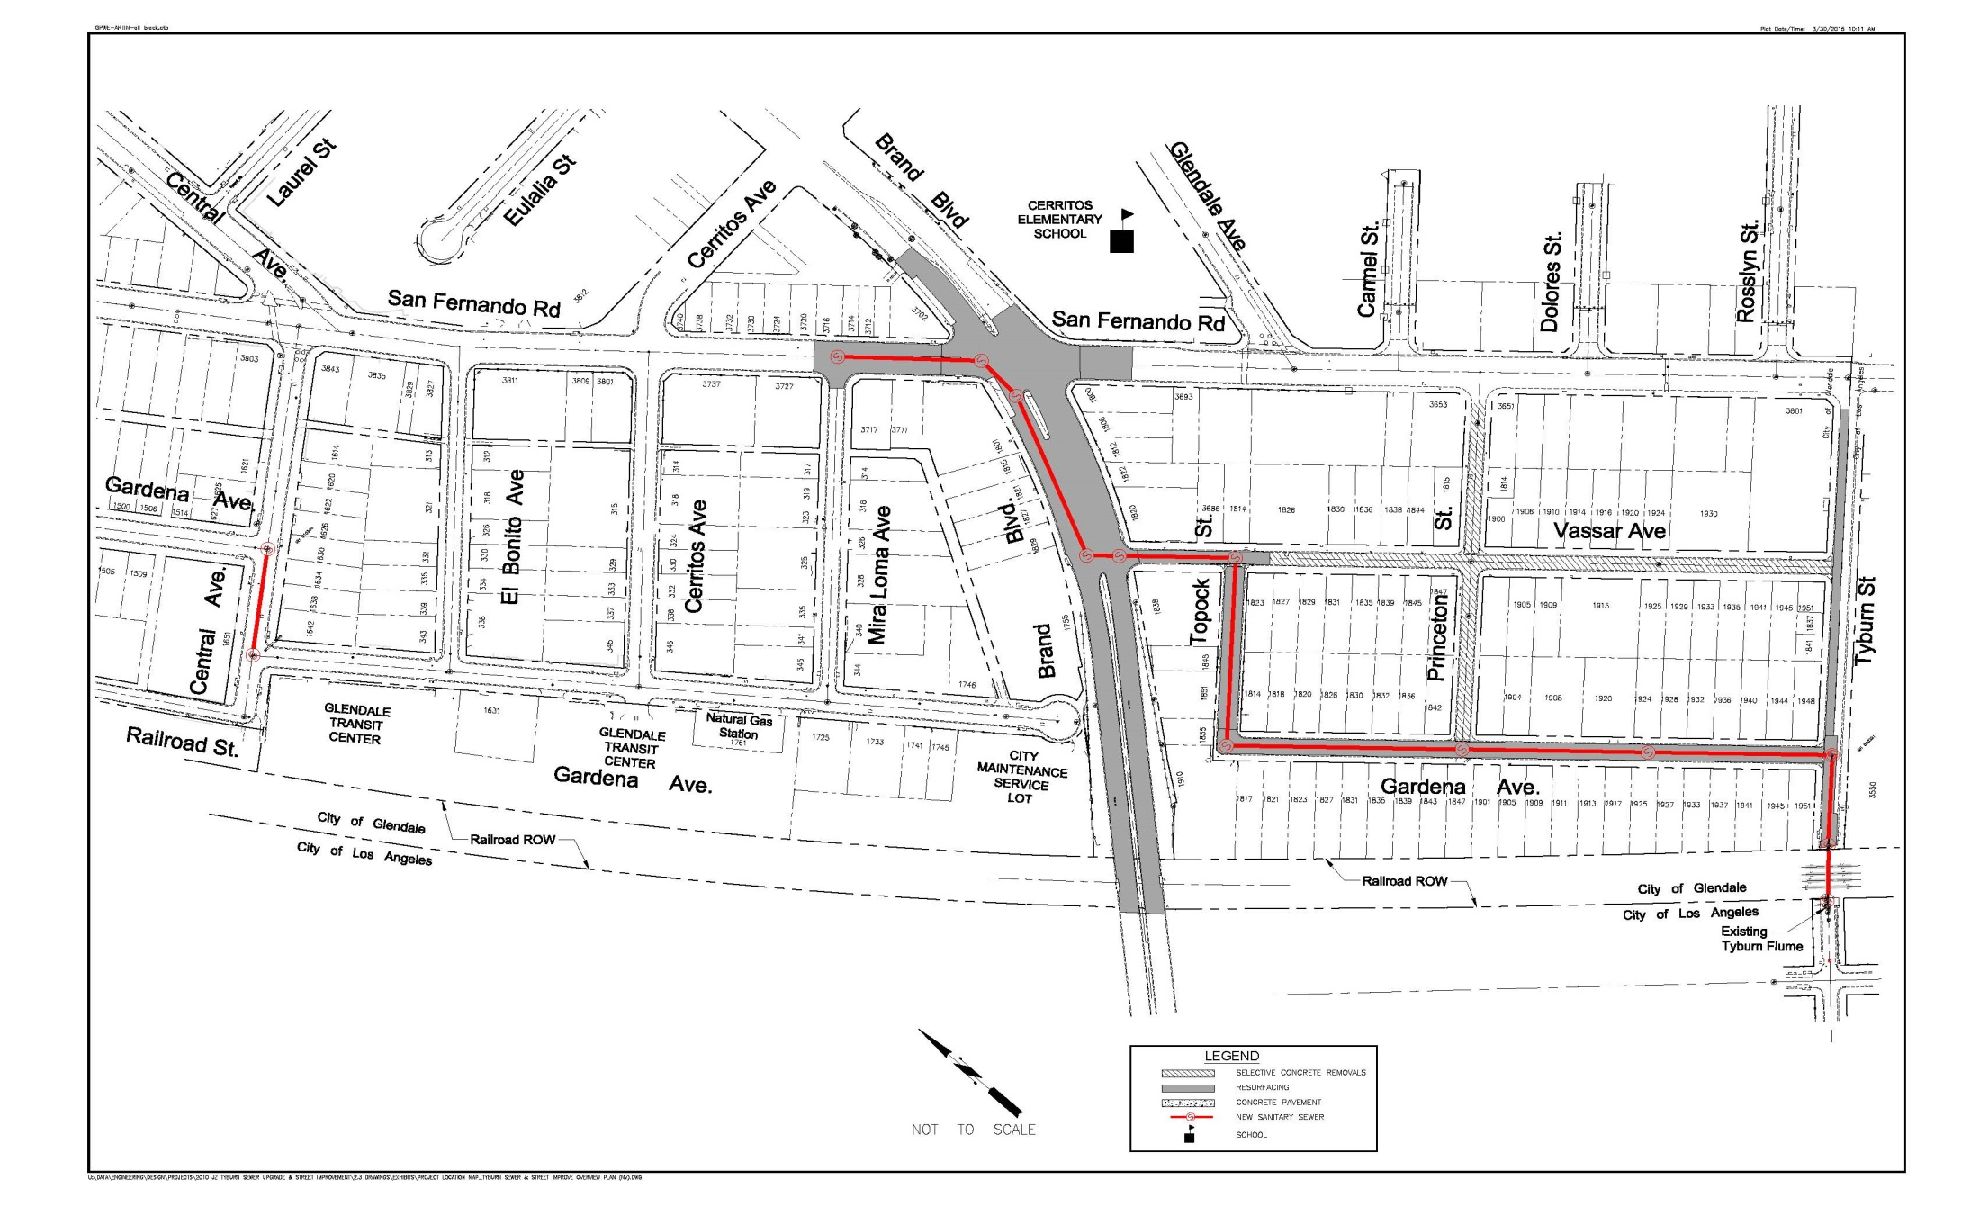
LOCATION MAP

Slide 4
BRAND BLVD, GARDENA AVE & ADJACENT STREETS - SEWER AND STREET IMPROVEMENTS, AND TYBURN SEWER TRUNK LINE AT RAILROAD CROSSING IMPROVEMENT PROJECT
ANTICIPATED CONSTRUCTION START DATE:
September 2015
PROJECT DURATION:
100 Working Days
(About 5 Months)
barring any unforeseen conditions

Slide 5
RESOURCEFUL FACTS
- R&R (Remove & Replace) - ARHM (Asphalt Rubber Hot Mix) - AC (Asphalt Concrete) - VCP (Vitrified Clay Pipe)
- ADA (Americans with Disabilities Act)

Slide 6
REASONS FOR PROJECT
• Need to increase pipe size of the Sewer Collector on San Fernando Road, Gardena Ave and Tyburn Street
• Age of Existing Sewer Pipe
• Repair Broken Sidewalk, Driveways and other PCC Improvements
• Repair Deteriorated Roadway Pavement Conditions ( Completes San Fernando Road and Brand Boulevard South of San Fernando Road)

Slide 7
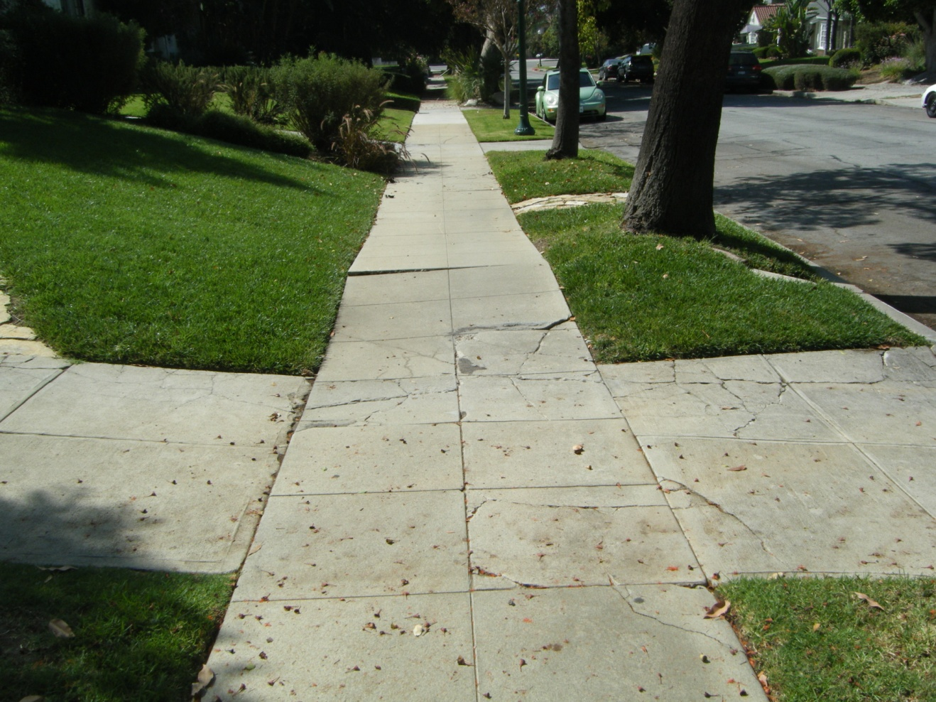
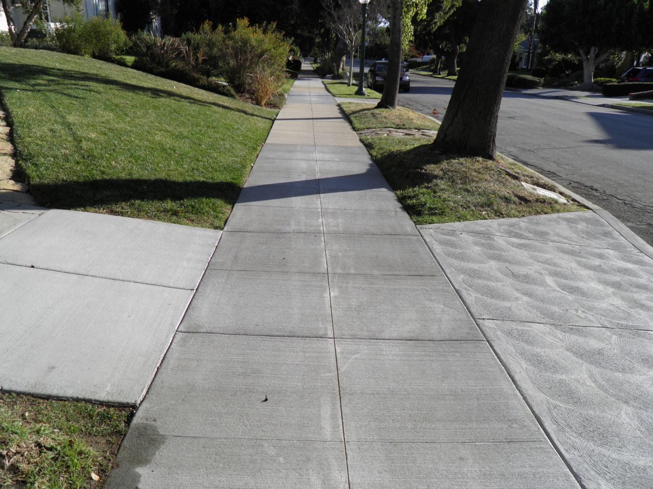
BRAND BLVD, GARDENA AVE & ADJACENT STREETS - SEWER AND STREET IMPROVEMENTS, AND TYBURN SEWER TRUNK LINE AT RAILROAD CROSSING IMPROVEMENT PROJECT
CONCRETE IMPROVEMENTS
Selective R&R of Uplifted and Damaged:
-Sidewalks -Curb Ramps -Driveway Aprons -Curb/Gutter
-Upgrade Curb Ramps with ADA Compliance
Before
After

Slide 8
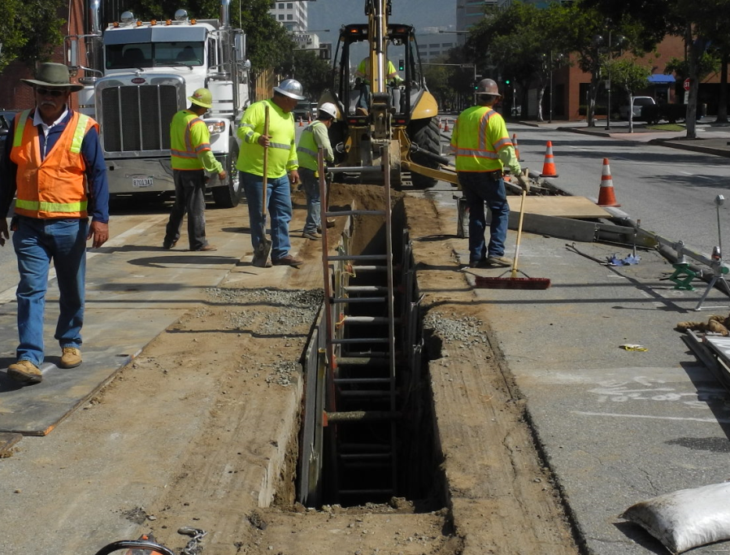
BRAND BLVD, GARDENA AVE & ADJACENT STREETS - SEWER AND STREET IMPROVEMENTS, AND TYBURN SEWER TRUNK LINE AT RAILROAD CROSSING IMPROVEMENT PROJECT
SEWER MAIN PIPE IMPROVEMENTS
A. New Sewer line/Pipe Upgrade/Replacement
Central Ave, San Fernando Road, Brand Blvd, Vassar Ave, Topock St, Gardena Ave, Tyburn St.
$•$ Remove Existing Sewer Pipe and Replace
with New Larger Pipe at Same Location
$•$ Install New Sewer Pipe
• Open Trench/ 2 Lanes will be Occupied During Construction

Slide 9
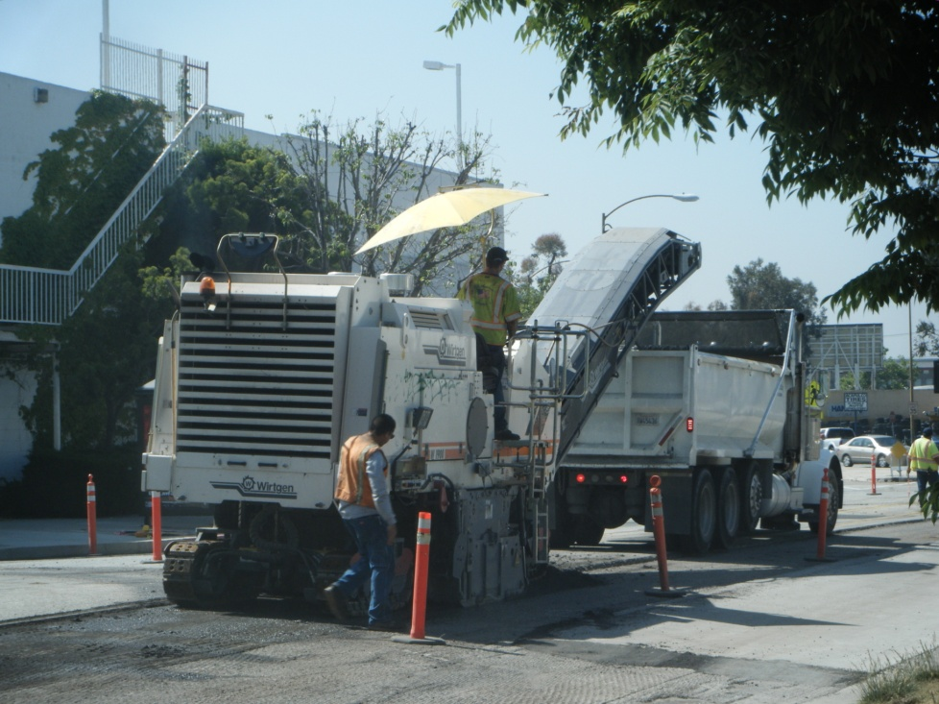
BRAND BLVD, GARDENA AVE & ADJACENT STREETS - SEWER AND STREET IMPROVEMENTS, AND TYBURN SEWER TRUNK LINE AT RAILROAD CROSSING IMPROVEMENT PROJECT
STREET PAVEMENT REHABILITATION
PAVEMENT GRINDING (AKA Cold Mill/ Surface Plane)
Remove Existing Deteriorated AC Pavement
Grinds will be Hauled Away
Full Lane Grinding
Can Drive on Immediately after Grinding

Slide 10
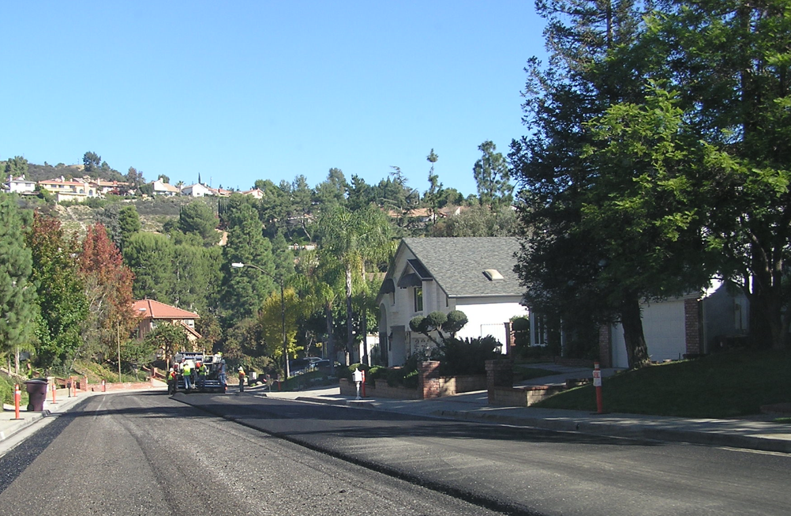
BRAND BLVD, GARDENA AVE & ADJACENT STREETS - SEWER AND STREET IMPROVEMENTS, AND TYBURN SEWER TRUNK LINE AT RAILROAD CROSSING IMPROVEMENT PROJECT
STREET PAVEMENT REHABILITATION
RUBBERIZED (ARHM) PAVEMENT OVERLAY
Improves the Ride and Structural Integrity of the Roadway
Place 1.5” ARHM Overlay Over Base Pavement
Compact Newly Placed Pavement
Eco-Friendly (Uses Tires)
Begins NEW Service Life for Pavement
Quieter and Smoother Ride
Better Road Friction

Slide 11
TRAFFIC SIGNAL IMPROVEMENTS - Traffic Signal Modifications - Striping and Signing

Slide 12
BRAND BLVD, GARDENA AVE & ADJACENT STREETS - SEWER AND STREET IMPROVEMENTS, AND TYBURN SEWER TRUNK LINE AT RAILROAD CROSSING IMPROVEMENT PROJECT
TRAFFIC SIGNAL MODIFICATIONS
Relocate Existing Signals at San Fernando Road and Brand Boulevard
B. Upgrade Signal and Pedestrian Indications at San Fernando Road and Brand Boulevard

Slide 13
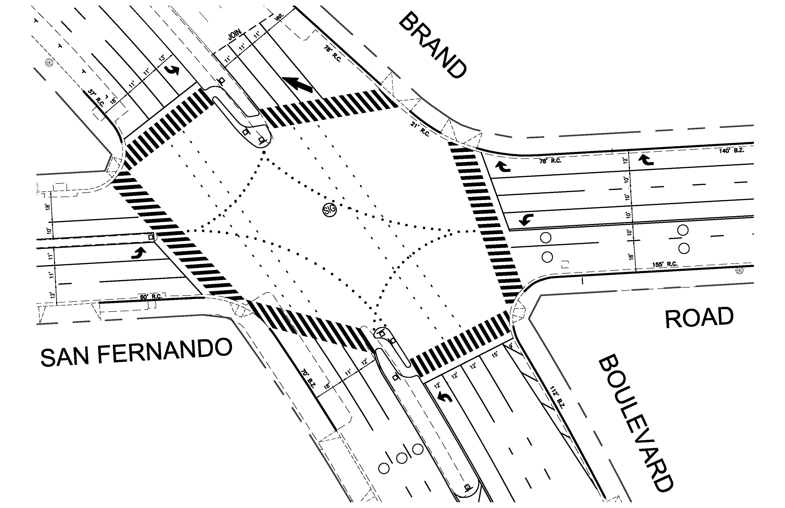
BRAND BLVD, GARDENA AVE & ADJACENT STREETS - SEWER AND STREET IMPROVEMENTS, AND TYBURN SEWER TRUNK LINE AT RAILROAD CROSSING IMPROVEMENT PROJECT

Slide 14
BRAND BLVD, GARDENA AVE & ADJACENT STREETS - SEWER AND STREET IMPROVEMENTS, AND TYBURN SEWER TRUNK LINE AT RAILROAD CROSSING IMPROVEMENT PROJECT
SIGNING AND STRIPING
Install New Signing and Striping to Comply with New CALTRANS Standards
New Pavement Markings, Lane Lines, Curb Markings, Retro-reflective Pavement Markings
Installation of New Fluorescent and High Intensity Signing for Improved visibility
Installation of Bike Lanes on Brand Boulevard between San Fernando Road and the City of Los
Angeles to Connect to the Existing Bike Lanes in Los Angeles

Slide 15
BRAND BLVD, GARDENA AVE & ADJACENT STREETS - SEWER AND STREET IMPROVEMENTS, AND TYBURN SEWER TRUNK LINE AT RAILROAD CROSSING IMPROVEMENT PROJECT
ANTICIPATED CONSTRUCTION PHASING
Phase 1a: Sewer Improvements
Phase 1b: Traffic Signal Modifications
Phase 1c: Concrete R&R
Phase 1a, 1b and 1c Will Not Occur Simultaneously within Several Blocks of Each Work
Phase 2: Pavement Grinding / Rubberized Pavement Overlay
Phase 3: Utility Covers Adjustment to Finished Grade
Phase 4: Striping and Pavement Markings, Sign Installation
CONSTRUCTION WORK WILL BE COORDINATED TO MINIMIZE IMPACT TO LOCAL BUSINESSES & TRAFFIC

Slide 16
Public Notification Process
Community Meeting
Contractor’s Notification Letter
(1-2 weeks prior)
Project Signs
3-Day Door Hanger
(Grinding/
Paving)
Website Updates
Driveway Closures
Director of Public Works’ Letter

Slide 17
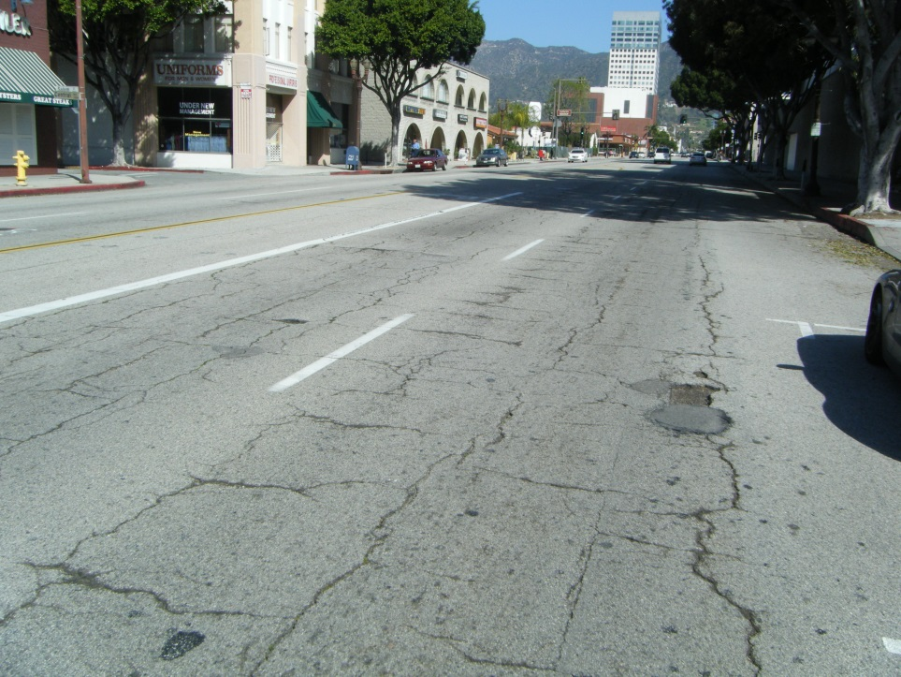
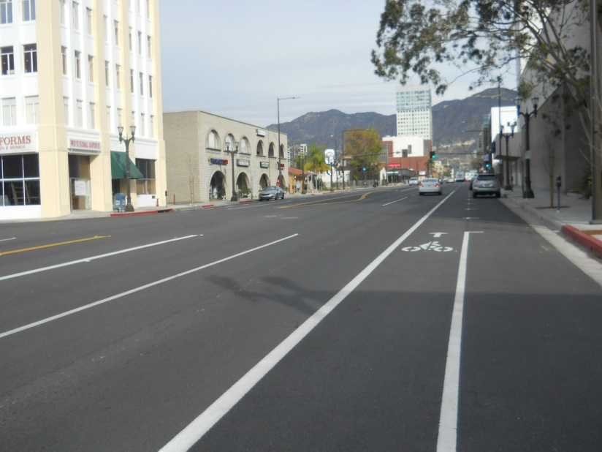
BRAND BLVD, GARDENA AVE & ADJACENT STREETS - SEWER AND STREET IMPROVEMENTS, AND TYBURN SEWER TRUNK LINE AT RAILROAD CROSSING IMPROVEMENT PROJECT
Before
After
For questions or general information, please contact:
Saumil Mody Yvonne Guerra
Project Manager Community Outreach
(818) 548-3945 (818) 548-3945
::THANK YOU::
Public Works’ Website: http://www.ci.glendale.ca.us/public_works

Slide 18
This PowerPoint presentation will be available for viewing at : http://www.glendaleca.gov/government/departments/public-works/projects/brand-blvd-and-adjacent-street-sewer-improvements. The project-dedicated webpage includes project updates and other information.

