Slide 1

Community Meeting
SR 134/GLENDALE AVENUE INTERCHANGE MODIFICATION AND MONTEREY ROAD IMPROVEMENTS PROJECT
WELCOME
To The
For The

Slide 2
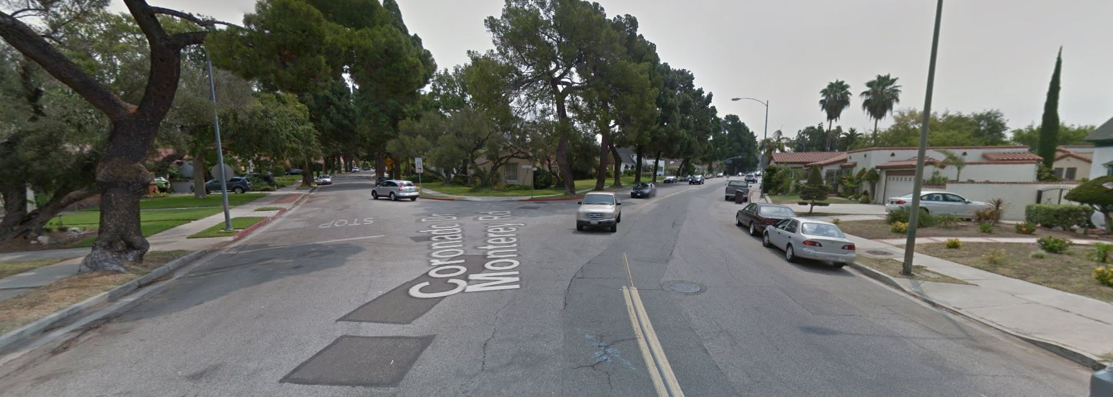

SR 134/Glendale Avenue Interchange Modification and Monterey Road Improvements Project
CITY OF GLENDALE, CA
Community Meeting , August 26th, 2015

Slide 3
SR 134/Glendale Avenue Interchange Modification and Monterey Road Improvements Project
Concrete and Pavement R&R
Questions / Comments
Project Scope of Work and Locations
MEETING AGENDA
Installation of Bioswale
Public Notification Process
Street Resurfacing
Street Alignment Modification
ANTICIPATED
CONSTRUCTION START DATE:
January 2016
PROJECT DURATION:
112 Calendar Days/
80 Working Days
barring any unforeseen conditions

Slide 4
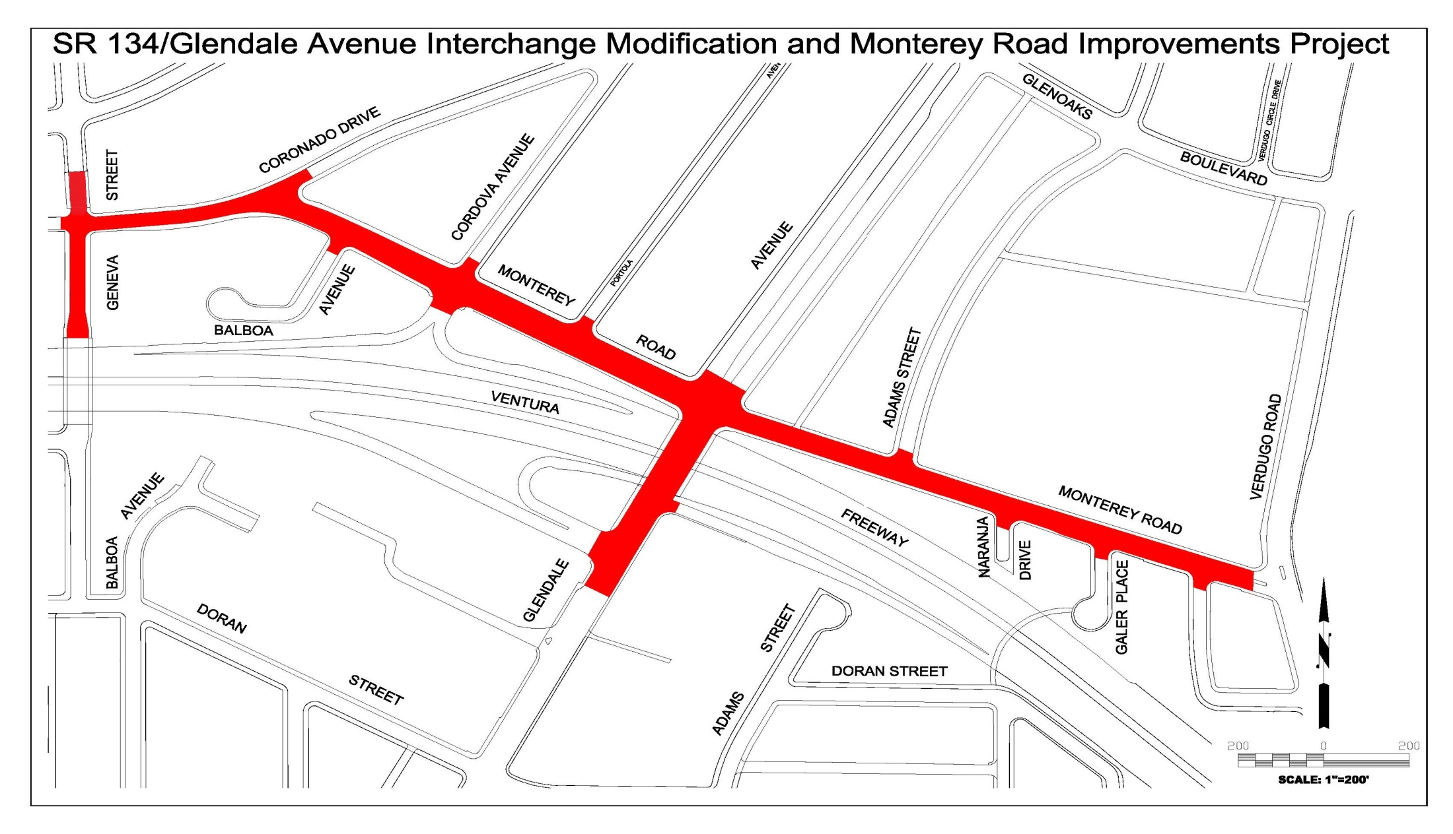
SR 134/Glendale Avenue Interchange Modification and Monterey Road Improvements Project

Slide 5

Fun Facts
R&R - Remove and Reconstruct
AC - Asphalt Concrete
ARHM - Asphalt Rubber Hot Mix
BIOSWALE – Landscape elements designed to remove silt and pollutions from surface storm runoff

Slide 6

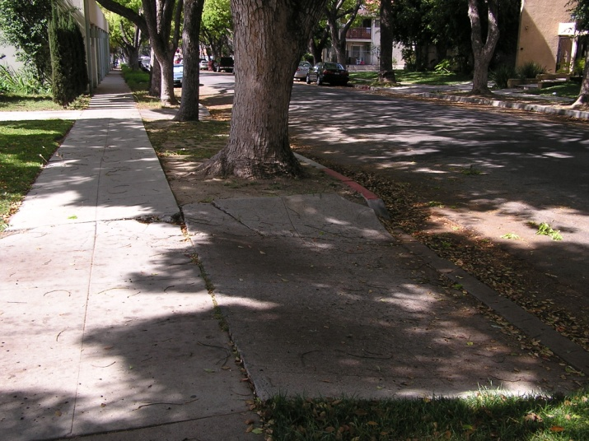
SR 134/Glendale Avenue Interchange Modification and Monterey Road Improvements Project
CONCRETE
R&R Uplifted/Damaged:
Sidewalks
Curb Ramps
Driveway Aprons
Curb/Gutter
Cross Gutters

Slide 7
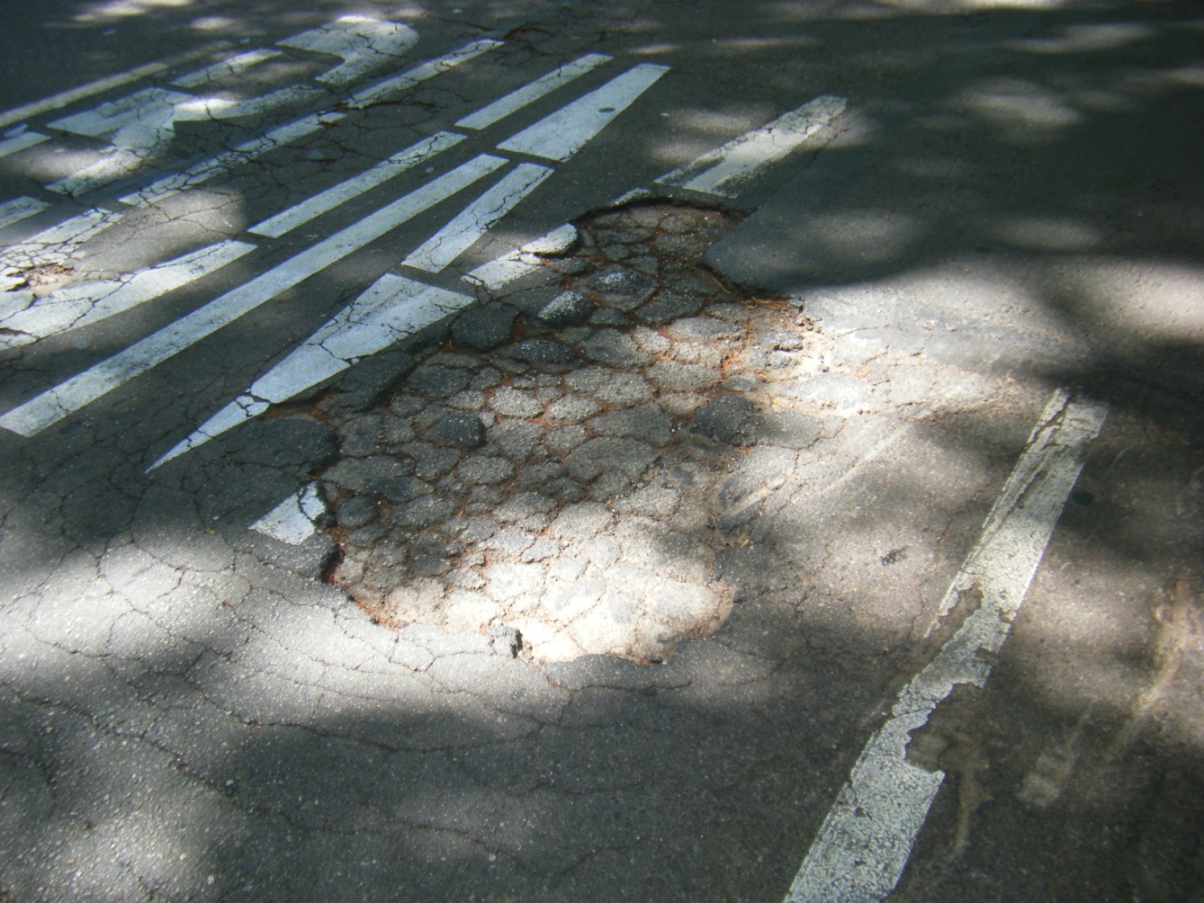
SR 134/Glendale Avenue Interchange Modification and Monterey Road Improvements Project
PAVEMENT
R&R Pavement:
Base Failure
Erosion
Potholes
Service Life

Slide 8
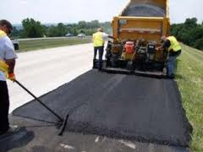
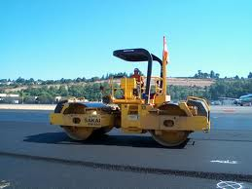
SR 134/Glendale Avenue Interchange Modification and Monterey Road Improvements Project
Street Resurfacing
Method used to improve the ride of the roadway and structural integrity of the pavement
Grind 2” of existing AC
Place 0.5” leveling course
Place 1.5” ARHM
Begins NEW service life
Limits Full AC Pavement R&R
Parking and access to your street may be unavailable during the day of the application

Slide 9
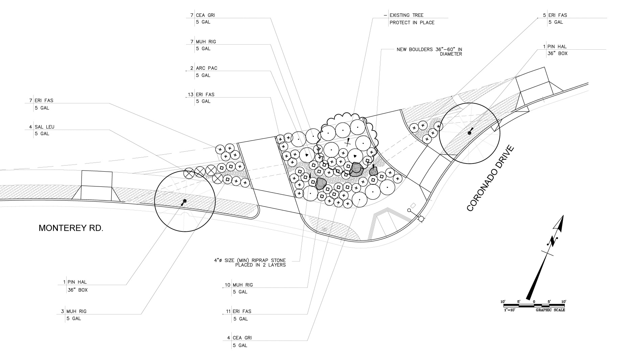
Bioswale at Coronado Drive

Slide 10
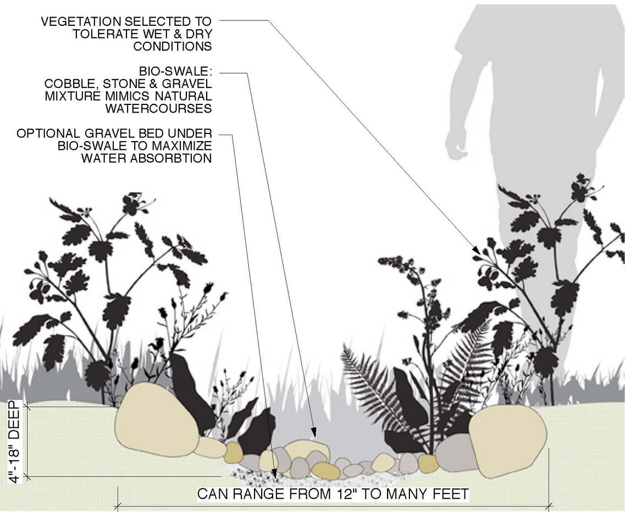
Bioswale at Coronado Drive
Typical Plans
Yankee Point
Pacific Mist
Low Purple Sage
California Buckwheat
Deergrass
Dwarf Coyote Brush

Slide 11
STREET ALIGNMENT MODIFICATION

Slide 12
PUBLIC NOTIFICATION PROCESS:
Community Meeting (Today)
City Council Approves the Project
City Website (Bid Advertisement)
DIRECTOR’S LETTER (1-2 months prior to start of construction)
CONTRACTOR’S NOTIFICATION LETTER
  Letter 2-3 weeks prior
  Notice of Construction Door Hanger (3 days prior)
    Concrete R&R, AC Pavement R&R
  Notice of Construction Door Hanger (3 days prior)
    Street Resurfacing - ARHM

Slide 13
Questions / Comments

Slide 14
::THANK YOU::
For questions or general information, please contact:
Arthur Asaturyan Yvonne Guerra
Project Manager Community Outreach
(818) 937-8247 (818) 937-8288

