Slide 1
City of Glendale
Budget Study Session #1
May 1, 2018

Slide 2
Agenda
FY 2017-18
  3rd Quarter General Fund Update
    Revenues & Resources
    Department Expenditures
    PERS Rate Stabilization Fund
    Projected Year-end Fund Balance

Slide 3
Agenda
FY 2018-19
  Proposed General Fund Budget
  Revenue Estimates & Opportunities
  Organizational Profile
  Summary of All Funds by Type
  Department Dashboards
  Budget Adoption Calendar
Conclusion

Slide 4
City of Glendale
Third Quarter Financial Update
May 1, 2018

Slide 5
FY 2017-18 3rd Quarter Update
General Fund Revenues
Revenues received as of March 31, 2018 were $125.5 million versus $121.1 million compared to the same period last year, an increase of 3.6%.
For FY 2017-18 the Revenue estimates have been increased by $1.7 million, due to:
  Increase in property tax, sales tax and occupancy and other taxes categories based on actuals received
Revenues are expected to meet forecast by year-end, no adjustments to recurring revenues proposed at this time
  One-time sales tax audit revenue adjustment of $9.0 million

Slide 6
General Fund Resources - March 31, 2018 (In Thousands)
 | Adopted Budget | Adjustments | Revised Resources | Actual Receipts | % Received
Property Taxes | $ 56,229 | $ 1,200 | $ 57,429 | $ 34,413 | 59.9%
Sales Taxes | 41,015 | 1,000 | 42,015 | 24,502 | 58.3%
Utility Users Taxes | 30,054 | (700) | 29,354 | 17,951 | 61.2%
Occupancy & Other Taxes | 14,859 | 600 | 15,459 | 8,542 | 55.3%
Licenses And Permits | 9,597 | 130 | 9,727 | 7,827 | 80.5%
Revenue From Other Agencies | 112 | 50 | 162 | 160 | 98.9%
Charges For Services | 9,225 | - | 9,225 | 7,095 | 76.9%
Interfund Revenue | 18,099 | (500) | 17,599 | 13,058 | 74.2%
Fines & Forfeitures | 2,622 | (100) | 2,522 | 1,791 | 71.0%
Interest/Use Of Money | 4,045 | - | 4,045 | 3,696 | 91.4%
Misc. & Non-Operating | 1,456 | - | 1,456 | 822 | 56.5%
Transfers | 21,310 | - | 21,310 | 767 | 3.6%
GSA Reimbursement | 4,885 | - | 4,885 | 4,885 | 100.0%
Subtotal Revenues: | $213,508 | $ 1,680 | $ 215,188 | $125,509 | 58.3%
Use of Assigned Fund Bal. | 906 | 2,316 | 3,222 | - | -
Use of Unassigned Fund Bal. | 629 | 4,126 | 4,755 | - | -
Resources: | $215,043 | $ 8,122 | $ 223,165 | $125,509 | 56.2%
One-Time CDTFA Sales Tax Audit | - | 9,000 | 9,000 | 9,000 | -
Total Resources: | $215,043 | $17,122 | $232,165 | $134,509 | -

Slide 7
FY 2017-18 3rd Quarter Update
General Fund Expenditures
Department expenditures are tracking as expected
  Total expenditures are $155.5 million (70% of total budget) compared to $146.2 million (70.9%) at the same point last year
  All departments are below the 75% mark
  Transferring $9.0 million from one time sales tax audit to CIP
    Purchase of Maryland Street Retail Units - $1.5 million
    Maryland Street & Alley Improvements - $3 million
    Central Park Block Project - $2 million
    Fremont Park Renovation - $2.5 million

Slide 8
FY 2017-18 3rd Quarter Update
General Fund Expenditures
 | Adopted Budget | Adjustments* | Revised Budget | Actual Expended | % Expended
Administrative Services | $ 5,000 | $ 231 | $ 5,231 | $ 3,594 | 68.7%
City Attorney | 3,694 | 51 | 3,745 | 2,548 | 68.0%
City Clerk | 1,426 | 350 | 1,776 | 595 | 33.5%
City Treasurer | 751 | 86 | 837 | 555 | 66.3%
Community Development | 16,174 | 2,452 | 18,626 | 10,895 | 58.5%
Comm. Services & Parks | 12,389 | 556 | 12,945 | 9,118 | 70.4%
Fire | 58,346 | 1,224 | 59,570 | 44,093 | 74.0%
Human Resources | 2,997 | 40 | 3,037 | 1,939 | 63.8%
IPA | 1,253 | 12 | 1,265 | 669 | 52.9%
Library, Arts & Culture | 10,536 | 731 | 11,267 | 7,481 | 66.4%
Management Services | 4,376 | 200 | 4,576 | 2,990 | 65.3%
Police | 80,621 | 384 | 81,005 | 59,222 | 73.1%
Public Works | 14,900 | 380 | 15,280 | 9,919 | 64.9%
Transfers | 2,580 | 385 | 2,965 | 1,840 | 62.1%
Subtotal: | $215,043 | $7,082 | $222,125 | $155,458 | 70.0%
Pend. Approval 3rd Qtr. Adj. | - | 1,040 | 1,040 | - | -
Revised Subtotal: | $215,043 | $8,122 | $223,165 | $155,458 | 69.7%
Pending one-time sales tax to CIP | - | 9,000 | 9,000 | - | -
Total Expenditures: | $215,043 | $17,122 | $232,165 | $155,458 | -
* Includes Carryovers & Adjustments

Slide 9
FY 2017-18 3rd Quarter Update
Pending Budget Adjustments
Slide 9
Departments | Pending One-time Adjustments | Description Detail
City Clerk | $ 7,000 | Travel & Training
Community Development | 224,000 | Community Plans & Outreach Efforts; East/West Community Plan Historic Context & Resource Survey
Fire | 488,860 | Emergency Operation Plan; Equipment for Engines; Upgrades to Equipment; Various Capital Outlay Items
Police | 270,000 | Dispatch Consoles
Public Works | 50,000 | Traffic Impact Studies
Total Adjustments: | $ 1,039,860

Slide 10
Slide 10
PERS Rate Stabilization Fund
FY 2017-18 3rd Quarter Update
Review
Three deposits totaling $26.5 million
  Dates:
    Aug. 9, 2017: $8.833 million
    Aug. 31, 2017: $8.833 million
    Sept. 21, 2017 $8.833 million
Moderate Portfolio Target Allocation:
  3% Cash, 50% Equities, 47% Fixed Income
  Individual equity/fixed income funds are actively managed by portfolio managers
Targeted Annual Net Return of 5.0%
    Q3 YTD net return is 3.86%

Slide 11
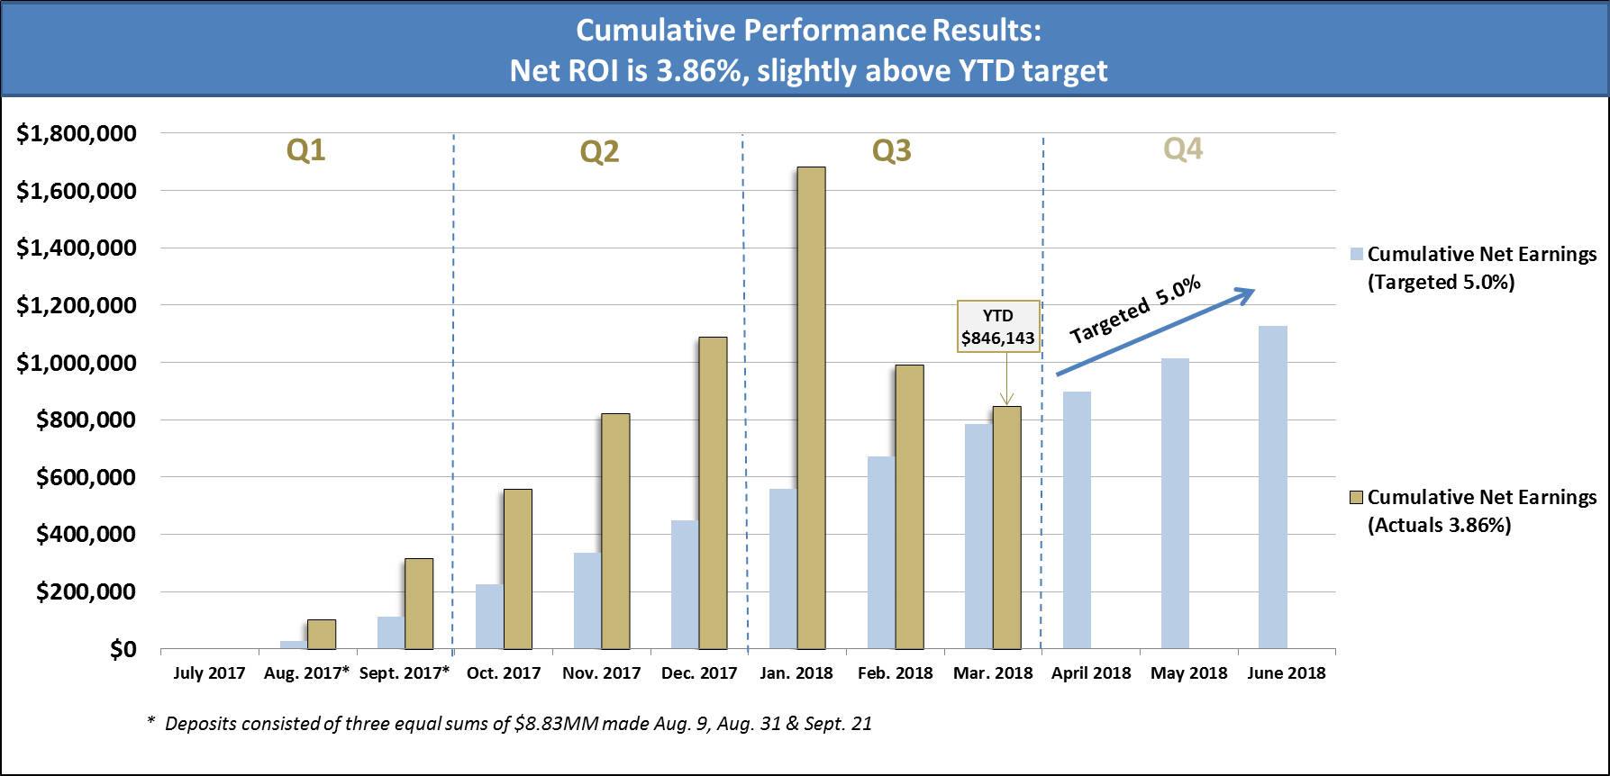
Slide 11
PERS Rate Stabilization Fund
FY 2017-18 3rd Quarter Update

Slide 12
FY 2017-18 General Fund Projected Year-End
Fund Balance
As of June 30, 2018 (In Thousands)
 |  | Unassigned & Charter Reserve |  | % of Budget*
Beginning Fund Balance, 7/1/2017 |  | $ 87,997 |  | 40.9%
Projected Year-end Savings, 6/30/2018 |  | 6,254
Projected Ending Fund Balance, 6/30/2018 |  | $ 94,251 |  | 43.8%
Less One-time Pending 3rd. Qtr. Adj. |  | (1,040)
Less Carryovers into FY 2018-19 |  | (3,437)
Projected Ending Fund Balance, 6/30/2018 |  | $ 89,774 |  | 41.8%
FY 2017-18 Deposit to PERS Stabilization Fund |  | (26,500)
Projected Ending Fund Balance, 6/30/2018 |  | $ 63,274 |  | 29.4%
*Based on proposed recurring appropriation of $215.0 million. Current policy is floor of 25% with a target of 35%.

Slide 13
Slide 13
Next Steps
Questions/Comments
Staff Recommendation
  Note and File Financial Status Report as of March 31, 2018
  Council Approve Resolution of Appropriation for FY 2017-18 Third Quarter Budget Adjustments

Slide 14
FY 2018-19 General Fund
Proposed Budget

Slide 15
FY 2018-19 Budget Process
Timeline for Budget Development (1 of 2)
Slide 15
Late October, Budget Process starts with annual cost allocation process. This is a process to distribute General Funds support department costs to non-General Fund departments to maximize cost recovery to the General Fund
Late November, Internal Service Fund Rates are established for all Internal Service Funds (i.e. Medical Insurance, Workers’ Compensation Insurance, Liability Insurance, Information Services Funds, Fleet/Equipment Fund)
Early February, Citywide Budget Kickoff is held
  All key staff from all departments are present for discussion and direction on the FY2018-19 Budget
  Calendar of key dates and deliverables are provided and discussed
  Changes impacting the budget are highlighted, such as overhead rates, etc.

Slide 16
FY 2018-19 Budget Process
Timeline for Budget Development (2 of 2)
Slide 16
Early February, budget module opens for inputting FY 2018-19 budget to all departments
  Budget module is used to build the budget via worksheets generated for all 77 funds across 15 departments
Mid February, departments submit budget requests, which include Personnel Requests, Capital Outlay, Equipment Replacement, New Fees, and Service Level Adjustments
  These requests are analyzed and reviewed with each department
Late March, individual departmental meetings are held with City Manager and budget staff to discuss the departmental submittals
Early April, an all hands meeting with department Executives, Budget staff, and the City Manager is held to review and determine which items are approved for inclusion in the proposed FY 2018-19 Budget
Mid April is used to finalize the proposed FY 2018-19 Budget and prepare for Study Sessions held in May

Slide 17
FY 2018-19 General Fund Proposed Budget
Proposed Resources
Slide 17
Starting Revenue Estimate: |  | $ 215,188,136
Adjustments:
Property Tax | $ 4,108,587
Sales Tax | 2,669,860
Utility Users Tax | 501,000
Occupancy & Other Taxes | 820,000
Interfund Revenue | 1,982,264
All Other Revenues (net) | 3,139,399
Total Adjustments: |  | $ 13,221,110
FY 2018-19 Revenue Estimate: |  | $ 228,409,246
Use of Assigned Econ Dev Fund Balance |  | 985,379
FY 2018-19 Proposed Resources: |  | $ 229,394,625

Slide 18
FY 2018-19 General Fund Proposed Budget
Revenue Changes
Slide 18
Overall General Fund revenues are expected to grow by 7.0%
Increases include:
  Property Tax forecasted to increase 9.4%
  Sales Tax forecasted to increase 8.9%
  Transient Occupancy Tax (TOT) is estimated to increase by 6.2% due to continues improved economy and addition of a new hotel
  Licenses and permits 1.3%
  Interfund revenues are increasing by 8.2%
  Electric Fund Transfer to General fund will equal to 10.0% of estimated Electric Revenues

Slide 19
Slide 19
FY 2018-19 General Fund Proposed Budget
Proposed Appropriations
Adopted FY 2017-18 Budget |  | $ 215,042,945
Salaries & Benefits Increase
Salaries | $ 5,494,411
PERS, Net of Cost Share | 6,323,246
Hourly Wages | 515,718
Overtime | 371,116
All Other Benefits (Medical, Dental, Vision, Work’ Comp, etc.) | 715,696
Total Salaries & Benefits Increase |  | $ 13,420,187
Maintenance & Operation Increase / (Decrease)
Liability Insurance | $ 1,029,953
Fleet/Equipment Rental Charge | (1,017,379)
ISD Service Charge | 382,248
All Other M&O | (2,292,883)
Total Maintenance & Operations Increase/(Decrease) |  | $ (1,898,061)
Transfers Out/Capital Outlay |  | $ 1,220,947
Total Proposed FY 2018-19 General Fund Budget |  | $ 227,786,018

Slide 20
Slide 20
FY 2018-19 General Fund Proposed Budget
General Fund Resources and Appropriations
Resources:
Revenues | $ 228,409,246
Use of Assigned Econ Dev Fund Balance | 985,379
Total Resources: | $ 229,394,625
Total Appropriations: | $ 227,786,018
Projected Net Surplus: | $ 1,608,607

Slide 21
FY 2018-19 General Fund Proposed Budget
Fund Balance Projection
 | Unassigned & Charter Reserve | % Projected Reserve
Projected Beginning Balance, 7/1/2018 | $ 63,274,000 | 27.9%
Projected Surplus | 1,608,607
Projected Ending Fund Balance, 6/30/2019 | $ 64,882,607 | 28.6%
*
*Based on proposed recurring appropriation of $226.8 million. Current policy is floor of 25% with a target of 35%.

Slide 22
Slide 22
FY 2018-19 General Fund Proposed Budget
Budget Overview (1 of 4)
Salaries & Benefits net increase of $13.4 million primarily due to:
  Increases In:
    $6.3 million for net PERS compared to last year
    $2.15 million for proposed service level adjustments
    Net 7 vacant positions redirected to General Fund - $799 thousand
      Community Development (4)
      Administrative Services (1)
      Human Resources (1)
      Police (1)
      Public Works (1)
    Additional Position – Police (School Resource Officer) - $229 thousand
    Overtime for Police Department - $250 thousand
    Reallocation of one position in the City Clerk’s Department - $36 thousand
    Shift of 25% of a Police Officer position into the General Fund - $61 thousand
    Hourly wages for Library, CS&P, Police, City Clerk, and IPA - $486 thousand
    Salary Adjustments for Police Communications - $290 thousand

Slide 23
FY 2018-19 General Fund Proposed Budget
Budget Overview (2 of 4)
Slide 23
Salaries & Benefits changes continued…
  Increases In:
    $1.8 million in Workers’ Comp
      Mainly due to increase in safety rates
    Cost of Living Adjustments for GPOA (3.5%), GMA (Police Sworn) (3.0%), GCEA (1.5%), GMA (1.5%), and Hourly Employees (1.5%)
  Decreases In:
    $1.3 million in Sick Leave/RHSP due to a decrease in rate

Slide 24
FY 2018-19 General Fund Proposed Budget
Budget Overview (3 of 4)
Slide 24
Maintenance & Operation net decrease of $1.9 million primarily due to:
  Increases In:
    $1.0 million in Liability Insurance
    $382 thousand for ISD Service Charge
    $152 thousand for proposed service level adjustments across various M&O accounts
  Decreases In:
    $2.1 million in one-time miscellaneous adjustments
    $1.0 million in Fleet/Equipment Rental Charge
    $614 thousand in Building Maintenance

Slide 25
FY 2018-19 General Fund Proposed Budget
Budget Overview (4 of 4)
Slide 25
Transfers and Capital Outlay net increase of $1.2 million primarily due to:
  Increases In:
    $1.0 million in transfers due to the 20% transfer of the GSA Loan Repayment to the Low and Mod Housing Fund
    $200 thousand in transfer to the Debt Service Fund
    $116 thousand in transfer to the Capital Funds
  Decrease In:
    $126 thousand in Capital Outlay

Slide 26
FY 2018-19 General Fund Proposed Budget
Proposed Service Level Adjustments Recap
Slide 26
Departments | Recurring Adjustments | Description Detail
Administrative Services | $ 41,079 | One vacant position redirected for Accounts Payable Tech I position
City Clerk | 58,100 | Reallocation of Admin Analyst to City Clerk Records Administrator; Hourly Wages; General Supplies
Innovation Performance & Audit (IPA) | 74,682 | Hourly Wages for Data and Performance Analyst
Community Development | 573,086 | Four vacant positions redirected for Planning Assistant, Planning Associate, Principal Planner, and Planner positions
Community Services & Parks | 84,000 | Increase in Aquatic Swim Lessons & Recreation Swim Hours
Human Resources | 70,263 | One vacant position redirected for HR Technician
Library, Arts & Culture | 257,000 | Contractual Services for security guard services, Hourly Wages and additional Utilities budget to maintain Central and Branch Library hours
Police | 1,029,966 | Addition of a School Resource Officer position; Salary Adjustments for Communications Operator and Shift Supervisor positions; Overtime; Contractual for Medical services; Hourly Wages
Public Works | 114,657 | One vacant position redirected for a Traffic Engineering Associate
Total Adjustments: | $ 2,302,833 | $2.15M in Salaries and Benefits, $152K in M&O

Slide 27
FY 2017-18 General Fund Forecast (In Millions)
(as of June 30, 2018)
 | Est. Actuals FY 17-18 | Proposed FY 18-19 | Projected FY 19-20 | Projected FY 20-21 | Projected FY 21-22 | Projected FY 22-23
Resources | $ 218.4 | $ 229.4 | $ 234.6 | $ 241.9 | $ 246.2 | $ 251.7
Appropriations
Base Line | $ 182.0 | $ 190.2 | $ 193.6 | $ 198.4 | $ 200.0 | $ 201.4
PERS | 32.4 | 40.6 | 46.9 | 51.7 | 56.0 | 59.7
PERS Cost Share | (3.3) | (3.8) | (3.9) | (4.0) | (4.0) | (4.1)
Net PERS | $ 29.1 | $ 36.8 | $ 43.0 | $ 47.7 | $ 52.0 | $ 55.6
CIP | 1.1 | 0.8 | 0.9 | 0.9 | 1.0 | 1.0
Total Appropriations | $ 212.2 | $ 227.8 | $ 237.5 | $ 247.0 | $ 253.0 | $ 258.0
Change in Fund Balance | $ 6.2 | $ 1.6 | $ (2.9) | $ (5.1) | $ (6.8) | $ (6.3)
One-time Adjs. Approved for 3rd Qtr | 0.5 | - | - | - | - | -
One-time Service Level Inc. Approved for FY 18-19 | 0.5 | - | - | - | - | -
Est. FY 17-18 Carryovers to FY 18-19 | 3.4 | - | - | - | - | -
Change in Fund Balance | $ 1.8 | $ 1.6 | $ (2.9) | $ (5.1) | $ (6.8) | $ (6.3)

Slide 28
FY 2018-19 Proposed Budget
Revenue Estimates
& Opportunities

Slide 29
General Fund Revenues
Introduction
General Fund Revenues
California Propositions
Revenue Opportunities
Revenue Summary
Questions & Comments

Slide 30
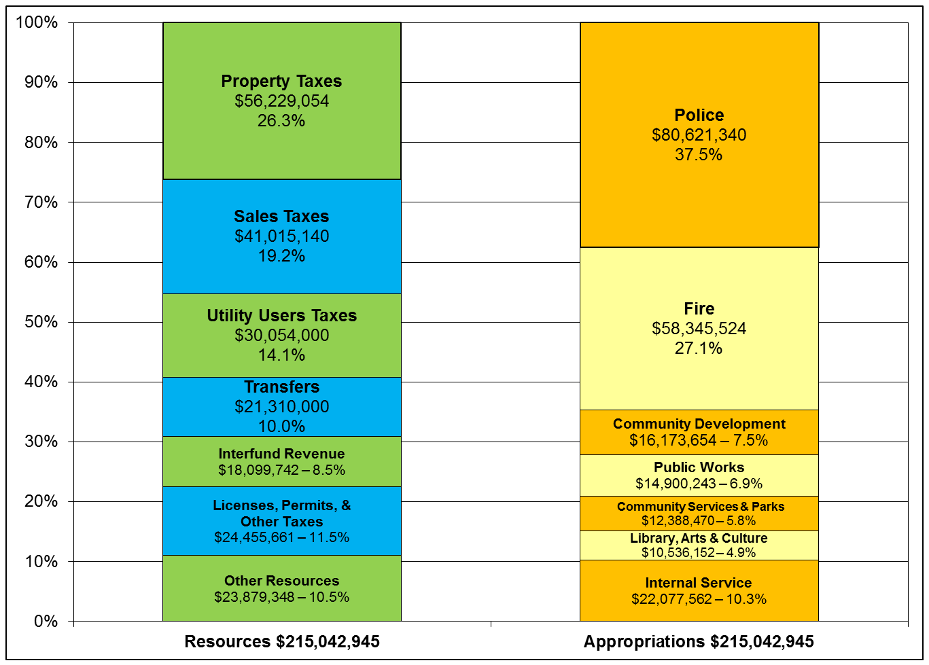
FY 2017-18 General Fund Adopted Budget
Resources vs Appropriations
Slide 30

Slide 31
Proposition 13
Passed in 1978
  Property-Taxpayer relief and uniformity
  Established 1% rate cap. Prior to Prop 13 local jurisdictions independently established their tax rates.
  Property is assessed at market value for tax purposes only when it changes ownership.
  Subsequent annual values are limited to ‘base year’ amount plus an annual growth factor of 2%
  Requires 2/3 voter approval for taxes raised by local governments for a designated ‘special purpose’

Slide 32
Proposition 8
Passed in 1978
  Constitutional amendment to Article XIIIA that allows a temporary reduction in assessed value when real property suffers decline in value
  A decline in value occurs when the current market value of real property is less than the current assessed (taxable) factored base year value as of the lien date, January 1

Slide 33
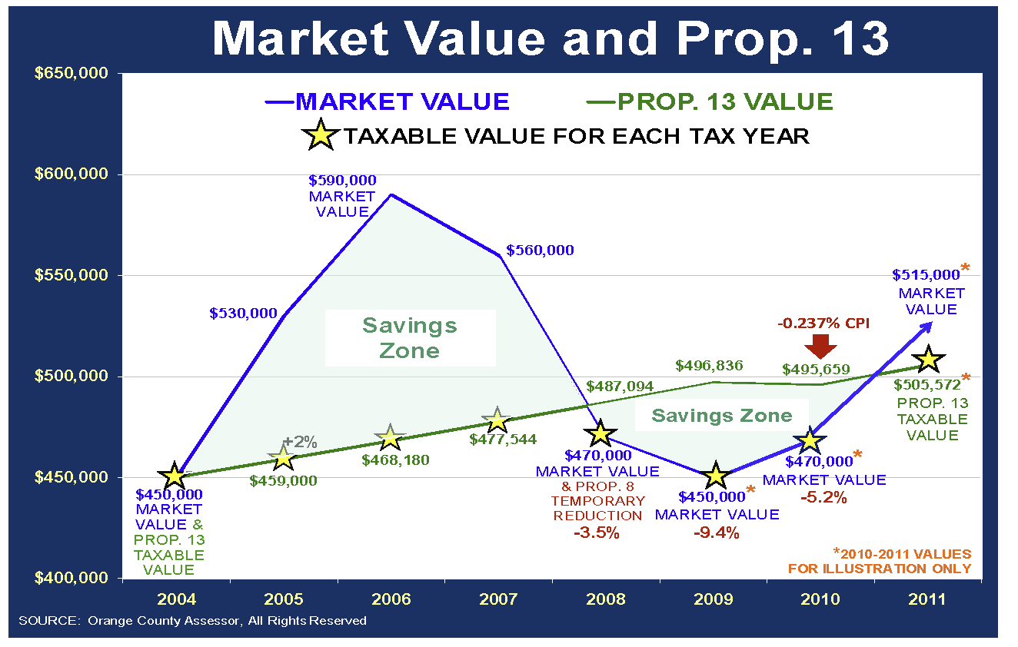

Slide 34
Proposition 218
Passed in 1996
  Shifted most of the power over taxation from locally elected governing boards to residents & property owners.
  Ensures all taxes and most charges on property owners are subject to voter approval
  Voter Requirements for taxes are:
    General Tax – requires majority voter approval
    Special Tax – requires 2/3 voter approval
    Parcel Tax – enacted as Special Tax
  Provides citizens with the power to repeal taxes
  Establishes a formal balloting procedure

Slide 35
Proposition 26
Passed in 2010
  All fees are deemed to be a tax unless one of the following seven exceptions apply:
    Specific Benefit/Privilege (permits, franchises)
    Specific Service/Product (utility charges, park & rec. fees)
    Reasonable Regulatory Fees for licenses & permits (permits, inspections)
    Fee for entry, use or purchase of government property (parks & rec. entrance fees, equipment rental, some franchises)
    Fines & penalties
    Fees imposed as a condition of property development (limited to cost by other law)
    Assessments & property-related fees subject to Prop.218 (limited to cost by 218)
  If fees don’t fall within one of the seven exceptions listed above, then Prop 26 defines it as a Tax for which voter approval is required under Prop 218

Slide 36
New California Ballot Initiative
“Tax Fairness, Transparency and Accountability Act of 2018”
  Will be destructive to Local Governments
  Will eliminate the distinction between special and general tax
  Will require two-thirds supermajority for any new tax, tax increase or tax extension, making it much more difficult for cities and counties to control their own financial destinies
  Will not be able submit a tax to the voters at a special election unless the City Council unanimously declares an emergency
  If approved the measure would retroactively wipe out any voter-improved tax investment back to the beginning of 2018
  Will eliminate the Prop. 26 exception for fees for a benefit & privilege
  Opposed by the League of California Cities

Slide 37
General Fund Revenues
Approximately 69.6% of the City’s major revenues consist of four revenue sources for FY 2017-18 budget:
 | % | $
Property Taxes | 26.3 | 56,229,054
Sales Taxes | 19.2 | 41,015,140
UUT | 14.1 | 30,054,000
Transfer from Utilities | 10.0 | 21,310,000

Slide 38
General Fund Revenues
Slide 38
Property Taxes
  The Property Tax is imposed on real property (land & permanently attached improvements such as building) and tangible personal property (movable property)
  The value of the property is based on a determination made by the County
  The property tax rate is limited to 1% of assessed value plus any rates imposed to fund indebtedness approved by the voters
  The General Fund receives about 0.1357% of the 1% levy; specifically, the General Fund receives only 13.5 cents for every one dollar of property taxes paid by Glendale property owners

Slide 39
Tri City Comparison
Property Tax Breakdown
Slide 39
0.36% - Los Angeles County
0.20% - School District
0.17% - Educational Aug. Fund Impound
0.135% - Tax District #1 (City Share)
0.07% - Education Rev. Aug. Fund
0.04% - Community College District
0.03% - Other
0.1357 0.1847 0.2109
% of Property Tax $

Slide 40
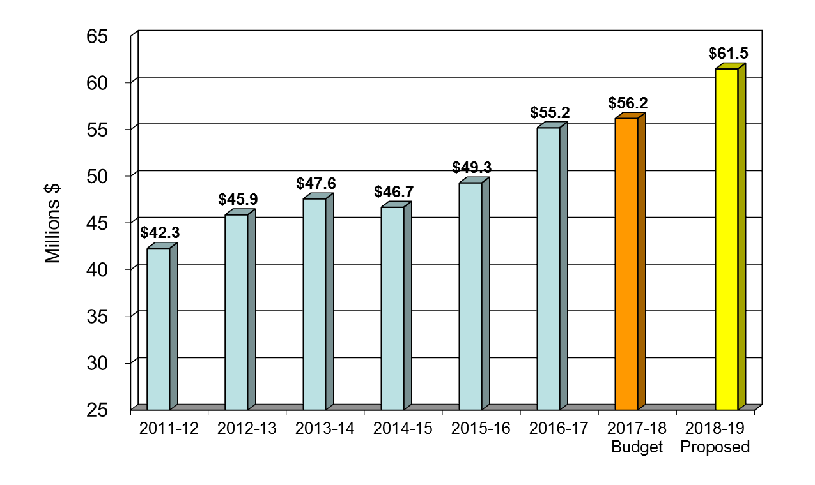
General Fund Revenues
Property Taxes
Slide 40
Revenues include the estimated property tax revenue from AB 1x26

Slide 41
General Fund Revenues
Slide 41
Sales & Use Taxes
  Current Sales Tax is 9.5%
  The CDTFA (California Department of Tax and Fee Administration) collects and distributes local sales tax revenue
  The General Fund receives 1% of the 9.5% of sales tax collected in the City
  The sales and use tax revenue can be used for any general purpose

Slide 42
Sales Tax Breakdown
Slide 42
0.25% - Measure H (Homelessness)
0.25% - County Transportation Fund
0.50% - County Health/Welfare
0.50% - Public Safety Augmentation Fund
1.00% - Glendale Allocation
2.00% - L.A. County Transportation (Includes
Prop A, C and Measure R, M Funds)
1.06% - State Local Revenue Fund
3.94% - State General Fund
State Taxes
Local / Direct
Local / Per Capita
Local / Based on Need
9.5% Sales Tax

Slide 43
Sales Tax Breakdown With Add-on Tax
Slide 43
0.75% - Available for Local Use
0.25% - Measure H (Homelessness)
0.25% - County Transportation Fund
0.50% - County Health / Welfare Fund
0.50% - Public Safety Augmentation Fund
1.00% - Glendale Allocation
2.00% - L.A. County Transportation (Includes
Prop A, C and Measure R, M Funds)
1.06% - State Local Revenue Fund
3.94% - State General Fund
State Taxes
Local / Direct
Local / Per Capita
Local / Based on Need
10.25% Sales Tax

Slide 44
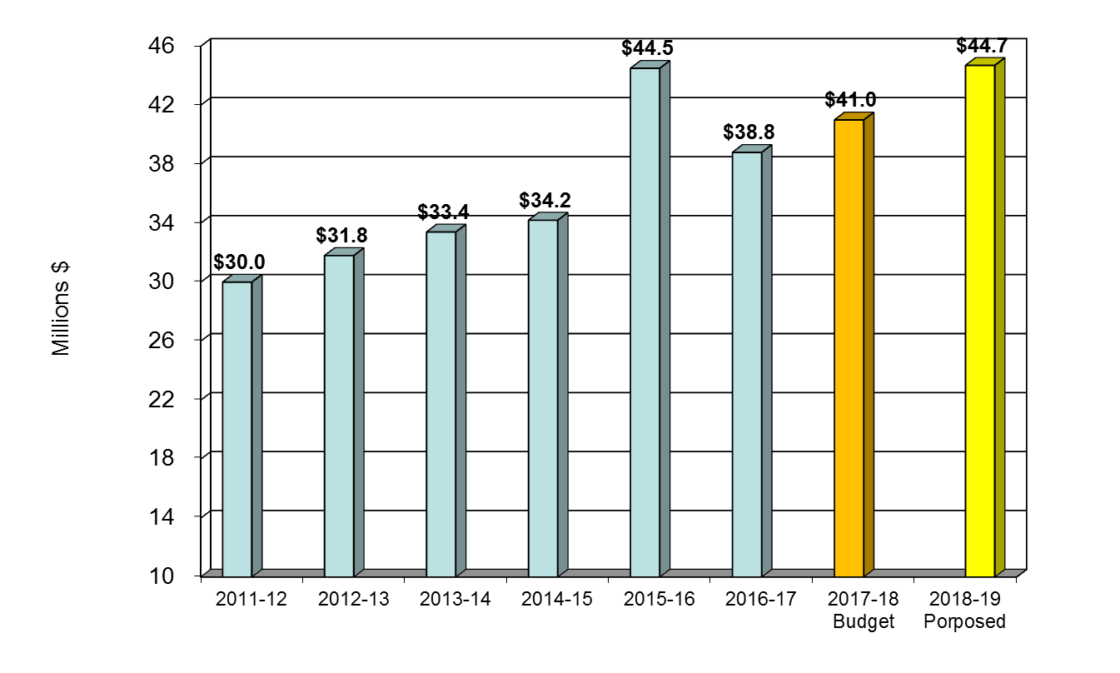
General Fund Revenues
Sales Tax
FY 2015-16 includes the one-time revenue from the triple flip

Slide 45
Sales Tax Recap
Slide 45
  Glendale receives 1.0% out of the 9.5%
    This produces over $40 million for the General Fund
  State current limitation is 10.25% for total sales tax
    State could raise that for its own use
  There is a limit of 2.0% for local use
    1.0 % has been utilized by LA County for Prop A and C
    0.25% was implemented for Measure H (Homeless Services)
    Only 0.75% left for local use
  Burbank, and likely Pasadena, are initiating ballot measures of 0.75% local tax on the November ballot
    Burbank will generate approx. $24 million
    Pasadena will generate approx. $26 million
  Similar measure in Glendale would generate approx. $30 million for use in Glendale

Slide 46
Other Sales Tax Recap
Slide 46
  Other local sales taxes that have been voted in historically in Los Angeles County that apply to Glendale are:
    Prop A: 0.50% tax allocated on a per capita basis to Glendale for transit operations
    Prop C: 0.50% tax allocated on a per capita basis to Glendale for transit capital projects
    Measure R: 0.50% tax allocated on a per capita basis to Glendale for multi-jurisdictional coordinated projects
    Measure M: 0.50% tax allocated on a per capita basis to Glendale to improve transit services and ease traffic congestion
    Measure H: 0.25% tax allocated per homeless count for homeless services

Slide 47
Non-General Fund Sales Tax Revenues
2% County Transit: Prop A & C, Measure R & M, and 0.25% Measure H
- Data is based on FY 2018-19 Estimates for the Local Returns

Slide 48
General Fund Revenues
Utility Users Tax
 | Glendale | Burbank | Pasadena | Los Angeles
Telecommunication: Prepaid Wireless* | 6.50% 6.50% | 7.00% 6.50% | 8.28% 7.50% | 9.00% 9.00%
Video (Cable) | 6.50% | - | 9.40% | -
Electricity | 7.00% | 7.00% | 7.67% | 10.00%
Water | 7.00% | - | 7.67% | -
Gas | 7.00% | 7.00% | 7.90% | 10.00%
- In 2009 voters approved a rate reduction for Telecommunications and Video (reduced from 7% to 6.5%)

Slide 49
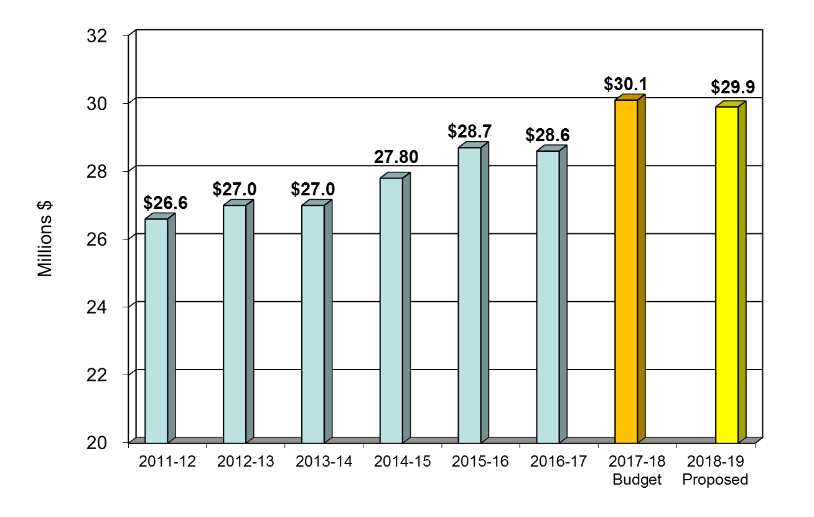
General Fund Revenues
Utility Users Tax

Slide 50
General Fund Revenues
Other GF Revenue Sources
Slide 50
Transient Occupancy Tax (TOT)
  Hotel/motel operators in the City are required to charge the 12% TOT of the rent charged to ‘Transient’ guests
  The increase from 10% to 12% was approved by voters at the General Municipal Election on April 7, 2015
  ‘Transient’ is any person who exercises occupancy in a hotel/motel for a period of 30 consecutive calendar days or less
  Currently there are 25 hotels/motels in the City

Slide 51
General Fund Revenues
Other GF Revenue Sources
Slide 51
Franchise Tax
  Amount received from Franchisee for ‘rental’ or ‘toll’ for use of the City streets and right-of-way
  Following are some of the Firms that have a franchise agreement with the City:
    Southern Cal. Edison Co.
    Southern Cal. Gas Co.
    Pacific Pipeline System LLC
    Charter Communications, etc.

Slide 52
General Fund Revenues
Other GF Revenue Sources
Slide 52
Licenses & Permits category includes:
  Building Permits, Planning Permits, Business Registration, Dog Licenses, etc.
Charges for Services include:
  Emergency Medical Response Fees, Other Fire Fees, Police Fees, Zoning-Subdivision Fees, Express Plan Check Fees, Code Enforcement Fees, Library Misc. Fees, Etc.
Cost Allocation Revenue:
  General Fund recapturing overhead cost from other funds
Fines & Forfeitures include:
  Traffic Safety Fines

Slide 53
Tri City Revenue Comparison
City Profile
 | Glendale | Burbank | Pasadena
Area | 30.58 sq. ml. | 17.38 sq. ml. | 23.13 sq. ml.
No. of Parcels | 44,559 | 28,896 | 39,305
Net Taxable Value | $30,468,249,664 | $23,088,309,691 | $29,270,814,989
% of Taxable Value:
Residential | 87.0% | 87.1% | 88.9%
Commercial | 4.8% | 6.5% | 5.2%
Industrial | 1.4% | 2.7% | 0.7%
All Other | 6.8% | 3.6% | 5.2%
Median Home Value (Detached SFR) | $905,000 | $830,000 | $940,000
Data Source: HdL Coren & Cone – FY 2017-18 (Entire City)

Slide 54
Tri City Revenue Comparison
FY 2017-18 Adopted General Fund Budget
 | Glendale | Burbank | Pasadena
Population: | 201,748 | 105,033 | 142,059
Property Tax | $ 56,229,054 | $ 41,811,106 | $ 61,375,000
Sales Tax | 41,015,140 | 32,833,500 | 35,557,209
UUT | 30,054,000 | 19,930,344 | 29,101,000
TOT | 8,058,661 | 11,749,009 | 16,510,000
Parking Tax | - | 3,018,996 | -
Business Tax | - | 2,405,000 | 6,543,000
Licenses & Permits | 9,597,000 | 3,004,718 | 3,908,000
Other Revenues | 47,244,281 | 41,256,674 | 64,566,000
Subtotal | $ 192,198,136 | $ 156,009,347 | $ 217,560,209
Transfers In | 21,310,000 | 8,889,775 | 19,261,000
Total | $ 213,508,136 | $ 164,899,122 | $ 236,821,209

Slide 55
Tri City Per Capita
FY 2017-18 Adopted General Fund Budget
 | Glendale | Burbank | Pasadena
Population: | 201,748 | 105,033 | 138,101
Property Tax | $ 279 | $ 398 | $ 432
Sales Tax | 203 | 313 | 250
UUT | 149 | 190 | 205
TOT | 40 | 112 | 116
Parking Tax | - | 29 | -
Business Tax | - | 23 | 46
Licenses & Permits | 48 | 29 | 28
Other Revenues | 234 | 393 | 455
Subtotal | $ 953 | $1,487 | $1,532
Transfers In | 106 | 85 | 136
Total | $ 1,059 | $1,572 | $1,668

Slide 56
Revenue Opportunities
  What can Glendale Implement to Enhance Tax Revenues to fund future programs and services?:
    Additional 0.75% Local Sales Tax
    Business Tax
    Parcel Tax
    Transient Parking Tax
    Special Assessment Districts
    Additional Development Impact Fees

Slide 57
Revenue Options Summary
Revenue Options | Tax Applied to: | Vote Requirement | Rate | Estimated Gross Revenue
Sales Tax | Residents / Non-Residents | Simple Majority | 0.75% | $25 - $30 Million
Business Tax | Glendale Businesses | Simple Majority | Various | $5 - $6 Million
Parcel Tax | Glendale Property Owners | Simple Majority / 2/3 | Various | $3.9 Million
Transient Parking Tax | Residents / Non-Residents | Simple Majority | 10% - 12% | $0.8 - $1.0 Million
Various Assessment Districts | Glendale Property Owners | Simple Majority / 2/3 | Various | Various

Slide 58
Questions
&
Comments

Slide 59
FY 2018-19
Organizational Profile

Slide 60
FY 2018-19 Citywide Organizational Profile
 | Adopted FY 2017-18 |  | Proposed FY 2018-19
Total Population | 201,748 |  | 201,748
Total Citywide City Employees (FTE) | 1,587 |  | 1,588
Total General Fund FTE | 879 |  | 894
Total Adopted Budget | $ 836,914,477 |  | $ 920,966,353
Total General Fund Adopted Budget | $ 215,042,945 |  | $ 227,786,018
Residents served per FTE (All Funds) | 127 |  | 127
Residents served per FTE (General Fund) | 230 |  | 226
Total Budget per capita (All Funds) | $4,148 |  | $4,565
Total Budget per capita (General Fund) | $1,066 |  | $1,129
*
Estimated population. Department of Finance Annual Publication not yet available.

Slide 61
FY 2018-19 Citywide Organizational Profile
 | Adopted FY 2017-18 |  |  | Proposed FY 2018-19 |  |  | Expenditure% Change from 17-18
Public Safety | $ 157,358,189 | 19.4% |  | $ 164,001,316 | 18.5% |  | 4.2%
Public Works & Utilities* | 433,861,634 | 53.5% |  | 502,783,505 | 56.6% |  | 15.9%
Community* Development | 75,728,806 | 9.4% |  | 66,196,041 | 7.4% |  | (12.6%)
Quality of Life | 43,314,139 | 5.3% |  | 48,201,191 | 5.4% |  | 11.3%
Administration & Internal Service | 100,762,032 | 12.4% |  | 107,561,748 | 12.1% |  | 6.7%
Total Expenditures** | $ 811,024,800 | 100.0% |  | $ 888,743,801 | 100.0% |  | 9.6%
*Transit section is stated under “Community Development” category in FY 17-18 however beginning FY 18-19 Transit Funds are shifting to Public Works and are reflected under “Public Works & Utilities” category.
**Data excludes transfers out

Slide 62
Total Personnel Appropriation - All Funds
Four-Year Comparison (in millions)
FY 2018-19 Citywide Organizational Profile
 | Adopted FY 2015-16 | Adopted FY 2016-17 | Adopted FY 2017-18 | Proposed FY 2018-19 | % Change from 17-18
Salaries & Benefits | $ 230.4 | $ 241.6 | $ 257.4 | $ 278.7 | 8.3%
Maintenance & Operation/Capital Outlay | 465.1 | 490.2 | 511.4 | 505.1 | (1.2%)
Total Operating Costs* | $ 695.5 | $ 731.8 | $ 768.8 | $ 783.8 | 2.0%
Personnel v. Operating | 33.1% | 33.0% | 33.5% | 35.6% | 6.3%
Employee Count | 1,566 | 1,579 | 1,587 | 1,588 | 0.1%
**
* Operating Cost does not include transfers or capital improvement
** Does not meet target of 35% or less

Slide 63
Total Personnel Appropriation - General Fund
Four-Year Comparison (in millions)
FY 2018-19 Citywide Organizational Profile
 | Adopted FY 2015-16 | Adopted FY 2016-17 | Adopted FY 2017-18 | Proposed FY 2018-19 | % Change from 17-18
Salaries & Benefits | $ 142.2 | $ 147.7 | $ 162.6 | $ 176.0 | 8.2%
Maintenance & Operation/Capital Outlay | 38.6 | 44.1 | 49.8 | 47.8 | (3.8%)
Total Operating Costs* | $ 180.8 | $ 191.8 | $ 212.4 | $ 223.8 | 5.4%
Personnel v. Operating | 78.7% | 77.0% | 76.6% | 78.6% | 2.6%
Employee Count | 882 | 866 | 879 | 894 | 1.8%
**
*
*Operating Cost does not include transfers
**Does not meet target of 75% or less

Slide 64
Total Personnel - All Funds
Management to Non-Management Ratio
FY 2018-19 Citywide Organizational Profile
 | Employee Count |  | Employee Count % |  | Salary %
Management | 172 |  | 10.8% |  | 16.8%
Non-Management** | 1,416 |  | 89.2% |  | 83.2%
Total | 1,588 |  | 100.0% |  | 100.0%
*
* Meets target of 25% maximum
** Includes Supervisor, Technical/Professional, and General Employees

Slide 65
FY 2018-19 Proposed Budget
Summary of All Funds by Type

Slide 66
FY 2018-19 Proposed Budget
Definitions
Two Categories of Fund Type:
  Governmental Funds – Used for specific governmental purposes and report on a modified accrual basis
  Proprietary Funds – Used to report business-like operations and report on a full accrual basis

Slide 67
FY 2018-19 Proposed Budget
Governmental Funds
  General Fund: The primary fund of the City used to account for all revenues and expenditures of the City not legally restricted as to use
  Special Revenue Funds: This fund type collects revenues that are restricted by the City, State, or Federal Government as to how they may be spent. Most of the special revenue funds are grant revenues
  Debt Service Funds: This fund type is used to account for the payment of principal and interest on an obligation resulting from the issuance of bonds, notes, or certificates of participation
  Capital Improvement Funds: Used for capital outlays including the acquisition or construction of capital facilities or other capital assets

Slide 68
FY 2018-19 Proposed Budget
Proprietary Funds
  Enterprise Funds: This fund type serves the public and charges a fee for services or goods. Fees, rather than taxes or transfers, are charged in order to fund the business which makes the fund self-supporting
  Internal Service Funds: This fund type provides services to other City departments and charges for services rendered, similar to a private business. It is intended to be self-supporting

Slide 69
FY 2018-19 Proposed Budget
Summary of Appropriations-All Funds Overview
Fund Type |  | Adopted FY 2017-18 | Proposed FY 2018-19 | Increase / (Decrease) | % Change
Governmental Funds
 | General Fund | $ 215,042,945 | $ 227,786,018 | $ 12,743,073 | 5.9%
 | Special Revenue Funds | 98,780,317 | 110,812,413 | 12,032,096 | 12.2%
 | Debt Service Funds | 2,222,150 | 2,619,909 | 397,759 | 17.9%
 | Capital Improvement Funds | 16,008,821 | 28,403,000 | 12,394,179 | 77.4%
Proprietary Funds
 | Enterprise Funds | 393,568,677 | 433,641,396 | 40,072,719 | 10.2%
 | Internal Service Funds | 111,291,567 | 117,703,617 | 6,412,050 | 5.8%
All Funds – Grand Total |  | $ 836,914,477 | $ 920,966,353 | $ 84,051,876 | 10.0%

Slide 70
FY 2018-19 Proposed Budget
Summary of Appropriations-General Fund (1 of 2)
General Fund Department | Adopted FY 2017-18 | Proposed FY 2018-19 | Increase / (Decrease) | % Change
Administrative Services | $ 5,000,178 | $ 5,787,467 | $ 787,289 | 15.7%
City Attorney | 3,693,779 | 3,801,964 | 108,185 | 2.9%
City Clerk | 1,426,103 | 1,451,530 | 25,427 | 1.8%
City Treasurer | 751,262 | 793,464 | 42,202 | 5.6%
Community Development | 16,173,654 | 17,465,318 | 1,291,664 | 8.0%
Community Services & Parks | 12,388,470 | 12,830,845 | 442,375 | 3.6%
Continuous Improvement, Performance & Audit* | 1,253,381 | 1,384,355 | 130,974 | 10.4%
Fire | 58,345,524 | 59,414,713 | 1,069,189 | 1.8%
Human Resources | 2,997,059 | 3,187,075 | 190,016 | 6.3%

Slide 71
FY 2018-19 Proposed Budget
Summary of Appropriations-General Fund (2 of 2)
General Fund Department | Adopted FY 2017-18 | Proposed FY 2018-19 | Increase / (Decrease) | % Change
Library, Arts & Culture | $ 10,536,152 | $ 10,560,186 | $ 24,034 | 0.2%
Management Services | 4,376,123 | 4,619,299 | 243,176 | 5.6%
Police | 80,621,340 | 87,315,322 | 6,693,982 | 8.3%
Public Works | 14,900,243 | 15,248,228 | 347,985 | 2.3%
Transfers | 2,579,677 | 3,926,252 | 1,346,575 | 52.2%
General Fund Total | $ 215,042,945 | $ 227,786,018 | $ 12,743,073 | 5.9%

Slide 72
FY 2018-19 Proposed Budget
Summary of Appropriations-Special Revenue Funds (1 of 4)
Fund | Adopted FY 2017-18 | Proposed FY 2018-19 | Increase / (Decrease) | % Change
201 - CDBG Fund | $ 1,674,621 | $ 1,689,680 | $ 15,059 | 0.9%
202 - Housing Assistance Fund | 32,511,799 | 38,029,143 | 5,517,344 | 17.0%
203 - Home Grant Fund | 958,800 | 1,272,951 | 314,151 | 32.8%
204 - Continuum of Care Grant Fund | 1,524,809 | 2,416,477 | 891,668 | 58.5%
205 - Emergency Solutions Grant Fund | 180,382 | 147,970 | (32,412) | (18.0%)
206 - Workforce Innovation and Opportunity Act Fund | 5,822,971 | 6,123,399 | 300,428 | 5.2%
209 - Affordable Housing Trust Fund | 20,000 | 24,739 | 4,739 | 23.7%
210 - Urban Art Fund | 292,850 | 89,500 | (203,350) | (69.4%)
211 - Glendale Youth Alliance Fund | 1,904,061 | 2,088,316 | 184,255 | 9.7%

Slide 73
FY 2018-19 Proposed Budget
Summary of Appropriations-Special Revenue Funds (2 of 4)
Fund | Adopted FY 2017-18 | Proposed FY 2018-19 | Increase / (Decrease) | % Change
212 - BEGIN Affordable Homeownership Fund | $ 300,000 | $ 300,000 | $ - | 0.0%
213 – Low & Mod Income Housing Asset Fund | 1,612,257 | 1,660,143 | 47,886 | 3.0%
216 - Grant Fund | 923,618 | 367,004 | (556,614) | (60.3%)
217 - Filming Fund | 481,604 | 609,464 | 127,860 | 26.5%
222 - Measure M Local Return Fund | 1,911,100 | 2,043,282 | 132,182 | 6.9%
224 – Measure H Fund | - | 278,114 | 278,114 | N/A
251 - Air Quality Improvement Fund | 326,978 | 334,283 | 7,305 | 2.2%
253 - San Fernando Landscape District Fund | 91,457 | 90,575 | (882) | (1.0%)
254 - Measure R Local Return Fund | 400,904 | 340,000 | (60,904) | (15.2%)
255 - Measure R-Regional Fund | 1,765,000 | 4,520,000 | 2,755,000 | 156.1%

Slide 74
FY 2018-19 Proposed Budget
Summary of Appropriation-Special Revenue Funds (3 of 4)
Fund | Adopted FY 2017-18 | Proposed FY 2018-19 | Increase / (Decrease) | % Change
256 - Transit Prop A Local Return Fund | $4,202,315 | $3,856,048 | $(346,267) | (8.2%)
257 - Transit Prop C Local Return Fund | 4,005,369 | 4,146,567 | 141,198 | 3.5%
258 - Transit Utility Fund | 9,944,008 | 10,333,998 | 389,990 | 3.9%
260 - Asset Forfeiture Fund | 775,200 | 727,036 | (48,164) | (6.2%)
261 - Police Special Grants Fund | 781,536 | 775,682 | (5,854) | (0.7%)
262 - Supplemental Law Enforcement Fund | 436,196 | 485,429 | 49,233 | 11.3%
265 - Fire Grant Fund | 4,400 | 4,400 | - | 0.0%
266 - Fire Mutual Aid Fund | 300,001 | 600,000 | 299,999 | 100.0%
267 - Special Events Fund | 481,294 | 1,195,010 | 713,716 | 148.3%

Slide 75
FY 2018-19 Proposed Budget
Summary of Appropriation-Special Revenue Funds (4 of 4)
Fund | Adopted FY 2017-18 | Proposed FY 2018-19 | Increase / (Decrease) | % Change
270 - Nutritional Meals Grant Fund | $ 442,712 | $ 457,464 | $ 14,752 | 3.3%
275 - Library Fund | 694,625 | 185,267 | (509,358) | (73.3%)
280 - Cable Access Fund | - | 865,000 | 865,000 | N/A
291 - Electric Public Benefit Fund | 8,284,181 | 9,243,196 | 959,015 | 11.6%
501 - Recreation Fund | 4,230,715 | 4,216,969 | (13,746) | (0.3%)
510 - Hazardous Disposal Fund | 1,640,565 | 1,761,348 | 120,783 | 7.4%
520 - Parking Fund | 9,853,989 | 9,533,959 | (320,030) | (3.2%)
Special Revenue Total | $98,780,317 | $110,812,413 | $12,032,096 | 12.2%

Slide 76
FY 2018-19 Proposed Budget
Summary of Appropriation-Debt Service Funds
Fund | Adopted FY 2017-18 | Proposed FY 2018-19 | Increase / (Decrease) | % Change
303-Police Building Project Fund | $2,222,150 | $2,619,909 | $397,759 | 17.9%
Debt Service Total | $2,222,150 | $2,619,909 | $397,759 | 17.9%

Slide 77
FY 2018-19 Proposed Budget
Summary of Appropriation-Capital Improvement Funds (1 of 2)
Fund | Adopted FY 2017-18 | Proposed FY 2018-19 | Increase / (Decrease) | % Change
Fund 401 Capital Improvement (GF)
Police | $ 450,000 | $ 100,000 | $ (350,000) | (77.8%)
Fire | 663,000 | 50,000 | (613,000) | (92.5%)
Public Works | 2,616,100 | 2,833,000 | 216,900 | 8.3%
Community Services & Parks | 3,171,771 | 5,250,000 | 2,078,229 | 65.5%
Community Development Department | - | 6,500,000 | 6,500,000 | N/A
Library, Arts & Culture | 200,000 | - | (200,000) | (100.0%)
Transfer to Scholl Canyon Landfill Post-closure Fund (403) | 2,000,000 | 4,560,000 | 2,560,000 | 128.0%
Total Fund 401 Capital Improvement | $ 9,100,871 | $ 19,293,000 | $ 10,192,129 | 112.0%

Slide 78
FY 2018-19 Proposed Budget
Summary of Appropriation-Capital Improvement Funds (2 of 2)
Fund | Adopted FY 2017-18 | Proposed FY 2018-19 | Increase / (Decrease) | % Change
402-State Gas Tax Fund | $4,135,000 | $7,610,000 | $3,475,000 | 84.0%
405-Parks Mitigation Fee Fund | - | 1,500,000 | 1,500,000 | N/A
407-Library Mitigation Fee Fund | 250,000 | - | (250,000) | (100.0%)
409-CIP Reimbursement Fund | 2,122,950 | - | (2,122,950) | (100.0%)
410 - San Fernando Corr. Tax Share Fund | 400,000 | - | (400,000) | (100.0%)
Capital Improvement Total | $16,008,821 | $28,403,000 | $12,394,179 | 77.4%

Slide 79
FY 2018-19 Proposed Budget
Summary of Appropriation-Enterprise Funds (1 of 2)
Fund | Adopted FY 2017-18 | Proposed FY 2018-19 | Increase / (Decrease) | % Change
525 - Sewer Fund | $32,803,047 | $39,630,237 | $6,827,190 | 20.8%
530 - Refuse Disposal Fund | 28,721,438 | 28,627,349 | (94,089) | (0.3%)
582 - Electric Works Revenue Fund | 258,624,130 | 243,504,907 | (15,119,223) | (5.8%)
583 - Electric Depreciation Fund | 6,485,320 | 47,158,938 | 40,673,618 | 627.2%
585 - Electric Customer Capital Fund | 1,819,781 | 2,000,000 | 180,219 | 9.9%
588 – Electric Customer Repair Fund | - | 50,000 | 50,000 | N/A
592 - Water Works Revenue Fund | 53,275,960 | 55,080,416 | 1,804,456 | 3.4%

Slide 80
FY 2018-19 Proposed Budget
Summary of Appropriation-Enterprise Funds (2 of 2)
Fund | Adopted FY 2017-18 | Proposed FY 2018-19 | Increase / (Decrease) | % Change
593 - Water Depreciation Fund | $2,983,680 | $8,602,062 | $5,618,382 | 188.3%
595 - Water Customer Capital Fund | 1,471,000 | 1,471,000 | - | 0.0%
598 – Water Customer Repair Fund | - | 100,000 | 100,000 | N/A
701 - Fire Communication Fund | 7,384,321 | 7,416,487 | 32,166 | 0.4%
Enterprise Total | $393,568,677 | $433,641,396 | $40,072,719 | 10.2%

Slide 81
FY 2018-19 Proposed Budget
Summary of Appropriation-Internal Service Funds (1 of 2)
Fund | Adopted FY 2017-18 | Proposed FY 2018-19 | Increase / (Decrease) | % Change
601 - Fleet Management Fund | $18,228,087 | $20,273,915 | $2,045,828 | 11.2%
602 - Joint Helicopter Operation Fund | 3,252,662 | 1,535,980 | (1,716,682) | (52.8%)
603 - ISD Infrastructure Fund | 8,507,798 | 13,430,865 | 4,923,067 | 57.9%
604 - ISD Applications Fund | 11,241,365 | 9,920,494 | (1,320,871) | (11.8%)
607 - Building Maintenance Fund | 8,546,671 | 8,672,128 | 125,457 | 1.5%
610 - Unemployment Insurance Fund | 75,020 | 741,028 | 666,008 | 887.8%
612 - Liability Insurance Fund | 8,548,211 | 7,327,247 | (1,220,964) | (14.3%)
614 - Compensation Insurance Fund | 13,513,294 | 14,996,770 | 1,483,476 | 11.0%
615 - Dental Insurance Fund | 1,490,082 | 1,960,222 | 470,140 | 31.6%

Slide 82
FY 2018-19 Proposed Budget
Summary of Appropriation-Internal Service Funds (2 of 2)
Fund | Adopted FY 2017-18 | Proposed FY 2018-19 | Increase / (Decrease) | % Change
616 - Medical Insurance Fund | $25,774,990 | $25,097,496 | $(677,494) | (2.6%)
617 - Vision Insurance Fund | 261,840 | 490,844 | 229,004 | 87.5%
640 - Compensated Absences Fund | 5,261,012 | 4,706,368 | (554,644) | (10.5%)
641 - RHSP Benefits Fund | 2,028,643 | 1,528,375 | (500,268) | (24.7%)
642 - Post Employment Benefits Fund | 222,429 | 628,842 | 406,413 | 182.7%
660 - ISD Wireless Fund | 4,339,463 | 6,393,043 | 2,053,580 | 47.3%
Internal Service Total | $111,291,567 | $117,703,617 | $6,412,050 | 5.8%

Slide 83
FY 2018-19 Proposed Budget
Summary of Appropriations-All Funds Recap
Fund Type |  | Adopted FY 2017-18 | Proposed FY 2018-19 | Increase / (Decrease) | % Change
Governmental Funds
 | General Fund | $ 215,042,945 | $ 227,786,018 | $ 12,743,073 | 5.9%
 | Special Revenue Funds | 98,780,317 | 110,812,413 | 12,032,096 | 12.2%
 | Debt Service Funds | 2,222,150 | 2,619,909 | 397,759 | 17.9%
 | Capital Improvement Funds | 16,008,821 | 28,403,000 | 12,394,179 | 77.4%
Proprietary Funds
 | Enterprise Funds | 393,568,677 | 433,641,396 | 40,072,719 | 10.2%
 | Internal Service Funds | 111,291,567 | 117,703,617 | 6,412,050 | 5.8%
 | All Funds – Grand Total | $ 836,914,477 | $ 920,966,353 | $ 84,051,876 | 10.0%

Slide 84
FY 2018-19 Departmental Dashboards

Slide 85
Administrative Services

Slide 86
Administrative Services
Proposed 2018-19 Budget Summary
Category
Salaries & Benefits | $ 4,781,613
M&O | 1,005,854
Capital Outlay | -
Capital Improvement | -
Total Budget | $ 5,787,467
Personnel
Executive | 1.00 | 2.7%
Management | 8.00 | 21.4%
Non-Management | 28.35 | 75.9%
Hourly FTE | 0.00 | 0%
Total | 37.35 | 100.0%
 | Adopted FY 2017-18 | Proposed FY 2018-19 | Increase/(Decrease)
 |  |  | $ | %
101 - General Fund | $ 5,000,178 | $ 5,787,467 | $ 787,289 | 15.7%

Slide 87
City Attorney

Slide 88
City Attorney
Proposed 2018-19 Budget Summary
Category
Salaries & Benefits | $ 3,983,478
M&O | 7,145,733
Capital Outlay | -
Capital Improvement | -
Total Budget | $ 11,129,211
Personnel
Executive | 1.00 | 5.1%
Management | 7.00 | 35.5%
Non-Management | 10.31 | 52.2%
Hourly FTE | 1.42 | 7.2%
Total | 19.73 | 100.0%
 | Adopted FY 2017-18 | Proposed FY 2018-19 | Increase/(Decrease)
 |  |  | $ | %
101 - General Fund | $ 3,693,779 | $ 3,801,964 | $ 108,185 | 2.9%
612 - Liability Insurance Fund | 8,548,211 | 7,327,247 | (1,220,964) | (14.3%)
Total Budget | $ 12,241,990 | $ 11,129,211 | $ (1,112,779) | (9.1%)

Slide 89
City Clerk

Slide 90
City Clerk
Proposed 2018-19 Budget Summary
Category
Salaries & Benefits | $ 757,917
M&O | 693,613
Capital Outlay | -
Capital Improvement | -
Total Budget | $ 1,451,530
Personnel
Executive | 1.00 | 13.8%
Management | 0.00 | 0.0%
Non-Management | 5.00 | 69.0%
Hourly FTE | 1.25 | 17.2%
Total | 7.25 | 100.0%
 | Adopted FY 2017-18 | Proposed FY 2018-19 | Increase/(Decrease)
 |  |  | $ | %
101 - General Fund | $ 1,426,103 | $ 1,451,530 | $ 25,427 | 1.8%

Slide 91
City Treasurer

Slide 92
City Treasurer
Proposed 2018-19 Budget Summary
Category
Salaries & Benefits | $ 675,421
M&O | 118,043
Capital Outlay | -
Capital Improvement | -
Total Budget | $ 793,464
Personnel
Executive | 1.00 | 19.4%
Management | 1.00 | 19.4%
Non-Management | 3.00 | 58.1%
Hourly FTE | 0.16 | 3.1%
Total | 5.16 | 100.0%
 | Adopted FY 2017-18 | Proposed FY 2018-19 | Increase/(Decrease)
 |  |  | $ | %
101 - General Fund | $ 751,262 | $ 793,464 | $ 42,202 | 5.6%

Slide 93
Community Development

Slide 94
Community Development (1 of 3)
Proposed 2018-19 Budget Summary
Category
Salaries & Benefits | $ 16,832,102
M&O | 42,832,939
Capital Outlay | 31,000
Capital Improvement | 6,500,000
Total Budget | $ 66,196,041
Personnel
Executive | 1.00 | 0.7%
Management | 16.00 | 11.3%
Non-Management | 101.64 | 71.5%
Hourly FTE | 23.41 | 16.5%
Total | 142.05 | 100.0%
 | Adopted FY 2017-18 | Proposed FY 2018-19 | Increase/(Decrease)
 |  |  | $ | %
101 - General Fund | $ 16,173,654 | $ 17,465,318 | $ 1,291,664 | 8.0%
202 - Housing Assistance Fund | 32,511,799 | 38,029,143 | 5,517,344 | 17.0%
203 - Home Grant Fund | 958,800 | 1,272,951 | 314,151 | 32.8%
209 - Affordable Housing Trust Fund | 20,000 | 24,739 | 4,739 | 23.7%

Slide 95
Community Development (2 of 3)
Proposed 2018-19 Budget Summary
 | Adopted FY 2017-18 | Proposed FY 2018-19 | Increase/(Decrease)
 |  |  | $ | %
212 - BEGIN Affordable Home. Fund | $ 300,000 | $ 300,000 | $ - | 0.0%
213 - Low & Mod Income Housing Fund | 1,612,257 | 1,660,143 | 47,886 | 3.0%
216 - Grant Fund | 923,618 | - | (923,618) | (100.0%)
217 - Filming Fund | 481,604 | 609,464 | 127,860 | 26.5%
222 - Measure M Local Return Fund* | 1,911,100 | - | (1,911,100) | (100.0%)
251 - Air Quality Improvement Fund | 326,978 | 334,283 | 7,305 | 2.2%
254 - Measure R Local Return Fund* | 400,904 | - | (400,904) | (100.0%)
* Fund shifting to Public Works beginning FY 2018-19

Slide 96
Community Development (3 of 3)
Proposed 2018-19 Budget Summary
 | Adopted FY 2017-18 | Proposed FY 2018-19 | Increase/(Decrease)
 |  |  | $ | %
256 - Transit Prop A Local Return Fund* | $ 4,202,315 | $ - | $ (4,202,315) | (100.0%)
257 - Transit Prop C Local Return Fund* | 4,005,369 | - | (4,005,369) | (100.0%)
258 - Transit Utility Fund* | 9,944,008 | - | (9,944,008) | (100.0%)
401 - Capital Improvement Fund | - | 6,500,000 | 6,500,000 | N/A
409 - CIP Reimbursement Fund | 1,556,400 | - | (1,556,400) | (100.0%)
410 - San Fern. Corr. Tax Share Fund | 400,000 | - | (400,000) | (100.0%)
Total Budget | $75,728,806 | $ 66,196,041 | $ (9,532,765) | (12.6%)
* Fund shifting to Public Works beginning FY 2018-19

Slide 97
Community Services & Parks

Slide 98
Community Services & Parks (1 of 2)
Proposed 2018-19 Budget Summary
Category
Salaries & Benefits | $ 17,071,314
M&O | 13,544,924
Capital Outlay | -
Capital Improvement | 6,750,000
Total Budget | $ 37,366,238
Personnel
Executive | 1.00 | 0.4%
Management | 15.00 | 5.4%
Non-Management | 82.25 | 29.6%
Hourly FTE | 179.67 | 64.6%
Total | 277.92 | 100.0%
 | Adopted FY 2017-18 | Proposed FY 2018-19 | Increase/(Decrease)
 |  |  | $ | %
101 - General Fund | $ 12,388,470 | $12,830,845 | $ 442,375 | 3.6%
201 - CDBG Fund | 1,674,621 | 1,689,680 | 15,059 | 0.9%
204 - Continuum of Care Grant Fund | 1,524,809 | 2,416,477 | 891,668 | 58.5%
205 - Emergency Solutions Grant Fund | 180,382 | 147,970 | (32,412) | (18.0%)

Slide 99
Community Services & Parks (2 of 2)
Proposed 2018-19 Budget Summary
 | Adopted FY 2017-18 | Proposed FY 2018-19 | Increase/(Decrease)
 |  |  | $ | %
206 - Workforce Innov. & Opport. Act Fund | $ 5,822,971 | $ 6,123,399 | $ 300,428 | 5.2%
211 - Glendale Youth Alliance Fund | 1,904,061 | 2,088,316 | 184,255 | 9.7%
216 - Grant Fund | - | 367,004 | 367,004 | N/A
224 - Measure H Fund | - | 278,114 | 278,114 | N/A
270 - Nutritional Meals Grant Fund | 442,712 | 457,464 | 14,752 | 3.3%
401 - Capital Improvement Fund | 3,171,771 | 5,250,000 | 2,078,229 | 65.5%
405 - Parks Mitigation Fee Fund | - | 1,500,000 | 1,500,000 | N/A
501 - Recreation Fund | 4,230,715 | 4,216,969 | (13,746) | (0.3%)
Total Budget | $31,340,512 | $37,366,238 | $6,025,726 | 19.2%

Slide 100
Fire Department

Slide 101
Fire Department (1 of 2)
Proposed 2018-19 Budget Summary
Category
Salaries & Benefits | $ 55,704,439
M&O | 10,892,790
Capital Outlay | 2,607,109
Capital Improvement | 50,000
Total Budget | $ 69,254,338
Personnel
Executive | 1.00 | 0.4%
Management | 12.00 | 4.7%
Non-Management | 198.00 | 77.8%
Hourly FTE | 43.37 | 17.1%
Total | 254.37 | 100.0%
 | Adopted FY 2017-18 | Proposed FY 2018-19 | Increase/(Decrease)
 |  |  | $ | %
101 - General Fund | $ 58,345,524 | $ 59,414,713 | $ 1,069,189 | 1.8%
265 - Fire Grant Fund | 4,400 | 4,400 | - | 0.0%
266 - Fire Mutual Aid Fund | 300,001 | 600,000 | 299,999 | 100.0%
267 - Special Events Fund | 23,523 | 7,390 | (16,133) | (68.6%)

Slide 102
Fire Department (2 of 2)
Proposed 2018-19 Budget Summary
 | Adopted FY 2017-18 | Proposed FY 2018-19 | Increase/(Decrease)
 |  |  | $ | %
401 - Capital Improvement Fund | $ 663,000 | $ 50,000 | $ (613,000) | (92.5%)
510 - Hazardous Disposal Fund | 1,640,565 | 1,761,348 | 120,783 | 7.4%
701 - Fire Communication Fund | 7,384,321 | 7,416,487 | 32,166 | 0.4%
Total Budget | $ 68,361,334 | $ 69,254,338 | $ 893,004 | 1.3%

Slide 103
Glendale Water & Power

Slide 104
Glendale Water & Power (1 of 2)
Proposed 2018-19 Budget Summary
Category
Salaries & Benefits | $ 46,878,175
M&O | 240,064,044
Capital Outlay | 4,686,000
Capital Improvement | 54,546,000
Transfers | 21,036,300
Total Budget | $ 367,210,519
Personnel
Executive | 1.00 | 0.3%
Management | 25.00 | 7.2%
Non-Management | 295.50 | 85.5%
Hourly FTE | 24.05 | 7.0%
Total | 345.55 | 100.0%
 | Adopted FY 2017-18 | Proposed FY 2018-19 | Increase/(Decrease)
 |  |  | $ | %
291 - Elec. Public Benefit Fund | $ 8,284,181 | $ 9,243,196 | $ 959,015 | 11.6%
582 - Elec. Works Rev. Fund | 258,624,130 | 243,504,907 | (15,119,223) | (5.8%)
583 - Elec. Depreciation Fund | 6,485,320 | 47,158,938 | 40,673,618 | 627.2%
585 - Elec. Customer Capt’l. Fund | 1,819,781 | 2,000,000 | 180,219 | 9.9%
588 - Elec. Customer Repair Fund | - | 50,000 | 50,000 | N/A

Slide 105
Glendale Water & Power (2 of 2)
Proposed 2018-19 Budget Summary
 | Adopted FY 2017-18 | Proposed FY 2018-19 | Increase/(Decrease)
 |  |  | $ | %
592 - Water Works Rev. Fund | $ 53,275,960 | $ 55,080,416 | $ 1,804,456 | 3.4%
593 - Water Depreciation Fund | 2,983,680 | 8,602,062 | 5,618,382 | 188.3%
595 - Water Customer Capt’l. Fund | 1,471,000 | 1,471,000 | - | 0.0%
598 - Water Customer Repair Fund | - | 100,000 | 100,000 | N/A
Total Budget | $ 332,944,052 | $ 367,210,519 | $34,266,467 | 10.3%

Slide 106
Human Resources

Slide 107
Human Resources (1 of 2)
Proposed 2018-19 Budget Summary
Category
Salaries & Benefits | $ 4,837,925
M&O | 46,949,095
Capital Outlay | -
Capital Improvement | -
Transfers | 1,550,000
Total Budget | $ 53,337,020
Personnel
Executive | 1.00 | 4.0%
Management | 4.00 | 15.9%
Non-Management | 17.90 | 71.4%
Hourly FTE | 2.18 | 8.7%
Total | 25.08 | 100.0%
 | Adopted FY 2017-18 | Proposed FY 2018-19 | Increase/(Decrease)
 |  |  | $ | %
101 - General Fund | $ 2,997,059 | $ 3,187,075 | $ 190,016 | 6.3%
610 - Unemployment Ins. Fund | 75,020 | 741,028 | 666,008 | 887.8%
614 - Compensation Ins. Fund | 13,513,294 | 14,996,770 | 1,483,476 | 11.0%
615 - Dental Ins. Fund | 1,490,082 | 1,960,222 | 470,140 | 31.6%

Slide 108
Human Resources (2 of 2)
Proposed 2018-19 Budget Summary
 | Adopted FY 2017-18 | Proposed FY 2018-19 | Increase/(Decrease)
 |  |  | $ | %
616 - Medical Ins. Fund | $ 25,774,990 | $ 25,097,496 | $ (677,494) | (2.6%)
617 - Vision Ins. Fund | 261,840 | 490,844 | 229,004 | 87.5%
640 - Compensated Absences | 5,261,012 | 4,706,368 | (554,644) | (10.5%)
641 - RHSP Benefits Fund | 2,028,643 | 1,528,375 | (500,268) | (24.7%)
642 - Post Emp. Benefits | 222,429 | 628,842 | 406,413 | 182.7%
Total Budget | $ 51,624,369 | $ 53,337,020 | $1,712,651 | 3.3%

Slide 109
Information Services

Slide 110
Information Services
Proposed 2018-19 Budget Summary
Category
Salaries & Benefits | $ 6,819,063
M&O | 14,218,983
Capital Outlay | 8,706,356
Capital Improvement | -
Total Budget | $ 29,744,402
Personnel
Executive | 1.00 | 2.0%
Management | 5.00 | 10.5%
Non-Management | 36.00 | 75.3%
Hourly FTE | 5.82 | 12.2%
Total | 47.82 | 100.0%
 | Adopted FY 2017-18 | Proposed FY 2018-19 | Increase/(Decrease)
 |  |  | $ | %
603 - ISD Infrastructure Fund | $ 8,507,798 | $ 13,430,865 | $ 4,923,067 | 57.9%
604 - ISD Applications Fund | 11,241,365 | 9,920,494 | (1,320,871) | (11.8%)
660 - ISD Wireless Fund | 4,339,463 | 6,393,043 | 2,053,580 | 47.3%
Total Budget | $ 24,088,626 | $ 29,744,402 | $ 5,655,776 | 23.5%

Slide 111
Innovation, Performance & Audit

Slide 112
Innovation, Performance & Audit
Proposed 2018-19 Budget Summary
Category
Salaries & Benefits | $ 1,229,487
M&O | 154,868
Capital Outlay | -
Capital Improvement | -
Total Budget | $ 1,384,355
Personnel
Executive | 1.00 | 11.6%
Management | 1.00 | 11.6%
Non-Management | 4.00 | 46.3%
Hourly FTE | 2.63 | 30.5%
Total | 8.63 | 100.0%
 | Adopted FY 2017-18 | Proposed FY 2018-19 | Increase/(Decrease)
 |  |  | $ | %
101 - General Fund | $ 1,253,381 | $ 1,384,355 | $ 130,974 | 10.4%

Slide 113
Library, Arts & Culture

Slide 114
Library, Arts & Culture
Proposed 2018-19 Budget Summary
Category
Salaries & Benefits | $ 7,169,459
M&O | 3,665,494
Capital Outlay | -
Capital Improvement | -
Total Budget | $ 10,834,953
Personnel
Executive | 1.00 | 1.3%
Management | 12.00 | 16.1%
Non-Management | 34.00 | 45.5%
Hourly FTE | 27.71 | 37.1%
Total | 74.71 | 100.0%
 | Adopted FY 2017-18 | Proposed FY 2018-19 | Increase/(Decrease)
 |  |  | $ | %
101 - General Fund | $ 10,536,152 | $ 10,560,186 | $ 24,034 | 0.2%
210 - Urban Art Fund | 292,850 | 89,500 | (203,350) | (69.4%)
275 - Library Fund | 694,625 | 185,267 | (509,358) | (73.3%)
401 - Capital Improvement Fund | 200,000 | - | (200,000) | (100.0%)
407 - Library Mitigation Fee Fund | 250,000 | - | (250,000) | (100.0%)
Total Budget | $ 11,973,627 | $ 10,834,953 | $ 1,138,674 | (9.5%)

Slide 115
Management Services

Slide 116
Management Services
Proposed 2018-19 Budget Summary
Category
Salaries & Benefits | $ 3,371,599
M&O | 1,262,700
Capital Outlay | -
Capital Improvement | 850,000
Total Budget | $ 5,484,299
Personnel
Council | 5.00 | 18.6%
Executive | 4.00 | 14.9%
Management | 1.00 | 3.7%
Non-Management | 12.00 | 44.6%
Hourly FTE | 4.90 | 18.2%
Total | 26.90 | 100.0%
 | Adopted FY 2017-18 | Proposed FY 2018-19 | Increase/(Decrease)
 |  |  | $ | %
101 - General Fund | $ 4,376,123 | $ 4,619,299 | $ 243,176 | 5.6%
280 - Cable Access Fund | - | 865,000 | 865,000 | N/A
Total Budget | $ 4,376,123 | $ 5,484,299 | $1,108,176 | 25.3%

Slide 117
Police Department

Slide 118
Police Department (1 of 2)
Proposed 2018-19 Budget Summary
Category
Salaries & Benefits | $ 76,615,153
M&O | 18,031,825
Capital Outlay | -
Capital Improvement | 100,000
Total Budget | $ 94,746,978
Personnel
Executive | 1.00 | 0.3%
Management | 19.00 | 5.4%
Non-Management | 322.00 | 91.5%
Hourly FTE | 9.92 | 2.8%
Total | 351.92 | 100.0%
 | Adopted FY 2017-18 | Proposed FY 2018-19 | Increase/(Decrease)
 |  |  | $ | %
101 - General Fund | $ 80,621,340 | $ 87,315,322 | $ 6,693,982 | 8.3%
260 - Asset Forfeiture Fund | 775,200 | 727,036 | (48,164) | (6.2%)
261 - Police Special Grants Fund | 781,536 | 775,682 | (5,854) | (0.7%)
262 - Supplemental Law Enf. Fund | 436,196 | 485,429 | 49,233 | 11.3%

Slide 119
Police Department (2 of 2)
Proposed 2018-19 Budget Summary
 | Adopted FY 2017-18 | Proposed FY 2018-19 | Increase/(Decrease)
 |  |  | $ | %
267 - Special Events Fund | $ 457,771 | $ 1,187,620 | $ 729,849 | 159.4%
303 - Police Bldg. Project Fund | 2,222,150 | 2,619,909 | 397,759 | 17.9%
401 - Capital Improvement Fund | 450,000 | 100,000 | (350,000) | (77.8%)
602 - Joint Helicopter Operation | 3,252,662 | 1,535,980 | (1,716,682) | (52.8%)
Total Budget | $ 88,996,855 | $ 94,746,978 | $ 5,750,123 | 6.5%

Slide 120
Public Works

Slide 121
Public Works (1 of 2)
Proposed 2018-19 Budget Summary
Category
Salaries & Benefits | $ 32,093,158
M&O | 82,914,628
Capital Outlay | 11,445,500
Capital Improvement | 30,156,000
Transfers | 1,150,000
Total Budget | $ 157,759,286
Personnel
Executive | 1.00 | 0.3%
Management | 23.00 | 7.3%
Non-Management | 266.05 | 85.0%
Hourly FTE | 23.09 | 7.4%
Total | 313.14 | 100.0%
 | Adopted FY 2017-18 | Proposed FY 2018-19 | Increase/(Decrease)
 |  |  | $ | %
101 - General Fund | $ 14,900,243 | $ 15,248,228 | $ 347,985 | 2.3%
222 - Measure M Local Return Fund* | - | 2,043,282 | 2,043,282 | N/A
253 - San Fern. Landscape Dist. Fund | 91,457 | 90,575 | (882) | (1.0%)
254 - Measure R Local Return Fund* | - | 340,000 | 340,000 | N/A
255 - Measure R Regional Fund | 1,765,000 | 4,520,000 | 2,755,000 | 156.1%
* Fund shifting from CDD to Public Works beginning FY 2018-19

Slide 122
Public Works (2 of 2)
Proposed 2018-19 Budget Summary
 | Adopted FY 2017-18 | Proposed FY 2018-19 | Increase/(Decrease)
 |  |  | $ | %
256 - Transit Prop A Local Return Fund* | $ - | $ 3,856,048 | $ 3,856,048 | N/A
257 - Transit Prop C Local Return Fund* | - | 4,146,567 | 4,146,567 | N/A
258 - Transit Utility Fund* | - | 10,333,998 | 10,333,998 | N/A
401 - Capital Improvement Fund | 2,616,100 | 2,833,000 | 216,900 | 8.3%
402 - State Gas Tax Fund | 4,135,000 | 7,610,000 | 3,475,000 | 84.0%
409 - CIP Reimbursement Fund | 566,550 | - | (566,550) | (100.0%)
520 - Parking Fund | 9,853,989 | 9,533,959 | (320,030) | (3.2%)
525 - Sewer Fund | 32,803,047 | 39,630,237 | 6,827,190 | 20.8%
530 - Refuse Disposal Fund | 28,721,438 | 28,627,349 | (94,089) | (0.3%)
601 - Fleet Management Fund | 18,228,087 | 20,273,915 | 2,045,828 | 11.2%
607 - Building Maintenance Fund | 8,546,671 | 8,672,128 | 125,457 | 1.5%
Total Budget | $ 122,227,582 | $157,759,286 | $ 35,531,704 | 29.1%
* Fund shifting from CDD to Public Works beginning FY 2018-19

Slide 123
FY 2018-19 Budget Adoption Calendar
Slide 123
May 1, Budget Study Session #1, 9:00 a.m.
  FY 2017-18 Third Quarter Update
  FY 2018-19 Proposed General Fund Budget
  Revenue Estimates & Opportunities
  FY 2018-19 Organizational Profile
  FY 2018-19 Summary of All Funds by Type
  Department Dashboards

Slide 124
FY 2018-19 Budget Adoption Calendar
Slide 124
May 8, Budget Study Session #2, 9:00 a.m.
  GWP-Public Benefit Charge Discussion
  Utility Rate Increases
    GWP - Electric & Water
    Public Works - Sewer
May 15, Budget Study Session #3, 9:00 a.m.
  Capital Improvement Program
  Citywide Fee Discussion
May 22, Budget Hearing, 6:00 p.m.
June 5, Budget Adoption, 6:00 p.m.

Slide 125
    Questions & Comments

