Slide 1
City of Glendale
Study Session #2
May 8, 2018

Slide 2
FY 2018-19 Proposed Rate Plans
Agenda
GWP
  Public Benefit Programs and Proposed 2-Year Budget
  Cost of Service Analyses and Proposed Rate Plans
    Water & Electric
Public Works
  Cost of Service Analysis & Proposed Rate Plan
    Wastewater

Slide 3
City of Glendale
GWP Public Benefit Programs & Proposed Budgets FY 2018-19 to FY 2019-20
May 8, 2018

Slide 4

Background
PBC Programs have been provided pursuant to State Mandate since January 1, 1998
PBC is funded by a separate fee on electric bills
Funds must be used for programs in one or more of the categories:
  Cost-effective energy efficiency and conservation programs
  New investments in renewable energy resources
  Research, development and demonstration programs
  Programs for low-income electricity customers
The current charge is 3.6% of retail electric revenues
Slide 4

Slide 5
Proposed Budget and
Fund Balance
Slide 5

Slide 6
Proposed Budget
Slide 6

Slide 7
Energy Efficiency Program Highlights
GWP programs have consistently ranked among the best in the State in energy savings produced
Creating a new online market store for customers to purchase discounted energy and water efficiency measures
Offering new app to help customers better understand and participate in new GWP Time-of-Use electric rate programs
$4.5 million is proposed for energy efficiency and demand reduction programs over the next two years
Slide 7

Slide 8
Renewable Energy Program Highlights
As Burbank, Pasadena, others discontinue solar incentive programs, GWP is proposing $2.0 million over the next two years for residential roof top solar
Restructuring our incentives to reflect market and increase participation
GWP is proposing $2.0 million over the next two years for a new Community Solar Program to provide solar access to low income, renters, and others that cannot install solar on their roof tops
A total of $4.3 million is proposed for renewable energy programs over the next two years
Slide 8

Slide 9
RD&D (Modernization) Highlights
New pilot programs are being proposed to facilitate easy customer participation in ongoing programs and new TOU rates, and reduce staff time, including:
  Peak Time of Use Energy Monitor
  Online Store for EE & Water Measures
  Low Income Online Application Portal
Ongoing programs include the CEIVA Frame, Smart Thermostat, Behavior Demand Response, and EV Charger programs
A total of $1.7 million is proposed for Research, Development & Demonstration (Modernization) programs over the next two years
Slide 9

Slide 10
Low Income Program Highlights
GWP is proposing to increase the low income bill discount from $13 to $15 a month starting July 2018
Last Year, GWP provided bill discounts and other services to 13,890 low income households (approximately 15% of our customers)
$5.5 million is proposed for low income programs over the next two years
Slide 10

Slide 11
Detailed PBC Approved and
Proposed Budgets ($1000s)
Slide 11

Slide 12
Detailed Approved and
Proposed PBC Budgets ($1000s)
Slide 12

Slide 13
Detailed Approved and
Proposed PBC Budgets ($1000s)
Slide 13

Slide 14
Detailed Approved and
Proposed PBC Budgets ($1000s)
Slide 14

Slide 16
City of Glendale
GWP Cost of Service Analyses &
Proposed 5-Year Rate Plans
Water & Electric
May 8, 2018

Slide 17
Background
History:
  Past practice led to sporadic rate development and implementation
  This created financial uncertainty. Capital improvement programs and operating cash reserve levels were negatively impacted. The result was that significant rate increases were required
  The 2014 to 2018 Electric Rate Schedule: increases of 8%, 7%, 5%, 2% and 2% respectively (26% compounded)
  The 2015 to 2018 Water Rate Schedule: increases of 4%, 4%, 4%, and 4% respectively (17% compounded)
  These rate increases were accompanied by bond issues of $60 million for Electric and $35 million for Water to reinstate the capital improvement programs
Slide 17

Slide 18
Background
Objective:
  Restructure GWP operations to achieve cost and revenue efficiency in order to minimize rate impacts
  Analyze and develop cost of service, finance and rate plans every five (5) years for consistency
  Maintain City Council approved cash reserve balances
  Establish an internally funded capital project program to address core infrastructure needs (“Pay-Go”)
Slide 18

Slide 19
Background
Slide 19

Slide 20
Financial Plan Development
The development of each 5 Year Finance and Rate Plan begins with the development of a Cost of Service Analysis (COSA)
GWP hired New Gen Strategies and Solutions, LLC (NewGen) and Raftelis Financial Consultants, Inc. (Raftelis) to conduct new electric and water COSAs
Slide 20

Slide 21
Financial Plan Development
COSA Goals:
  Evaluate and identify the total costs required to operate the utility over the study period
  Calculate the optimal mix of debt and rate (i.e. cash) funded portions of the capital program to provide financial stability over the study period, FY 2018-2019 to FY 2022-2023, and design competitive rates consistent with Propositions 26/218
Slide 21

Slide 22
GWP Water
5-Year Cost of Service & Proposed Rate Plan
May 8, 2018

Slide 23
Changes from Previous COSA
Projected capital improvement costs are included in potable rates using a hybrid methodology where 55% of the cost is included in the variable rate, and 45% of the cost is included in the fixed rate
The methodology for calculating the fixed (meter) charge was modified to include both customer and capacity costs
  All meters are charged the same customer cost
  The capacity cost is equal to the fixed portion of the capital and operating cost multiplied by the corresponding meter ratio for each meter size
Slide 23

Slide 24
Changes from Previous COSA
The tier structure for single family customers was reduced from four tiers to three
The total average rate for Recycled and Fire Line rates are reduced
The Drought Charge has been reduced
Slide 24

Slide 25
Proposed Revenue Adjustments
GWP is proposing the following total annual revenue adjustments over the next five years:
FY 2018-2019 +1.0%
FY 2019-2020 +1.0%
FY 2020-2021 +1.5%
FY 2021-2022 +2.0%
FY 2022-2023 +2.0%
Slide 25

Slide 26
Major Findings and Recommendations
  To remain in compliance with Proposition 218, the cost allocated to each customer class and each tier is proportionate to their fair share of the system costs
  In FY 2018-2019, this results in a bill decrease for the average Single Family and Multi-Family customer, while the average commercial and irrigation customer will see a bill increase
Slide 26

Slide 27
Major Findings and Recommendations
Slide 27
Notes:
SFR – ¾” meter 15 hcf/mo
MFR – 1” meter 4 DUs 20 hcf /mo
Comm – 1” meter 47 hcf/mo

Slide 28
Annual Water Demand (HCF)
Slide 28

Slide 29
Single Family Bill Impact
Slide 29

Slide 30
Single Family Bill Comparison
Slide 30

Slide 32
GWP Electric
5 -Year Cost of Service & Proposed Rate Plan
May 8, 2018

Slide 33
GWP Electric Rate Structure
GWP’s rate structure includes two components:
Base rates: reflect the majority, or the base costs of delivering power and electricity to customers
Cost adjustments: used to manage the difference between projected and actual costs for specific GWP accounts, market conditions, or regulatory impacts
  Regulatory Adjustment Charge (RAC)
  Currently ($0.0076/kWh)
  Energy Cost Adjustment Charge (ECAC)
  Currently ($0.00/kWh)
  Revenue Decoupling Charge (RDC)
  Currently ($0.00/kWh)
Slide 33
Notes:
Energy Cost Adjustment Charge
Charge or credit to adjust for the variation from projected costs of fuel and purchased power, charged on a $/kwh basis. Effective July 1, 2015 this charge is $0.00 per kilowatt sales.
Regulatory Adjustment Charge
Charge or credit to adjust for the variance from projected regulatory compliance costs, charged on a $/kwh basis. Effective July 1, 2015, this charge is $0.0076 per kilowatt sales.
Revenue Decoupling Charge
Charge or credit to adjust for the difference between actual and projected sales volumes, charged on a $/kwh basis. Effective July 1, 2015, this charge will remain at $0.00 per kilowatt sales.

Slide 34
Changes from Previous COSA
The new COSA indicates that the current revenues collected from the Residential class are significantly below Proposition 26 requirements, as such COSA proposes new rates designed to move this customer class closer to required levels
Time of Use rates have been redesigned to better incentivize off peak usage and to promote the use of electric vehicles
Slide 34

Slide 35
Changes from Previous COSA
“Pay-Go” capital improvement program is established
Maintains City Council approved reserve fund levels
Proposed Grayson Repower Project reviewed
Slide 35

Slide 36
Proposed Revenue Adjustments
GWP is proposing the following total annual base rate revenue adjustments over the next five years:
  FY 2018-2019 0.0%
  FY 2019-2020 +0.5%
  FY 2020-2021 +1.0%
  FY 2012-2022 +1.0%
  FY 2022-2023 +1.0%
Slide 36

Slide 37
Major Findings and Recommendations
In year 1, all customer classes realize a bill reduction as the Regulatory Adjustment Charge of $0.0076/kwh is reduced to zero
In year 2, commercial rates will remain steady or experience continued decline, while residential customers will experience increases due to Proposition 26 requirements
To reduce the impact on residential customers required by Proposition 26, GWP will phase in the required rate adjustments over 9 years starting in FY 2019-2020
Slide 37

Slide 38
Revenue Adjustments/
Prop 26 Structural Changes
Slide 38

Slide 39
Electric Demand (MWh)
Slide 39

Slide 40
Residential Monthly Bill
Slide 40

Slide 41
Low Income Monthly Bill
Slide 41

Slide 42
Residential
L1-A Bill Comparisons
Slide 42

Slide 43
Public Works
Proposed 4-Year Wastewater Rate Plan
May 8, 2018

Slide 44
Background
The 4 Year Rate Plan begins with the development of a Cost of Service Analysis (COSA)
Public Works Department hired HDR Engineering Inc. to conduct a new wastewater COSA
COSA Goals:
  Evaluate and identify the total costs required to operate the wastewater utility over the study period
  To design rates that are consistent with Proposition 218

Slide 45
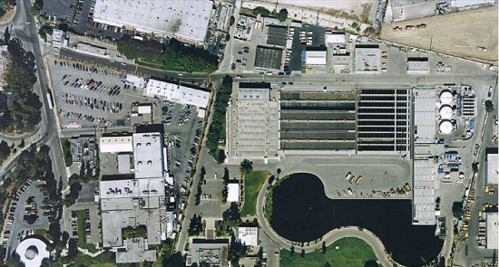
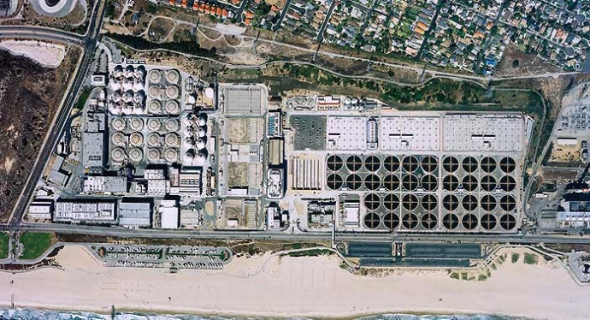
Overview of Glendale Wastewater System
Local Collection System
360 miles of wastewater (sewer) pipes
Flumes:
Elk
Doran
Doran Lift
Salem
Colorado
Chevy Chase
LA-GLENDALE
Water Reclamation Plant
Recycled Water:
Glendale 1.4 MGD;
LA 1.4 MGD
Sludge and By-pass
Flumes:
Tyburn
CITY OF LOS ANGELES
Hyperion Water Reclamation Plant

Slide 46
Wastewater Rate History
Last rate increase was implemented 19 years ago in 1999
Current Wastewater Rate
Monthly Flat Fee per Electrical Account: $2.30
Single Family Winter Water Charge ($/Hcf): $1.23
Multi Family Charge ($/Hcf): $1.31
Commercial - Low Strength Charge ($/Hcf): $1.39
Commercial - Med Strength Charge ($/Hcf): $2.02
Commercial - High Strength Charge ($/Hcf): $3.85
Examples:
Commercial-Low Strength: General merchandise stores, auto dealers
Commercial-Med Strength: Food stores, gas stations
Commercial-High Strength: Bakery product manufacturers, industrial printing companies

Slide 47
Proposal to Increase Wastewater Rates
Why the Increase?
  To pay for contractual obligations with the City of Los Angeles: Operation & Maintenance costs and Capital Improvement costs for LAGWRP and the Amalgamated System.
  To pay for Operation & Maintenance of the local collection system and local capital improvement projects.

Slide 48
Current Average Single Family Residential Monthly Bill
(Based on an average winter water usage of 8 HCF/Month)
Winter water usage means metered water readings between the beginning of December through to the end of March of the following year.
Current Average Monthly Bill
= Monthly Flat Fee + (Average Winter Water Usage X Wastewater Charge)
= $2.30 + (8 X $1.23) = $12.14

Slide 49
COST PER MONTH
Projected rates with 3% annually compounded CPI
YEAR

Slide 50
Costs to Treat Glendale Wastewater
Local Cost
  Operation and Maintenance cost and Capital Improvement cost within the City of Glendale
Los Angeles-Glendale Water Reclamation Plant Cost
  Glendale owns 50% of the plant with City of Los Angeles
  Glendale is contractually obligated to pay for 50% of the Operation & Maintenance Cost and Capital Improvements Cost
Amalgamated System Cost
  Glendale is contractually obligated to pay the Operation & Maintenance Cost and Capital Improvements Cost to City of Los Angeles for the conveyance of wastewater to City of Los Angeles’ Hyperion Plant and the treatment of wastewater at the plant.

Slide 51
Projected Wastewater O&M and CIP Costs
PROJECTED OPERATION & MAINTENANCE COSTS
 | FY 2017-18 | FY 2018-19 | FY 2019-20 | FY 2020-21 | FY 2021-22
Local O&M | $7,301,100 | $9,197,400 | $9,395,500 | $9,600,400 | $10,648,600
LAG O&M | $2,611,300 | $2,689,700 | $2,770,400 | $2,853,500 | $2,939,100
Amalgamated O&M | $5,278,100 | $4,673,300 | $4,756,100 | $4,855,800 | $5,134,300
Total | $15,190,500 | $16,560,400 | $16,922,000 | $17,309,700 | $18,722,000
PROJECTED CAPITAL IMPROVEMENT PROJECT COSTS
 | FY 2017-18 | FY 2018-19 | FY 2019-20 | FY 2020-21 | FY 2021-22
Local CIP | $500,000 | $389,000 | $602,000 | $1,209,000 | $987,000
LAG CIP | $2,339,400 | $12,804,100 | $8,864,400 | $1,788,900 | $697,700
Amalgamated CIP | $4,213,300 | $2,464,800 | $3,877,100 | $459,200 | $1,532,160
Total | $7,052,700 | $15,657,900 | $13,343,500 | $3,457,100 | $3,216,900

Slide 52
New Major LAG CIP Costs
For FY 2018/19 and FY 2019/20
  PRIMARY EFFLUENT EQUALIZATION PROJECT
  PROJECTED CITY OF GLENDALE’S
  SHARE : $9 MILLION
  ADMINISTRATION BUILDING PROJECT
  PROJECTED CITY OF GLENDALE’S
  SHARE: $9 MILLION

Slide 53
Projected Wastewater CIP Costs

Slide 54
Proposed 4-Year Wastewater Rates
 | Current Rate | Proposed Rates
 | FY 2017/18 | FY 2018/19 | FY 2019/20 | FY 2020/21 | FY 2021/22
Monthly Flat Fee per Elec. Acct. | $2.30 | $3.93 | $4.21 | $4.36 | $4.49
SFR Winter Water charge per HCF | $1.23 | $2.10 | $2.25 | $2.33 | $2.40
Multi-family charge per HCF | $1.31 | $2.24 | $2.40 | $2.49 | $2.56
Commercial – Low Strength Charge per HCF | $1.39 | $2.38 | $2.54 | $2.64 | $2.72
Commercial – Medium Strength Charge per HCF | $2.02 | $3.45 | $3.70 | $3.83 | $3.95
Commercial – High Strength Charge per HCF | $3.85 | $6.58 | $7.04 | $7.30 | $7.52
Notes:
http://www.mlive.com/news/kalamazoo/index.ssf/2015/03/five_things_about_reverse_angl.html

Slide 55
Monthly Average Bills for Single Family Residential and Multi-family
SINGLE FAMILY RESIDENTIAL
Monthly Bill = Monthly Flat Fee + (Winter Water Usage X Wastewater Charge)
  Based on an average winter water usage of 8 HCF/Month
Monthly Average SFR Bill for FY2018/19
= $3.93 + (8 X $2.10) = $20.73
A monthly average bill increase of $8.59 ($20.73 - $12.14)
MULTI-FAMILY
Monthly Bill = Monthly Flat Fee + (Water Usage X Wastewater Charge)
  Based on an average water usage of 6 HCF/Month per unit
Monthly Average Multi-Family Bill for FY 2018/19
= $3.93 + (6 X $2.24) = $17.37
A monthly average bill increase of $7.21 ($17.37 - $10.16)

Slide 56
Comparison of a Single Family Monthly Average Bill* with Six Other Cities (under Proposed Rate)
$32.09 for six cities average
  * Based on an average winter water usage of 8 HCF/Month
  ** Wastewater rates are fixed (no usage element)

Slide 57
Summary
This Wastewater Rates Increase will:
  Enable Glendale to meet our contractual obligations to City of Los Angeles for the Los Angeles-Glendale Reclamation Plant and the Amalgamated System
  Provide the necessary funds for ongoing wastewater system management and operation
  Maintain the “Pay-For-What-You-Use” philosophy
What if there is no Wastewater Rates Increase?
  Glendale will not be able to meet its contractual obligations to City of Los Angeles and will have to borrow monies
  Glendale will not be able to maintain its wastewater system leading to a public health issue

Slide 58
Summary of Residential Rates:
Before & After
Utility | Current Rates* | FY 2018-19 Proposed Rates*
Electric | $75.89 | $72.82
Water | $74.60 | $73.09
Wastewater** | $12.14 | $20.73
Total | $162.63 | $166.64
* Based on average use
** Single Family Residential

Slide 59
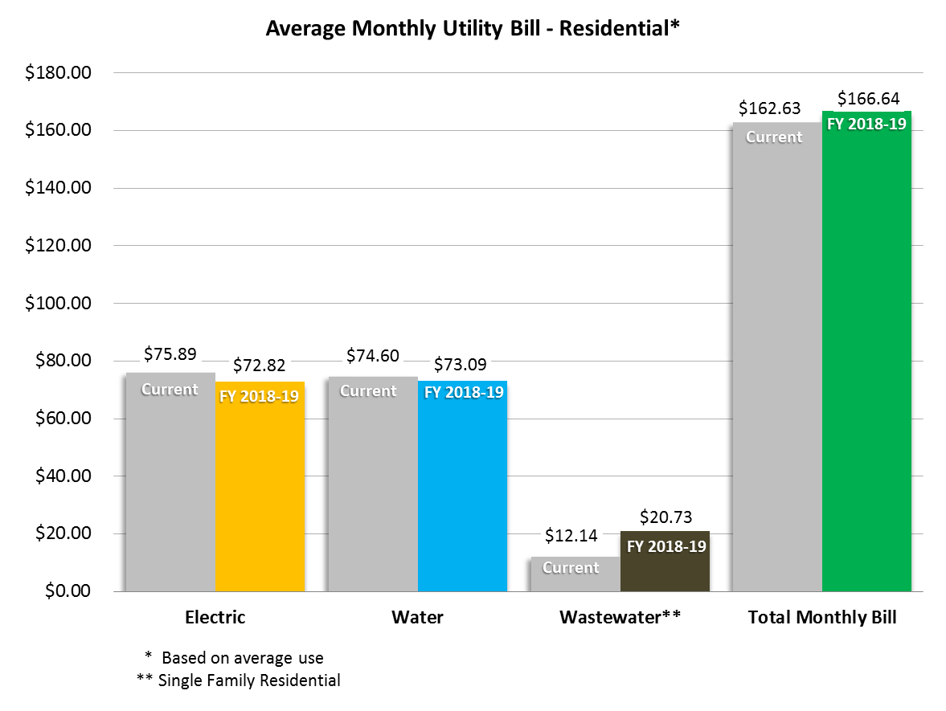
Summary of Residential Rates:
Before & After

Slide 60
Utility Rates Meeting Schedule
May 2, Community Meeting at Adult Recreation Center
May 3, Community Meeting at Sparr Heights Senior Center
May 8, Budget Study Session #2
May 22, Public Hearing, 6:00 p.m.
  Prop 218 Hearing for New Utility Rates
  Utility Rate Adoption
July 1, 2018 - Effective Date of New Rates

Slide 61
FY 2018-19 Budget Adoption Calendar
May 1, Budget Study Session #1, 9:00 a.m.
  Proposed General Fund Budget
  Revenue Estimates & Opportunities
  Organizational Profile
  Summary of All Funds by Type
  Department Dashboards
May 8, Budget Study Session #2, 9:00 a.m.
  GWP Public Benefits Charge Discussion
  Proposed Utility Rate Increases
May 15, Budget Study Session #3, 9:00 a.m.
  Proposed Capital Improvement Projects
  Citywide Fee Discussion
May 22, Budget Hearing, 6:00 p.m.
June 5, Budget Adoption, 6:00 p.m.
Slide 61

