Slide 1
City of Glendale Budget Study Session #3
May 14, 2019

Slide 2
Agenda
Follow-up Items
Measure S Discussion
Background
Remittance Schedule
Menu of Options
Housing
Affordable Housing Development
Rental Rights Program
Monthly Housing Rental Subsidy Program
First Time Home Buyer Program
Infrastructure

Slide 3
Agenda
Menu of Options (continued)
Recreation
Aquatics Program Expansion
Site A Development
Holiday Programming
Ice Rink
Trolley
Other Options
Funding for Certificate of Participation Debt Payment
Programming for quality of life and essential services needs
Recap
Budget Adoption Calendar
Questions & Comments

Slide 4
Follow-up Items
Slide 4
Question: Why is there a discrepancy in the fee to appeal an Administrative Design Review/Administrative Use Permit ($520) and that of a Planning Hearing Officer ($2,000)?
Service Title | FY 2013-14 | 2014 Fee Study | Adopted FY 2014-15 through FY 2015-16 | 2016 Fee Study | Adopted FY 2016-17 through FY 2018-19 | Proposed FY 2019-20
Appeals to Planning Commission or City Council | $1,041.00 | $8,120.28 | $2,000.00 | $6,961.57 | $2,000.00 | $2,000.00
Appeals of Administrative Use Permits or Administrative Design Review | $520.00 | - | $520.00 | - | $520.00 | $520.00

Slide 5
Follow-up Items
Slide 5
Question: Why is there a discrepancy in the fee to appeal an Administrative Design Review/Administrative Use Permit ($520) and that of a Planning Hearing Officer ($2,000)?
Response: The appeal fee for ADR/AUP was reduced as part of the Permit Streamlining effort in 2013 to recognize the lack of a Public Hearing or ability for the community to comment on a project using the new administrative processes. The hearings conducted by the PHO are public hearings and open to the community for comment. The reduced fee was a means to allow the community an inexpensive way to make comment in a public venue, albeit on appeal.

Slide 6
Follow-up Items
Slide 6
Original proposal for new Administrative Design Review and CUP/AUP streamlining – no noticing and no public hearing
Streamline Committee was concerned with lack of public comment for administrative decisions
Compromise with Streamline Committee
Process will include regular notice for ADR/AUP.
Process will be administrative without a public meeting.
Tentative Decisions will be posted online for 10-day public comment period before a final decision is made.
All comments would be taken into account when making the final determination.
Appeal fee for administrative processes were reduced to make it more affordable to bring the item to a public meeting where public comment could be made.
No reduction in fee for Planning Hearing Officer appeals because it is not an administrative process and where the community is afforded the opportunity to a public hearing to make comment.

Slide 7
Measure S Discussion

Slide 8
Measure S Discussion Background
Slide 8
Glendale Quality of Life and Essential Services Protection Measure
Passed by voters on November 6, 2018
Effective April 1, 2019
0.75% increase to the City’s transaction and use (sales) tax
Total sales tax increased from 9.50% to 10.25%
$30.0 million estimate for FY 2019-20
$7.5 million estimate for FY 2018-19 (April 1 – June 30, 2019)
Separately accounted for within the General Fund

Slide 9
Measure S Discussion Remittance Schedule
Slide 9
Schedule of remittance from the State is two months of “advances”, followed by one month “clean-up” (to true up to actual sales tax receipts)
FY 2018-19 (April 1 – June 30) Schedule
1st Advance: June 2019
2nd Advance: July 2019 (accrued to 2018-19)
Clean-Up: August 2019 (accrued to 2018-19)
3-month cycle repeats every quarter

Slide 10
Menu of Options

Slide 11
Housing

Slide 12
Housing
Slide 12
Affordable Housing Development
Rental Rights Program
Monthly Housing Rental Subsidy Program
First Time Home Buyer Program

Slide 13
Housing Affordable Housing Development (1 of 3)
Slide 13
Development of new construction affordable housing
Two methods: Land Acquisition & Gap Financing
Two projects currently under construction
Staff and Housing Authority actively pursuing land acquisition opportunities for future projects:
New Construction
Acquisition/Rehab
Currently in active negotiations on one land acquisition
Identifying and pursuing other sites
Staffing: No changes for FY 2019-20

Slide 14
Housing Affordable Housing Development (2 of 3)
Slide 14
Status of affordable housing funds for development
SB 532 ($27M) if passed, not available until 2020
Affordable Housing Trust Fund | $ 2.5 Million
Low Moderate Income Housing Asset Fund | 7.5
2011 Housing Bonds | 7.5
HOME funds | 2.0
Total Funding Available* | $ 19.5 Million
*Subject to pending acquisition

Slide 15
Housing Affordable Housing Development (3 of 3)
Slide 15
Ability to fund future acquisitions/feasibility gaps
Options:
Pre-designate funding now in preparation of next development opportunity (approx. $10M); or
Wait until next development opportunity is identified and then designate additional funding necessary from Measure S funds. If insufficient Measure S funding is available, then utilize General Funds until Measure S funds, or other affordable funds, can backfill.

Slide 16
Housing Rental Rights Program
Slide 16
Relocation, Right To Lease, Just Cause Eviction
Adopted in February 2019 (Unallocated General Fund)
Staffing: 2.3 FTE’s, 1 PT-Hourly
Respond to inquiries
Education, outreach
Mediation
Enforcement
Track and maintain violations/complaints
Assess ordinance impact on housing stock
Anticipated FY 2019-20 Budget: $410,000

Slide 17
Housing Monthly Housing Subsidy Program (1 of 3)
Slide 17
Pilot program to address rent burdened, lower income, households
Program Parameters:
$300 per month subsidy
1,000 households to be assisted
12 month pilot program
Senior, disabled households
Extremely low income (<$21,950 & $25,050)
Glendale resident
Rent burdened

Slide 18
Housing Monthly Housing Subsidy Program (2 of 3)
Slide 18
12 month program administered over two Fiscal Years
Open enrollment period followed by lottery process
Staffing: 5 FTE’s Unclassified and 1 Position Reallocation
Marketing and selection
Data entry, vendor setup, payment issuance
Database management
Intake, qualifying, processing
Case management
Oversight and audit

Slide 19
Housing Monthly Housing Subsidy Program (3 of 3)
Slide 19
Program cost of approximately:
Direct Assistance - $ 3.60 Million
Staffing and M&O - 0.57 Million
Total Program - $ 4.17 Million
Policies and Procedures review and approval by City Council

Slide 20
Housing First Time Home Buyer Program (FTHB)
Slide 20
Prior to elimination of redevelopment, Housing Authority administered a FTHB program
Program provided down payment assistance loans to moderate income home buyers:
$75,000 second mortgage loan
Minimum 5% down payment from buyer
Approved lenders
Monthly payment/deferred
Equity share in event of presale, forgiven after 45 years
Staffing: To Be Determined
Is there a desire to allocate funding toward a FTHB program for the “missing middle” income (80%-150% AMI)?

Slide 21
Infrastructure

Slide 22
Infrastructure Projects (1 of 2)
Slide 22
Project Name | FY 20-21 | FY 21-22 | FY 22-23 | FY23-24 | FY24-25 | Unfunded Cost
Pavement Repair and Rehabilitation Program | $ 500,000 | $ 2,000,000 | $ 2,500,000 | $ 2,000,000 | $ 1,000,000 | $ 8,000,000
Annual Bridge Maintenance Program | 100,000 | 100,000 | 100,000 | 100,000 | 100,000 | 500,000
Internally Illuminated Sign Replacement Program | 300,000 | 300,000 | - | - | - | 600,000
ADA Curb Ramp and Sidewalk Installation and Repair Program | - | 1,000,000 | 1,000,000 | 500,000 | - | 2,500,000
Elevator Modernization | 200,000 | 200,000 | 200,000 | 200,000 | 200,000 | 1,000,000
City Hall Improvements | 250,000 | 200,000 | 200,000 | - | - | 650,000
Seismic Upgrade of All Fire Stations (Total of 9 Stations) | 1,620,000 | 1,620,000 | 1,620,000 | 1,620,000 | 1,620,000 | 8,100,000

Slide 23
Infrastructure Projects (1 of 2)
Slide 23
Project Name | FY 20-21 | FY 21-22 | FY 22-23 | FY23-24 | FY24-25 | Unfunded Cost
North Verdugo Road Rehabilitation Project | $ 2,500,000 | $ - | $ - | $ - | $ - | $ 2,500,000
Mountain Street and Adjacent Streets Rehabilitation Project | - | 1,500,000 | - | - | - | 1,500,000
South Central Avenue Rehabilitation Project | - | - | 2,000,000 | - | - | 2,000,000
Victory Boulevard Complete Street Project Phase 1 | - | - | - | 2,500,000 | - | 2,500,000
Victory Boulevard Complete Street Project Phase 2 | - | - | - | - | 2,500,000 | 2,500,000
Foothill Boulevard Rehab Project | - | - | 1,500,000 | - | - | 1,500,000
134 Freeway Ramp Widening (12 ramps to be improved: San Fernando Road, Pacific Avenue, Central/Brand, Glendale Avenue) | 9,600,000 | 9,600,000 | 9,600,000 | 9,600,000 | 9,600,000 | 48,000,000
Total 5-yr CIP Unfunded Cost | $ 15,070,000 | $ 16,520,000 | $ 18,720,000 | $ 16,520,000 | $ 15,020,000 | $ 81,850,000

Slide 24
Recreation

Slide 25
Recreation
Slide 25
Aquatics Program Expansion
Site A Development

Slide 26
Recreation Aquatics Program Expansion (1 of 4)
Slide 26
The Aquatics Program was formally developed in 2000, in response to community’s demand for additional summer programming.
Programming in the summer of 2000 included the original Pacific Park Pool, and Hoover and Glendale High School pools.
At the conclusion of the 2000 season, Pacific Park Pool was demolished as part of the Edison Pacific Project. The City continued to use the high school pools for the program through 2011, with varying hours of operation based on school use of the pools.
In 2011, the new Pacific Community Pool was opened, and operations at the high school pools were eliminated due to budget reductions.
Pacific Pool is open to the public from Memorial Day weekend through the last week of September

Slide 27
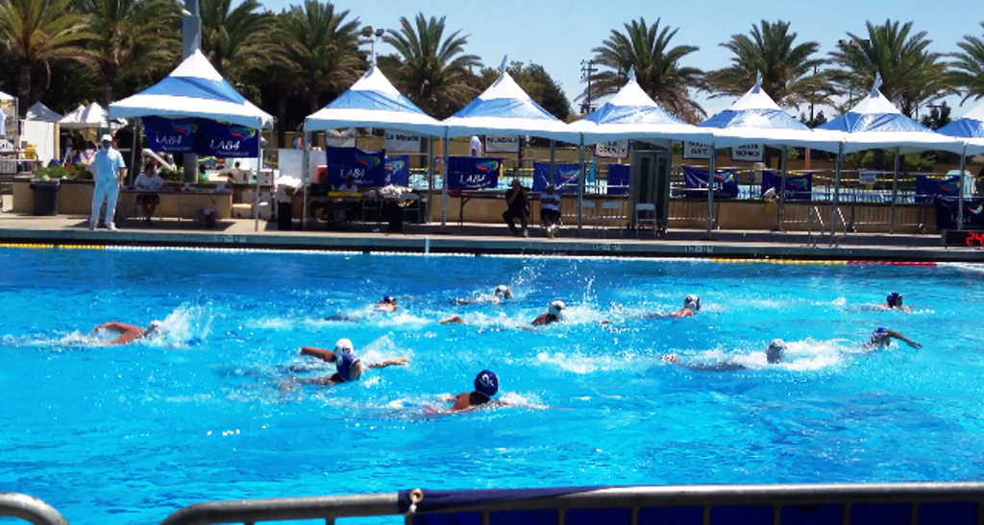
Recreation Aquatics Program Expansion (2 of 4)
Slide 27
Year Round Operation of Pacific Pool
Swim Lessons (after school and weekends)
Recreation Swim (weekends)
Master’s Swim Team
Lap Swim
Party Rentals
Private High School and Club Team Rentals
Classes (SCUBA, Fly Fishing, Aqua Motion, Water Aerobics)
Dive-in Movies

Slide 28
Recreation Aquatics Program Expansion (3 of 4)
Slide 28
Current cost for Pacific Pool summer operation is $489,474 annual
Expansion of Pacific Pool to Year Round Operation will cost an additional $560,000
Estimated $137,000 increase in revenues from expansion to year round operation
Net cost of expansion to year round operation is $423,000

Slide 29
Recreation Aquatics Program Expansion (4 of 4)
Slide 29
Sample Year Round Pacific Pool Operation Schedule

Slide 30
Recreation Site A Development (1 of 5)
Slide 30
Site A is one of four fill areas from SR2 construction
Site B: Sports Complex
Site C: Undeveloped
Site D: Mayors Park
Proposed site A development area: 6 acre pad
Access from freeway or street

Slide 31
Recreation Site A Development (2 of 5)
Slide 31
Site A Existing Conditions

Slide 32
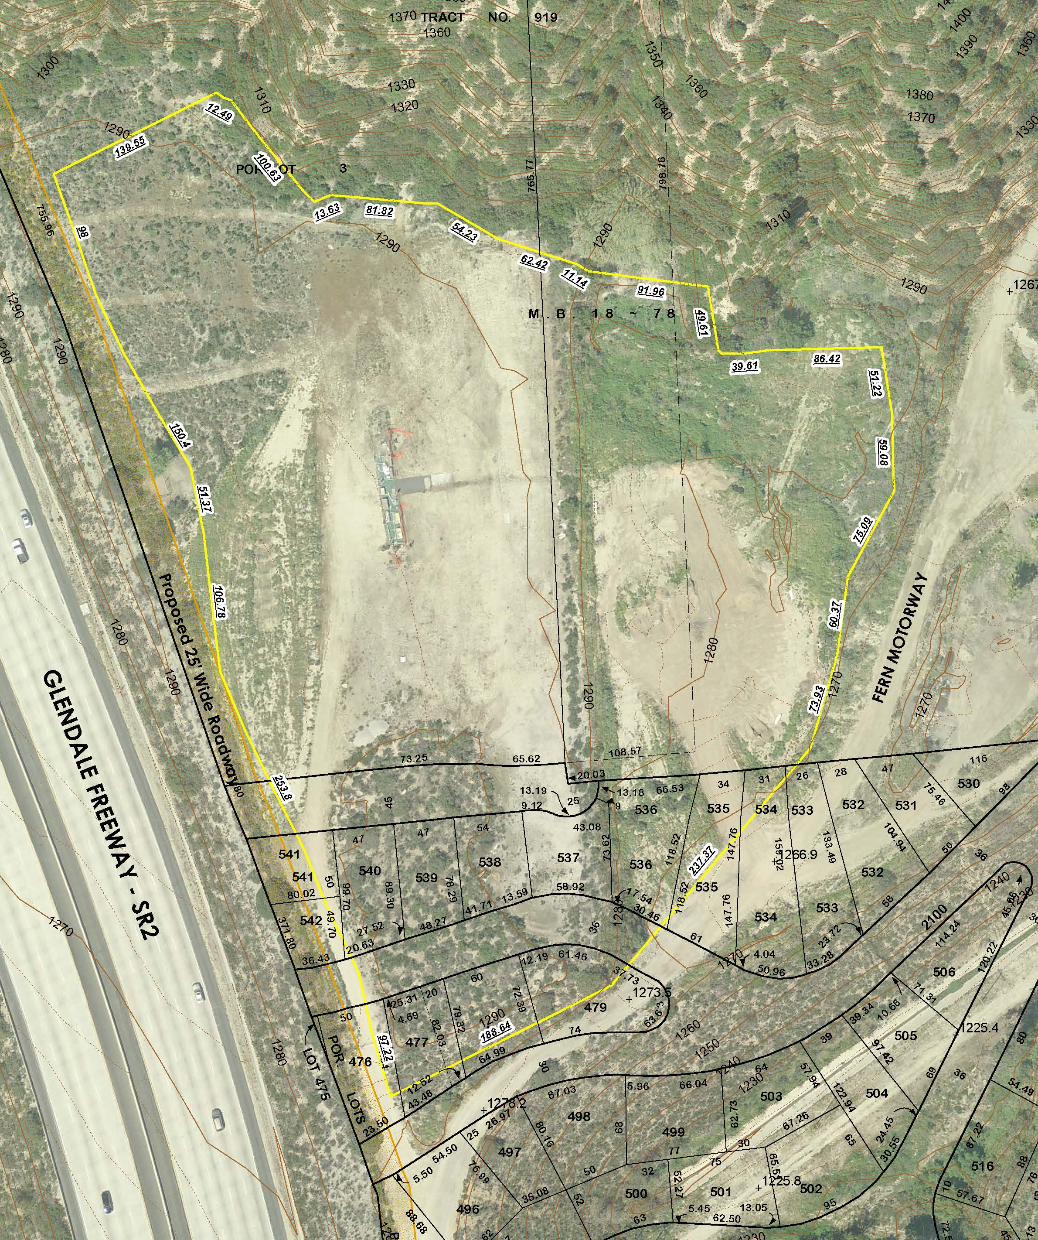
Recreation Site A Development (3 of 5)
Slide 32
Site A Existing Conditions

Slide 33
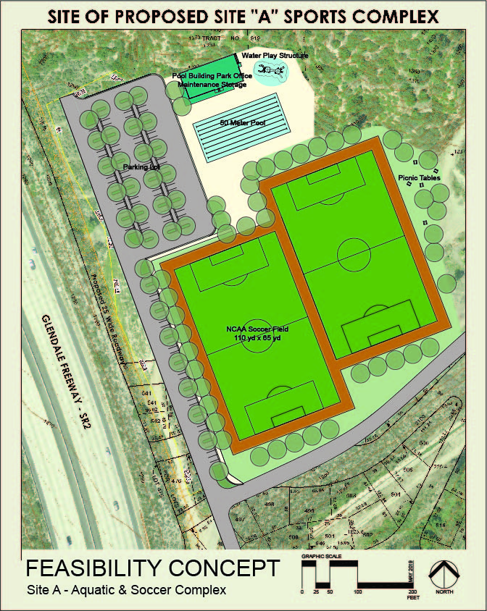
Recreation Site A Development (4 of 5)
Slide 33
Feasibility Concept
Two U19 artificial turf soccer fields
10,000 sf restroom/pool building
50 meter swimming pool
Water play feature / water slides
Office/maintenance bldg.
Parking lot

Slide 34
Recreation Site A Development (5 of 5)
Slide 34
Development Estimate is $35M:
Site Work - $12.5M
Includes excavation, grading, utilities, access road, landscaping, irrigation, parking, walkways, and security lighting
Aquatics Complex - $11M
Two Artificial Turf Soccer Fields - $3.5M
Soft Costs - $8M
Includes CEQA, Planning, project/construction management, design, and contingency

Slide 35
Holiday Programming

Slide 36
Holiday Programming
Slide 36
Ice Rink
Trolley

Slide 37
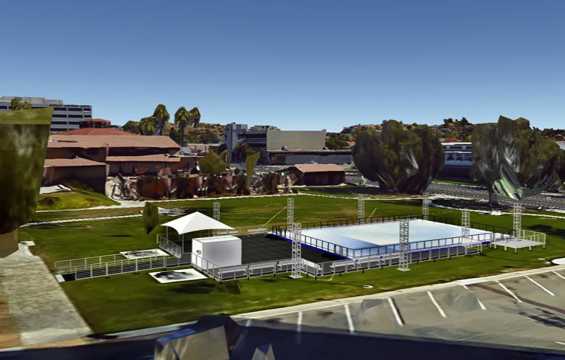
Holiday Programming Ice Rink (1 of 2)
Slide 37
Location: Isabel Parking Lot (City Hall)
Duration: 5-6 weeks (Nov 22-Jan 5)
Rink size: 82’x50’ = 4,100 sq. ft.
Capacity: 164 skaters (1 per 25 sq. ft. max)
Operating hours:
School Break: 10am-10pm daily (11pm Fri/Sat)
School Days: 2:30pm – 10pm

Slide 38
Holiday Programming Ice Rink (2 of 2)
Slide 38
 | Budget Estimate
Vendor Install & Operate | $ 358,000
Utilities/Generator Rental | 50,000
Porta Potties | 14,000
Marketing/Holiday Decorations | 22,000
Permits/Fees | 1,000
Ground Maintenance | 3,000
Contingency | 10,000
Total Annual Cost | $ 458,000
One Time Electrical Upgrades (Estimate) | 90,000
Total 1st Year Cost With Electrical Upgrades | $ 548,000
Revenue Estimate | $ 150,000

Slide 39
Holiday Programming Trolley
Slide 39
Objective: Improve mobility in Downtown Glendale and provide a fun experience for Glendale residents and visitors during the busy holiday season.
Pilot trial November 2017-January 2018
M-F 9AM-8PM; S-SU 10AM-7PM
Served almost 19,000 riders
15.6 Passengers/Hour
Weekly Ridership = 2,200 – 2,600 passengers
Total Cost $107,000 ($5.65/passenger)
Trolley lease - $17,000
Operations/Marketing - $90,000
AQMD funding available for trolley purchase only if we wish to buy the trolley and operate

Slide 40
Other Options

Slide 41
Other Options
Slide 41
Transfer from General Fund for Certificate of Participation debt payment
Annual Transfer of $1.5 million
Annual Transfer of any other amount
One-time Transfer
Programing for future quality of life and essential services needs

Slide 42
Menu of Options Recap
Slide 42
Program | Total Cost | Approved for Measure S? | Funding Approved for FY 2019-20 | Funding Approved for FY 2020-21
Housing
Affordable Housing Development | $ 10,000,000 |  | $ 20,000,000
Rental Rights Program | 410,000 |  | 410,000
Monthly Housing Rental Subsidy Program | 4,170,000 |  | 4,170,000 | 4,170,000
First Time Home Buyer Program | 750,000 |  | 750,000
Infrastructure | $ 81,850,000 |  | $ 3,000,000
Recreation
Aquatics Program Expansion | $ 560,000 |  | $ 560,000
Site A Development | 35,000,000 |  | -
Holiday Programming
Ice Rink | $ 458,000 |  | $ 458,000
Trolley | 107,000 |  | -
Other Options
Funding for COPS Annually | $ 1,500,000 |  | $ -
Quality of Life and Essential Services Needs | TBD |  | -
Total | $ 134,805,000 |  | $ 29,348,000 | $ 4,170,000

Slide 43
FY 2019-20 Budget Adoption Calendar
Slide 43
May 14, Budget Study Session #3, 9:00 a.m.
Follow-up Items
Measure S Discussion
May 21, Budget Hearing, 6:00 p.m.
June 4, Budget Adoption, 6:00 p.m.

Slide 44
Questions & Comments

