Slide 1
Los Angeles Regional Interoperable Communications System Informational Meeting for Scholl Canyon Public Safety Communications Site (SCHCYN)
May 12, 2020

Slide 2
What is LA-RICS?
A modern telecommunications network for emergency responders dedicated to keeping you safe.
Countywide day-to-day mission critical voice communications network.
Technically and structurally designed to sustain large emergency scenarios such as earthquakes, fires, and planned attacks.

Slide 3
Nationwide Public Safety Network
LA-RICS in conjunction with FirstNet is implementing additional LTE sites to be used to augment FirstNet’s coverage throughout LA County.
The focus of these additional sites is to provide better coverage for public safety users, ultimately ensuring their ability to better serve citizens.

Slide 4
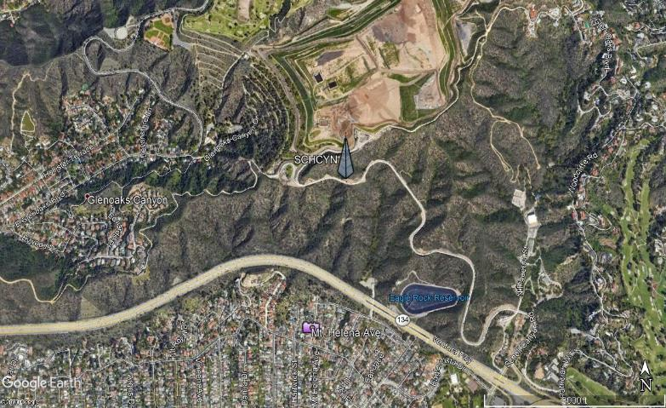
Contribution to Long Term Evolution
(LTE) Coverage

Slide 5
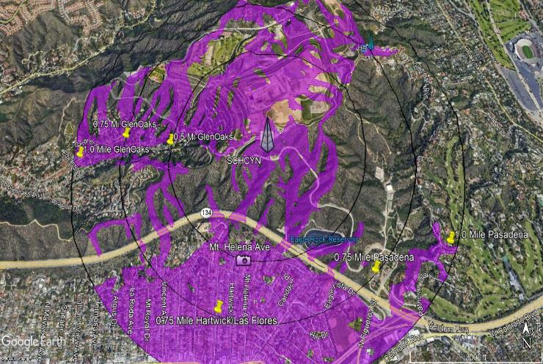
Scholl Canyon Landfield Viewshed (Miles)
0.5 Mi
0.75 MI
1.0 Mi

Slide 6
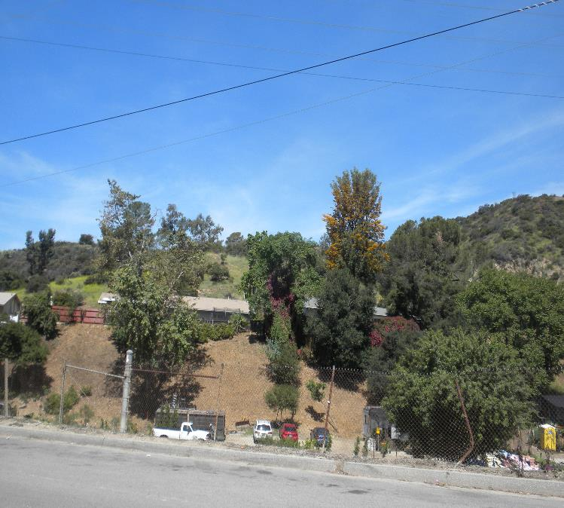
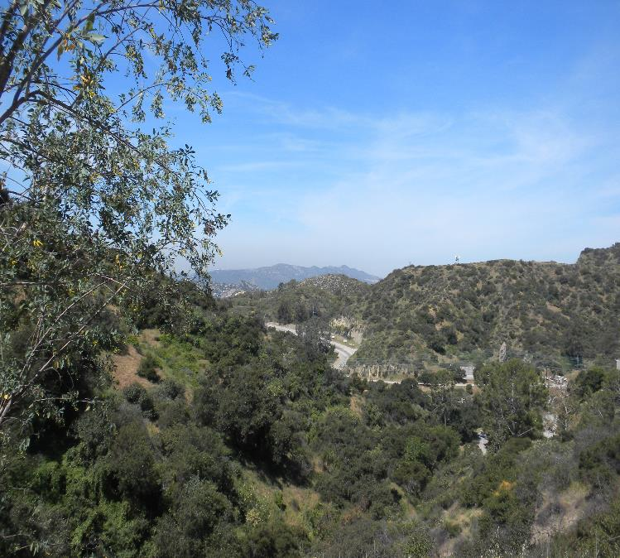
Pasadena View of Landfill
Current View of Landfill – 0.75 miles
Current View of Landfill – 1.0 miles

Slide 7
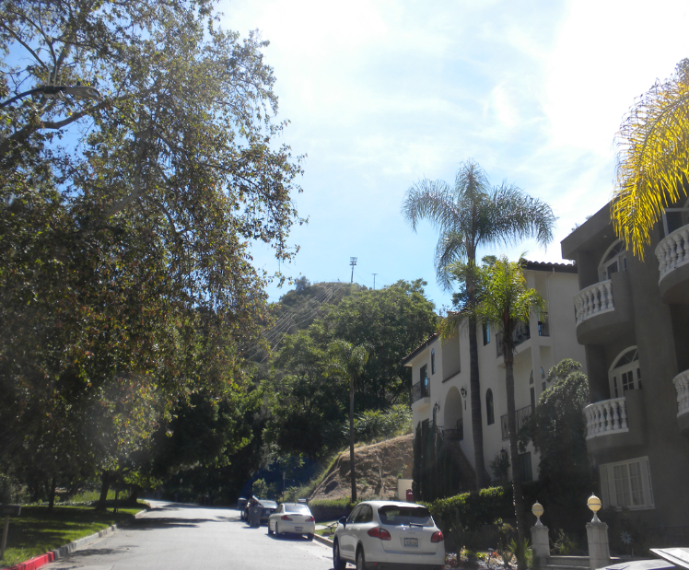
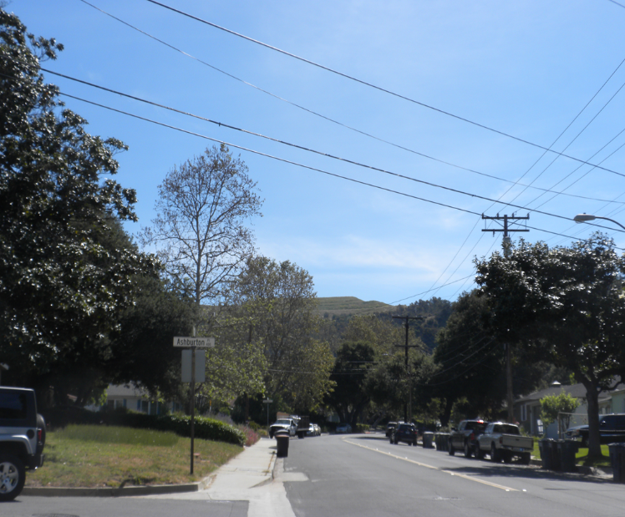
Glen Oaks View of Landfill
Current View of Landfill – 0.5 miles
Current View of Landfill – 0.75 miles

Slide 8
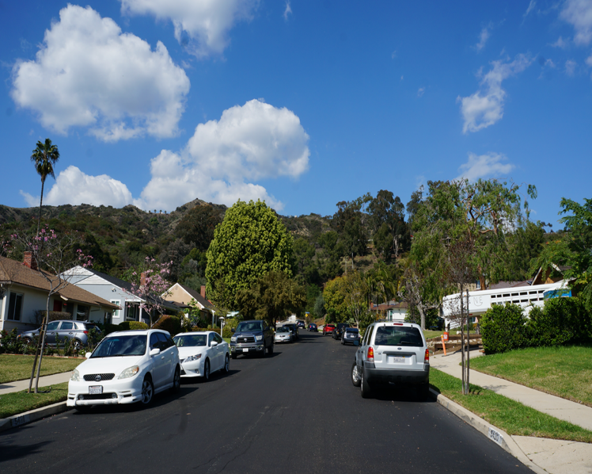
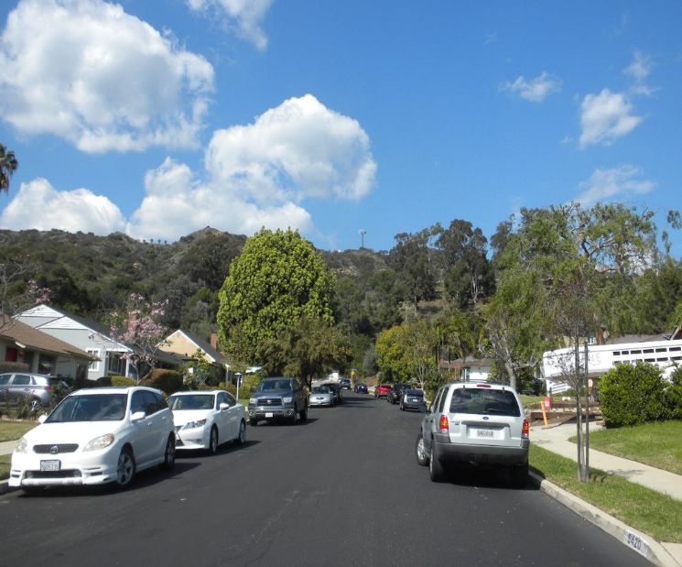
Eagle Rock View of Landfill
Current View of Landfill – 0.5 miles
Photosim of Site at Landfill – 0.5 miles

Slide 9
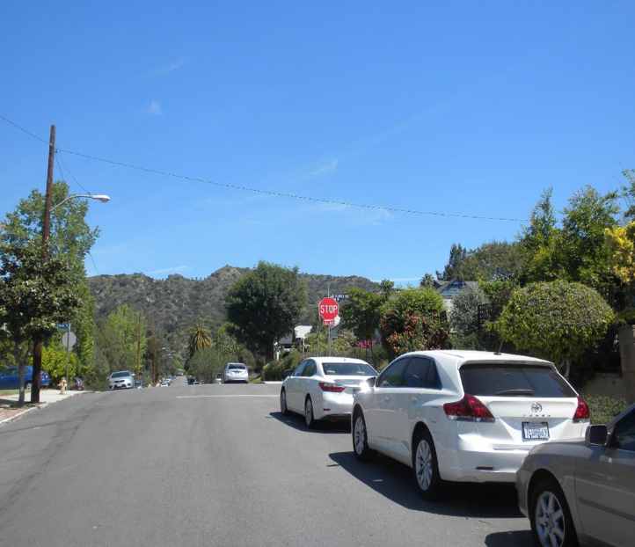
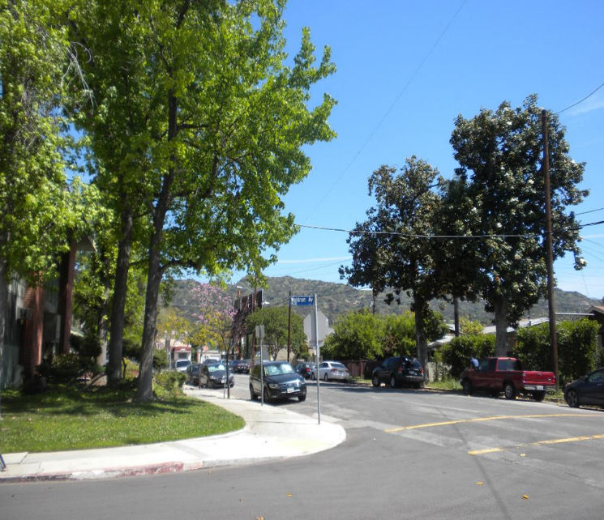
Eagle Rock Ave View of Landfill
Current View of Landfill – 0.75 miles
Current View of Landfill – 1.0 miles

Slide 10
Investigated Alternate Locations
Alternate site locations did not yield a replacement site. This location is the best option to provide a single site solution for much needed data coverage instead of multiple towers required to cover the foothills, Pasadena, Glendale and part of the City of Los Angeles.

Slide 11
Scholl Canyon Environmental Compliance
California Environmental Quality Act (CEQA)
Site was determined categorically exempted under CEQA Guidelines Section 15303, 15304, and 15332
Notice of Exemption (NOE) initially filed by LA-RICS Board on August 1, 2019
NOE filed by LA County CEO-RED on September 19, 2019
National Environmental Policy Act (NEPA)
Site included in Supplemental Environmental Assessment #5
Finding of No Significant Impact (FONSI) issued by National
Telecommunications and Information Administration on January 16, 2020
All Endangered Species Act and National Historic Preservation Act compliance was completed (as documented in FONSI)

Slide 12
Next Steps
Obtain all applicable jurisdiction permits (in progress).
Construction anticipated to start in Q2 of 2020.

Slide 13
Thanks!
ANY QUESTIONS?
CONTACT Wendy Stallworth-Tait info@la-rics.org (323) 881-8131

