Slide 1
Glendale 2022 Homeless Count
Richmond Amoah | HMIS System Admin

Slide 2
Agenda
2022 Homeless Count (highlights)
2021 Funding Allocations for Glendale CoC Programs
Emergency Housing Voucher Updates

Slide 3
Glendale Homeless Count Overview & Acknowledgements
On February 25th, 2022, Glendale CoC conducted a full sheltered count and unsheltered count, following HUD and CDC guidelines for Covid Safety
This information is utilized in the submission of a Continuum of Care (CoC) grant through the United States Department of Housing and Urban Development (HUD).
HUD requires providers who participate in CoC Homeless Assistance Programs to complete a Point-In-Time (PIT) count of the people who are experiencing homelessness in their community in order to compete for Homeless funding

Slide 4
2020 vs 2022 Unsheltered
Unduplicated
103
2022 Unsheltered Count
103
2020 Unsheltered Count 75
Interviews
106
%∆
+37.3 %
Observational
20

Slide 5
2020 vs 2022 Sheltered
Emergency Shelters
85
2022 Sheltered Count
133
2020 Sheltered Count 94
Transitional Housing
48
%∆
+41.5 %

Slide 6
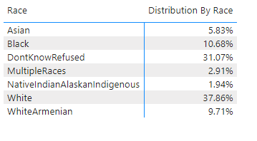
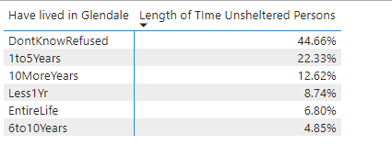

Slide 7
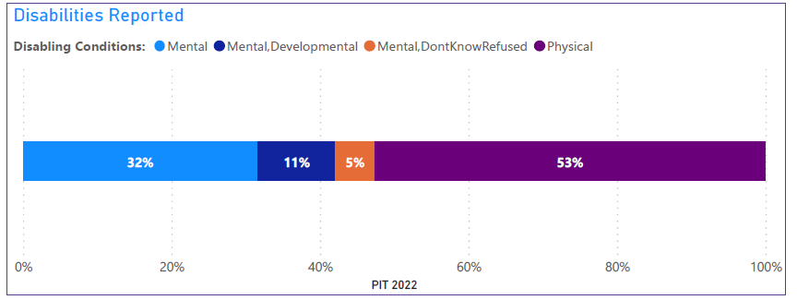
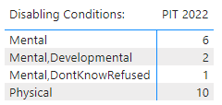

Slide 8
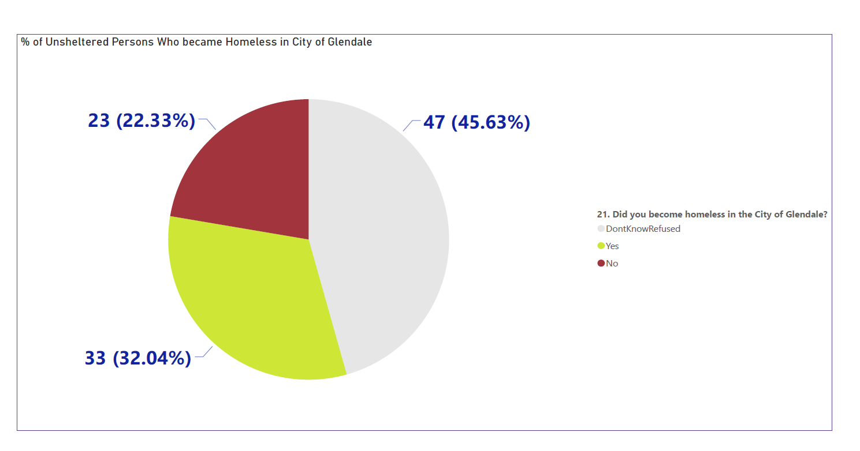
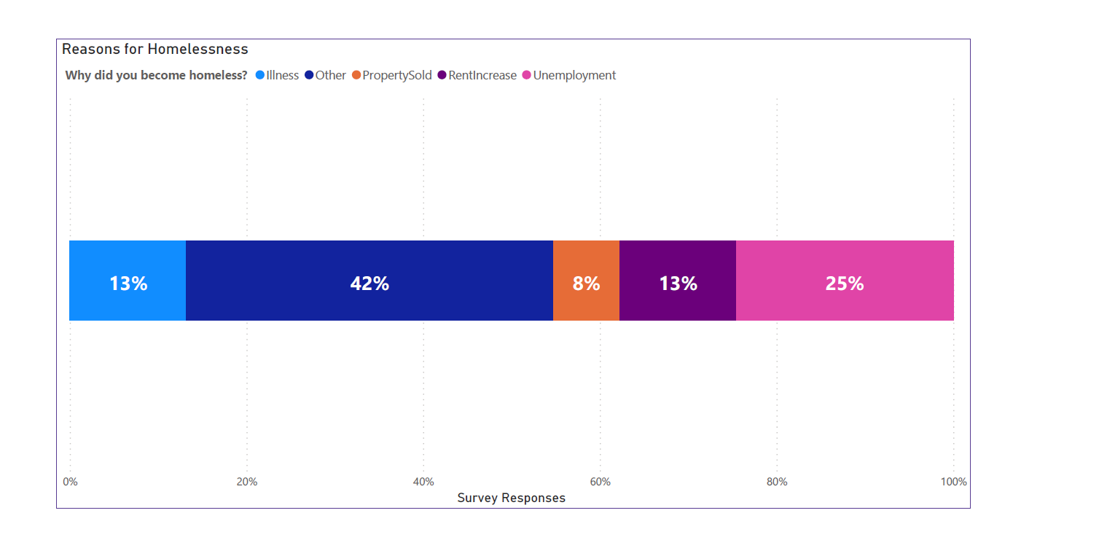
Unsheltered Survey
Of the Other Reasons:
Divorce/Broken Marriages was the leading reason for homelessness

Slide 9
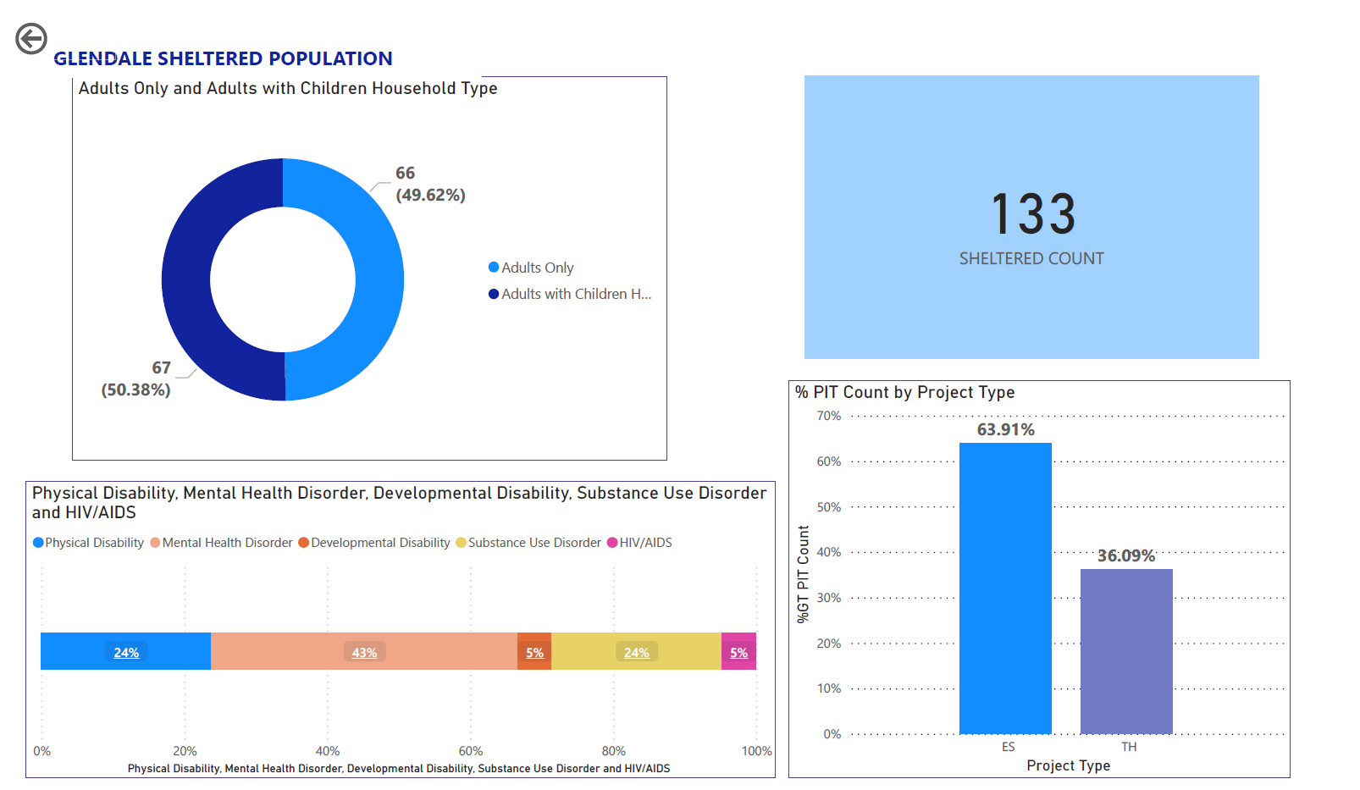

Slide 10
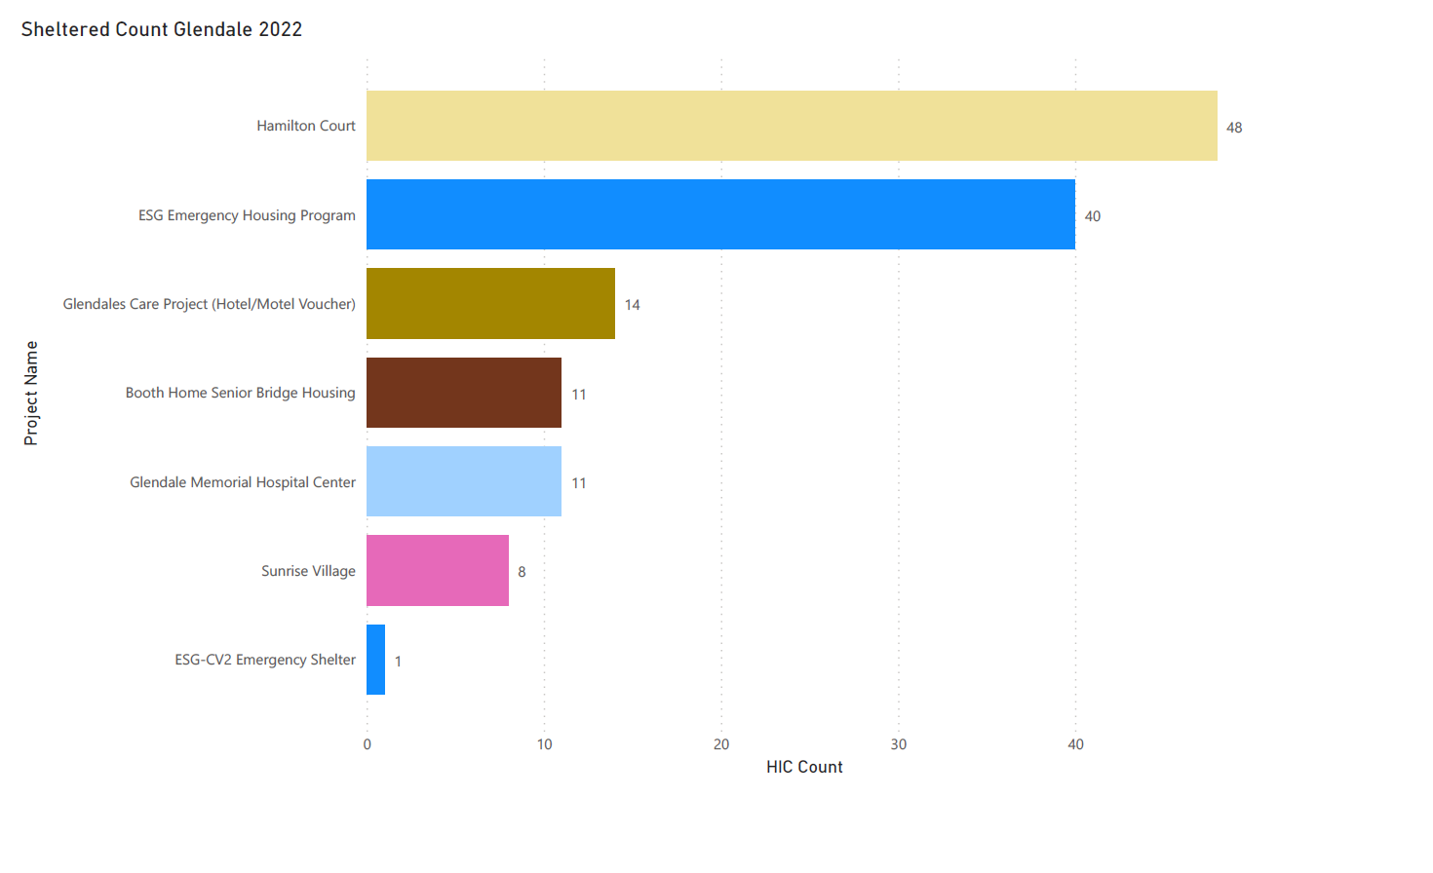
Emergency Shelters & Transitional Housing
**GMHC will not be included in Official HUD report as it falls under medical facilities
Official HUD submission will be 122 Sheltered Persons

Slide 11
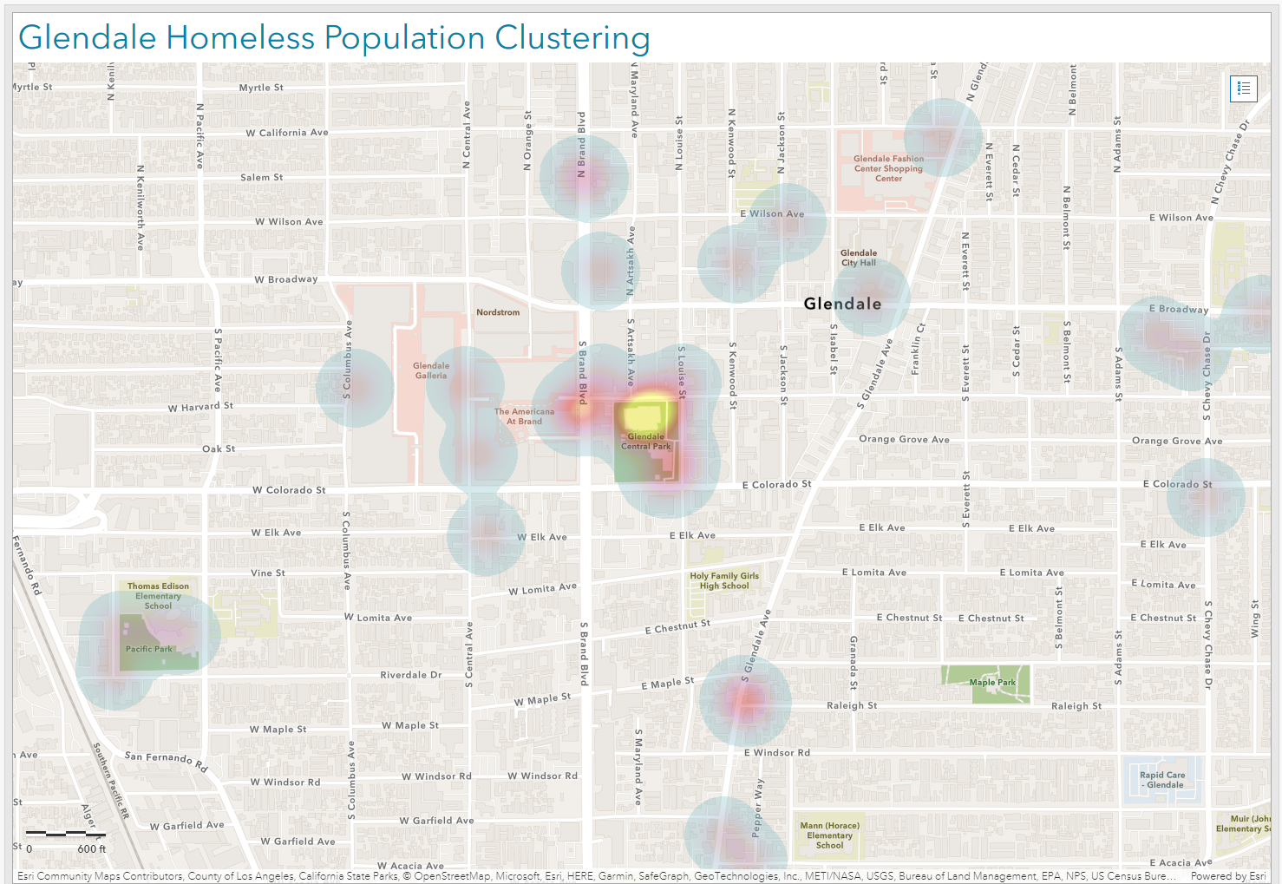
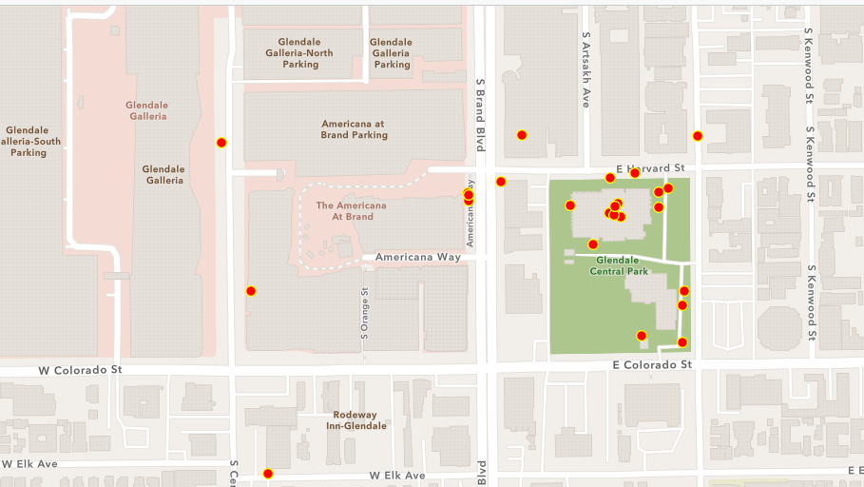

Slide 12
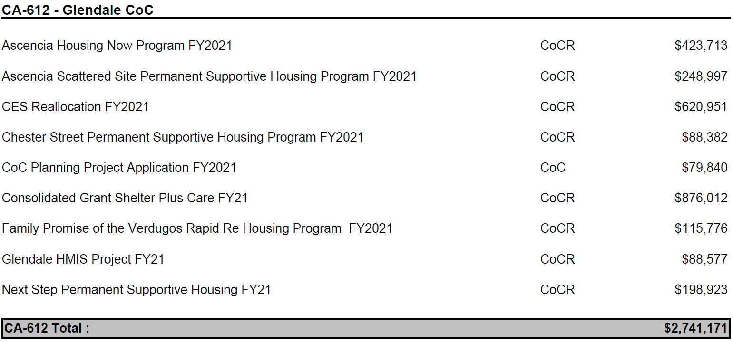
FY2021 CoC Competition Awards Projects Report
Glendale EHV Assessment
4.20
4.12
Coordinated
Situation
Entry Event
Coordinated Entry
4.19
Coordinated Entry Assessment
Refer Client to EHV Program

Slide 13
EHV Update
To Date the Total Number of:
Vouchers Allocated | 225
Vouchers Issued | 63
Leased Up | 13
Referred | 110
Absorbed by Other PHA | 2
Vouchers Available | 120
Reminder: In order to avoid delays in processing, please submit completely filled documents ONLY.

Slide 14
Any Questions?
#MyGlendale

