Slide 1
Transformative Climate Communities Grant

Slide 2
Transformative Climate Communities (TCC) is a grant sponsored by the California Strategic Growth Council.
It aims to empower communities most impacted by pollution to choose their own goals, strategies, and projects to reduce greenhouse gas emissions and local air pollution.

Slide 3
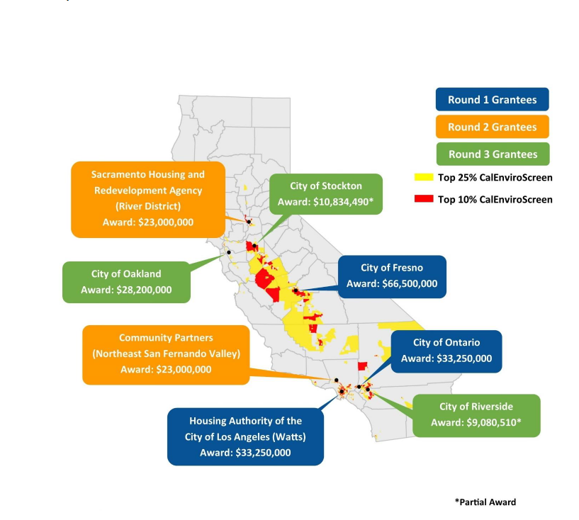
TCC grants are joint applications covering a variety of projects.
A variety of public agencies, nonprofits, local businesses, and community groups create application teams.
Each application include a variety of projects from public infrastructure to health and well-being and housing.
$9 – 30 million + available in funding.

Slide 4
Grant project qualifications:
Projects are ready for implementation
Within a 5 sq mile the area of Glendale encompassed by the 134, 2 and 5 freeways
Meet at least 3 of the following strategies:
Strategy 1: Equitable Housing and Neighborhood Development
Strategy 2: Land Acquisition for Affordable Housing
Strategy 3: Transit Access and Mobility Strategy
Strategy 4: Solar Installation, Energy Efficiency, and Appliance Electrification
Strategy 5: Water Efficiency
Strategy 6: Recycling and Waste Management
Strategy 7: Urban Greening and Green Infrastructure
Strategy 8: Health and Well-Being
Strategy 9: Indoor Air Quality
Strategy 10: Community Microgrids
Strategy 11: Brownfield Redevelopment

Slide 5
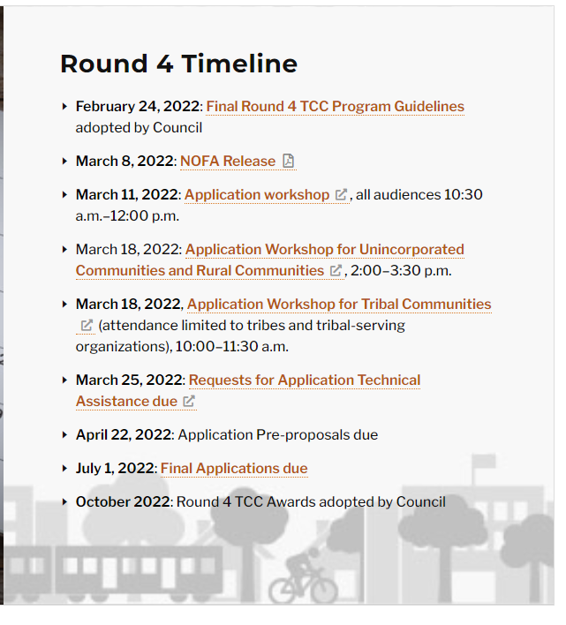
What we’re doing and what we need!
We’re building out a team from each department who can help put this grant application together.
We’re looking for community partners to be co-applicants for this grant.
We’re in the process of putting together a staff report and resolution for Council consideration of approval to apply and execute grant.

Slide 6
More Information and Resources
Contact Information
TCC Grant Links
Bryan Salazar, GWP at bsalazar@glendaleca.gov
David Jones, Sustainability Officer at djones@Glendaleca.gov
Elizabeth Harris, Sustainability Associate at eharris@glendaleca.gov
TCC Grant Website: https://sgc.ca.gov/programs/tcc/
TCC Resource & Grant Guidelines: https://sgc.ca.gov/programs/tcc/resources/
TCC Grant Workshop: https://www.youtube.com/watch?v=ywkrevzyygI&feature=emb_logo

Slide 7
#MyGlendale

