Slide 1
Adams Street Traffic Calming Measures Community Meeting March 30, 2023 Presented By: Department of Public Works

Slide 2
Presentation Outline
Project Purpose
Community Engagement History
Engineering Studies Conducted
Pilot Program Implementation Efforts
Phased Alternatives for Consideration

Slide 3
Project
Purpose:
Traffic Calming measures on Adams St. between Palmer Ave and Stanford Drive to reduce speeding and enhance pedestrian safety

Slide 4
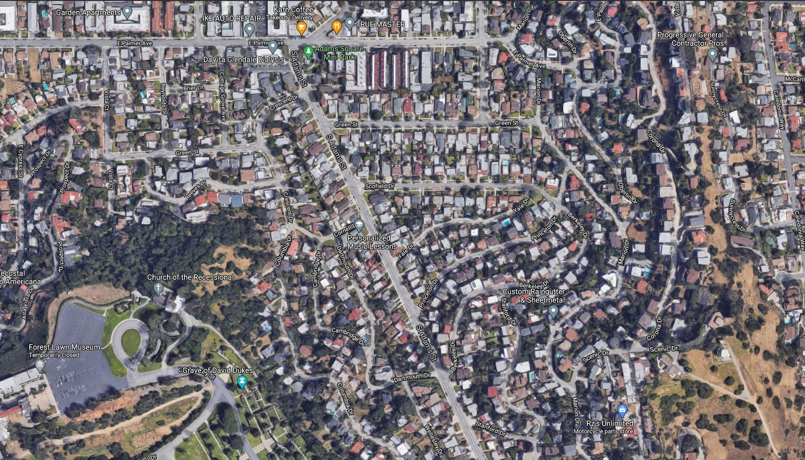
Vicinity Map
Adams St. between Palmer Ave. and Stanford Dr.
Palmer Ave.
Adams St.
Stanford
Dr.

Slide 5
Community Engagement History for Adams Street
3 February 2021
A Virtual Community Meeting
-Traffic Calming Study
-Stop Sign Studies
-Traffic Circle Concept
March 2021 – May 2022
Several Meetings with Adams Hill Neighborhood Association
-Traffic Calming Study
27 June 2022
Transportation and Parking Commission for Pilot Project Improvements
- Recommended Pilot Rumble Strip Project
-Stop Sign Studies
-Traffic Circle Concept
-Pilot Project

Slide 6
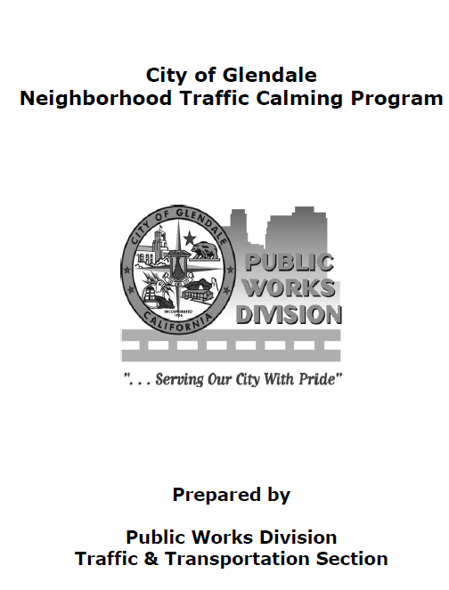
Engineering Studies
Traffic Calming Study:
Glendale Neighborhood Traffic Calming Program (NTCP*) Guidelines which studied street segment of Adams St. between Palmer Ave and Stanford Dr.
*Manual Available on City's Website

Slide 7
Traffic Calming Measures
Encourage drivers to comply with the speed limit. Examples include:
traffic circles/roundabouts
speed humps
center islands
diverters
curb Bump-outs
Per Glendale Neighborhood Traffic Calming Program (NTCP) And California Manual on Uniform Traffic Control Devices (CA-MUTCD)

Slide 8
Traffic Calming Study
Speed and Volume
Counts Conducted

Slide 9
Traffic Calming Study
Traffic calming study criteria:
Street classification,
24-hour speed counts
24-hour volume counts,
Field observations,
Street dimensions
Review of area Fire Response Routes.
*ADAMS ST QUALIFIES FOR TRAFFIC CALMING MEASURES

Slide 10
Speed Humps:
This segment of Adams St does not qualify for speed humps because:
The Glendale Fire Department has identified Adams St. as a primary emergency response route, and
Block lengths less that 500 feet

Slide 11
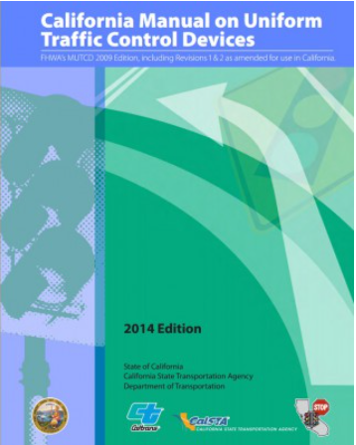
Engineering Studies
Three (3) Multi-Way Stop Control Warrant Analyses:
Adams St. / Scofield Drive
Adams St. / Cornell Drive
Adams St. / Princeton Drive
Using State of California Manual on Uniform Traffic Control Devices (CA-MUTCD) Guidelines and Standards

Slide 12
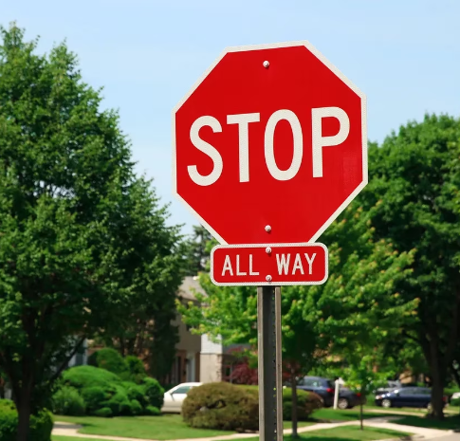
Technical Terminology
Multi-Way Stop Controls: refers to an intersection controlled by Stop Signs for all Traffic Approaching the intersection and not considered a traffic calming measure

Slide 13
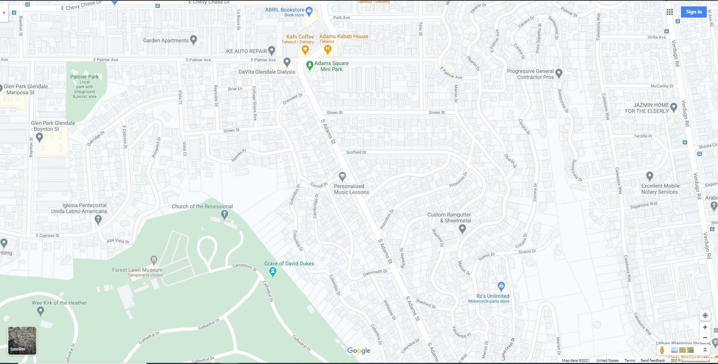
Existing Multi-Way Stop Controlled Intersections on Adams St at Palmer Ave. and at Stanford Dr.
Palmer Ave.
1
Existing Multi-Way Stop Intersections
(Distance ~1,850 ft)
Conducted Multi-Way Stop Studies
Scofield Dr
2
Cornell Dr
Princeton Dr
3
Adams St.
Stanford
Dr.

Slide 14
Stop Sign Study Criteria and Results
The Multi-way Stop studies for the three (3) subject intersections included analysis of the following:
Traffic count data,
Collision history data
Intersection geometry
Visibility,
Engineering field observations
Results:
Multi-Way Stop Warrants were not met at the three intersections analyzed (i.e., Scofield Dr., Cornell Dr. and Princeton Dr.)

Slide 15
Pilot Program Implementation Efforts
Raised Pavement Markers and Rumble Bars

Slide 16
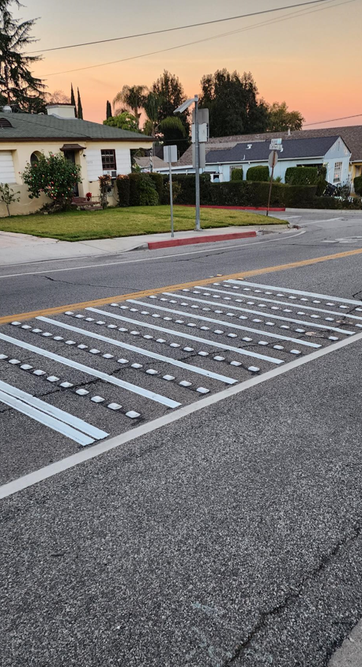
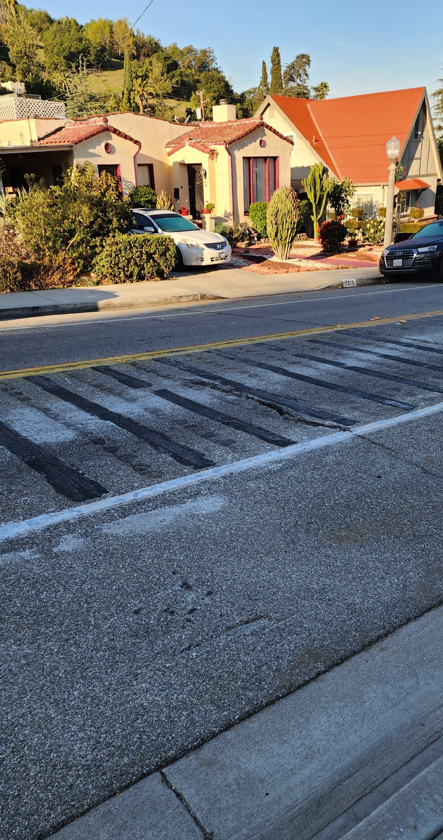
Implementation History
Petition circulated and approved by over 75% of nearby residents
Project was Installed in December 2022
Project was removed due to excessive noise complaints from neighboring residents.

Slide 17
Traffic Circle Concept
Virtual meeting on Feb 3, 2021
Meetings with Adams Hill Neighborhood Association
Concern regarding parking impacts

Slide 18
Traffic Circle Concept
- Traffic Circle Concept at:
Adams St./Scofield Dr. Intersection
- Why Scofield Dr.?
Scofield Dr. is a wider street compared to Cornell Dr., Yale Dr., and Princeton Dr.
- Challenges:
Loss of On-street Parking Spaces
Large vehicles turning

Slide 19
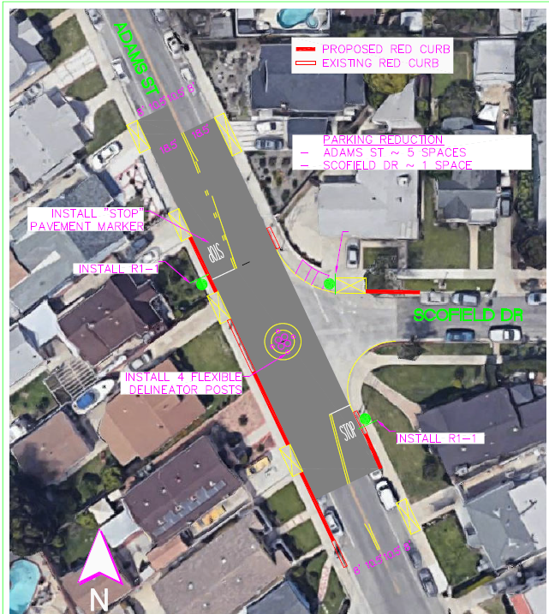
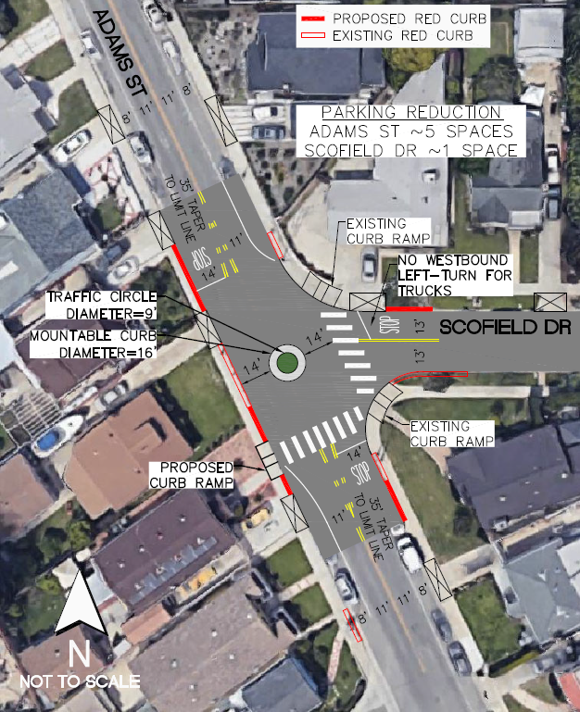
Traffic Circle Implementation
Phase 1
Pilot Program
Phase 2
Permanent

Slide 20
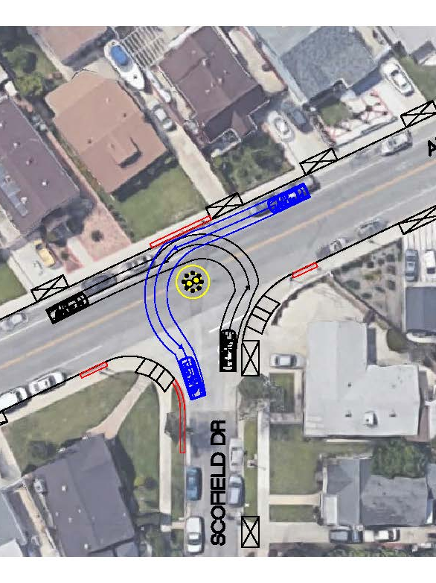
Left-Turn Study for Passenger Vehicles: Traffic circle can accommodate southbound left-turns and westbound left-turns for passenger vehicles.

Slide 21
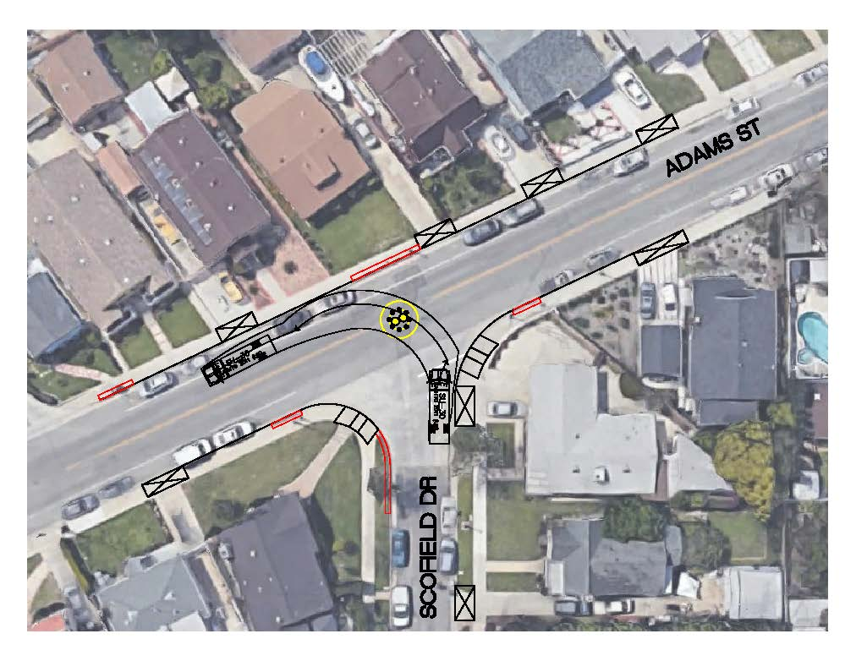
Left-Turn Study: SU-30 Trucks (30 feet in Length)
NO
LEFT-TURN
(TRUCKS ONLY)
Traffic circle cannot accommodate westbound left-turns for SU-30 trucks

Slide 22
Traffic Circle Concept with Stop Signs
Phase 1 – Pilot Program
Adams St. / Scofield Dr.
INSTALL
Traffic Circle Delineated with Striping;
Center of Circle Delineated with Temporary Yellow Traffic Barrels; and
Epoxy base Traffic Delineators along Inner Traffic Circle Striping
Stop Signs and Markings for Adams St
White and Yellow Roadway Striping
Red Curb Markings

Slide 23
Traffic Circle Concept with Stop Signs
Phase 2 – Permanent Features
Adams St. / Scofield Dr.

Slide 24
Additional Pilot Program Implementation Efforts
Intersection Enhancements and Creative Crosswalks

Slide 25
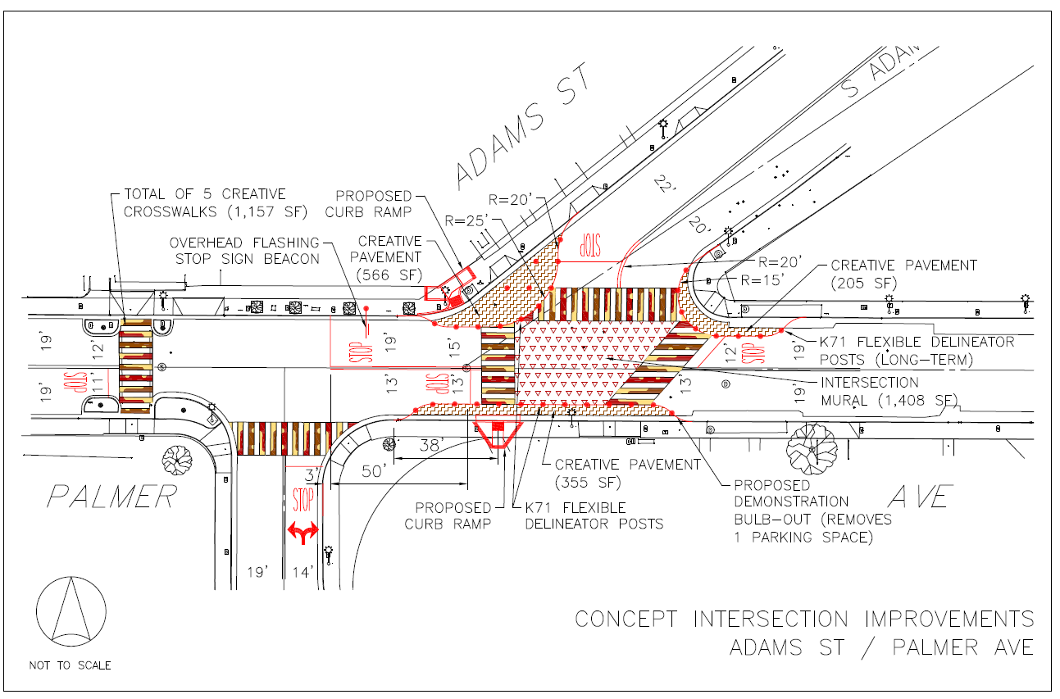
Adams St. and Palmer Ave.
Pilot Program Intersection Enhancements

Slide 26
Questions?

